Slide 1
Prototyping Next-Generation User Interfaces
Wake County EMS
1st Group Discussion

Slide 2
Goals
Present the methodology, possible scenarios and the decisions we have made
Present the possible user interface features we think could enhance the task in the chosen scenario
Discuss the procedures during the assessment and treatment of a trauma
Discuss the features that could be included and could be removed
Q&A

Slide 3
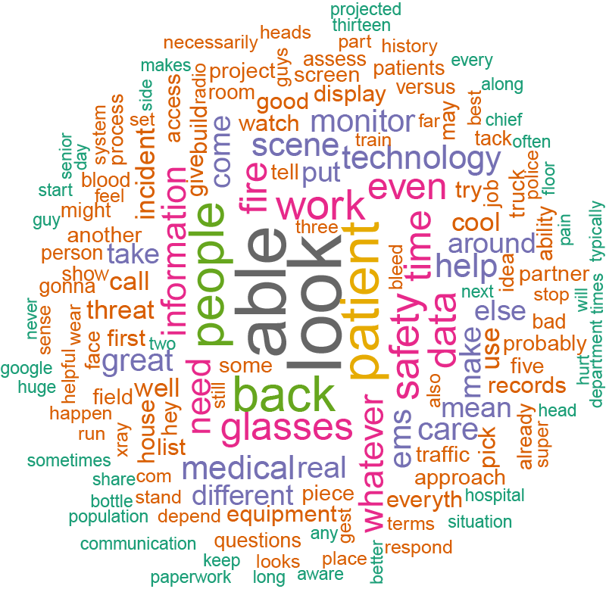
Methodology
Gather data through interviews and training observations
Speech to text conversion of the interviews
Analyze the answers and the video recordings of the training exercises
Brainstorm possible scenarios, task to simulate and user interfaces

Slide 4
Possible Scenarios
Basic Medical/Trauma Assessment
Gunshot
Conscious Patient with Head Injuries
Unresponsive Patient
Fractured bone
Overdose Patient
Burns
Car/motorcycle crash
Active Shooters

Slide 5
1st Chosen Scenario: Gunshot Wound to Upper Chest
Scenario
Gunshot Wound to Upper Chest
Key Role
EMS Paramedic
Task to simulate
Assess a trauma patient, control bleeding

Slide 6
Gunshot – Use Case Scenario
You arrive at the apartment complex. You touch the side of your safety glasses. It activates the HUD built-in. You enter the apartment and see the man lying on the floor, conscious and breathing. There is approximately 1 liter of external blood loss.
The system also recognizes a gun on top of a table near to the victim. It automatically sends an alert to the police. While you get close to the victim, the system scans the victim's face. After a few seconds, the HUD shows the patient information near to his body. The system highlights that the patient has allergies to two medicines.
You hook the monitoring equipment to the man. His vitals are shown in real time near to his body through you HUD display. You do a voice command that reports the gunshot wound trauma. The system automatically shows the best hospital to transport the patient and sends the patient's trauma and information, and the assessment done until that moment. During the procedure, you need to get the bandage, you ask for it, and the HUD automatically highlights the bag that contains the equip required.
You transport the patient to the ambulance. You receive an alert, the patient's heart beat has increased. You speak out loud that you are going to start a decompression, the system identifies the chest and gives you the indication where you should insert the needle.

Slide 7
Possible User Interface Features
Display
HUD
Forearm mounted display
Tablet, smartphone
Interactions
HUD on/off
Face scanner
Threat scanner
Ask backup
Voice commands
Haptics: touch in body parts to send information (danger, ask for help)
Audio: push-to-talk, radio
Information:
Patient’s info
Real-time patient’s vitals
Hospital recommendation based on location and trauma
Procedures checklist – dynamic
Procedures guidance
Alerts
Equipment location
Threat identification: guns, knifes, body language
Communication: voice, text, radio

Slide 8
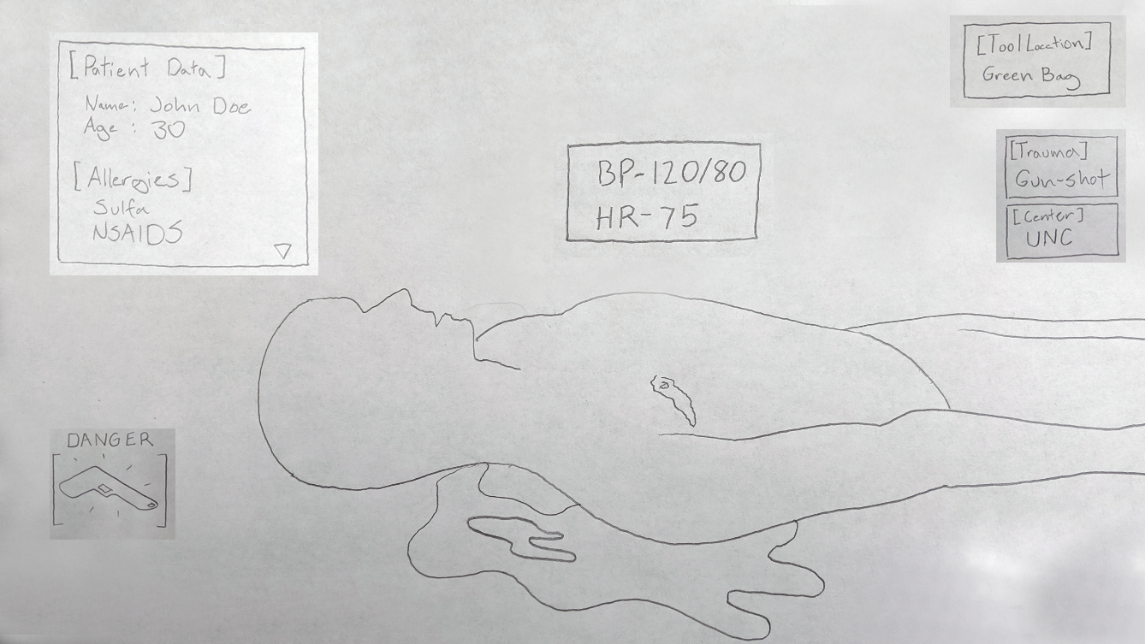

Slide 9
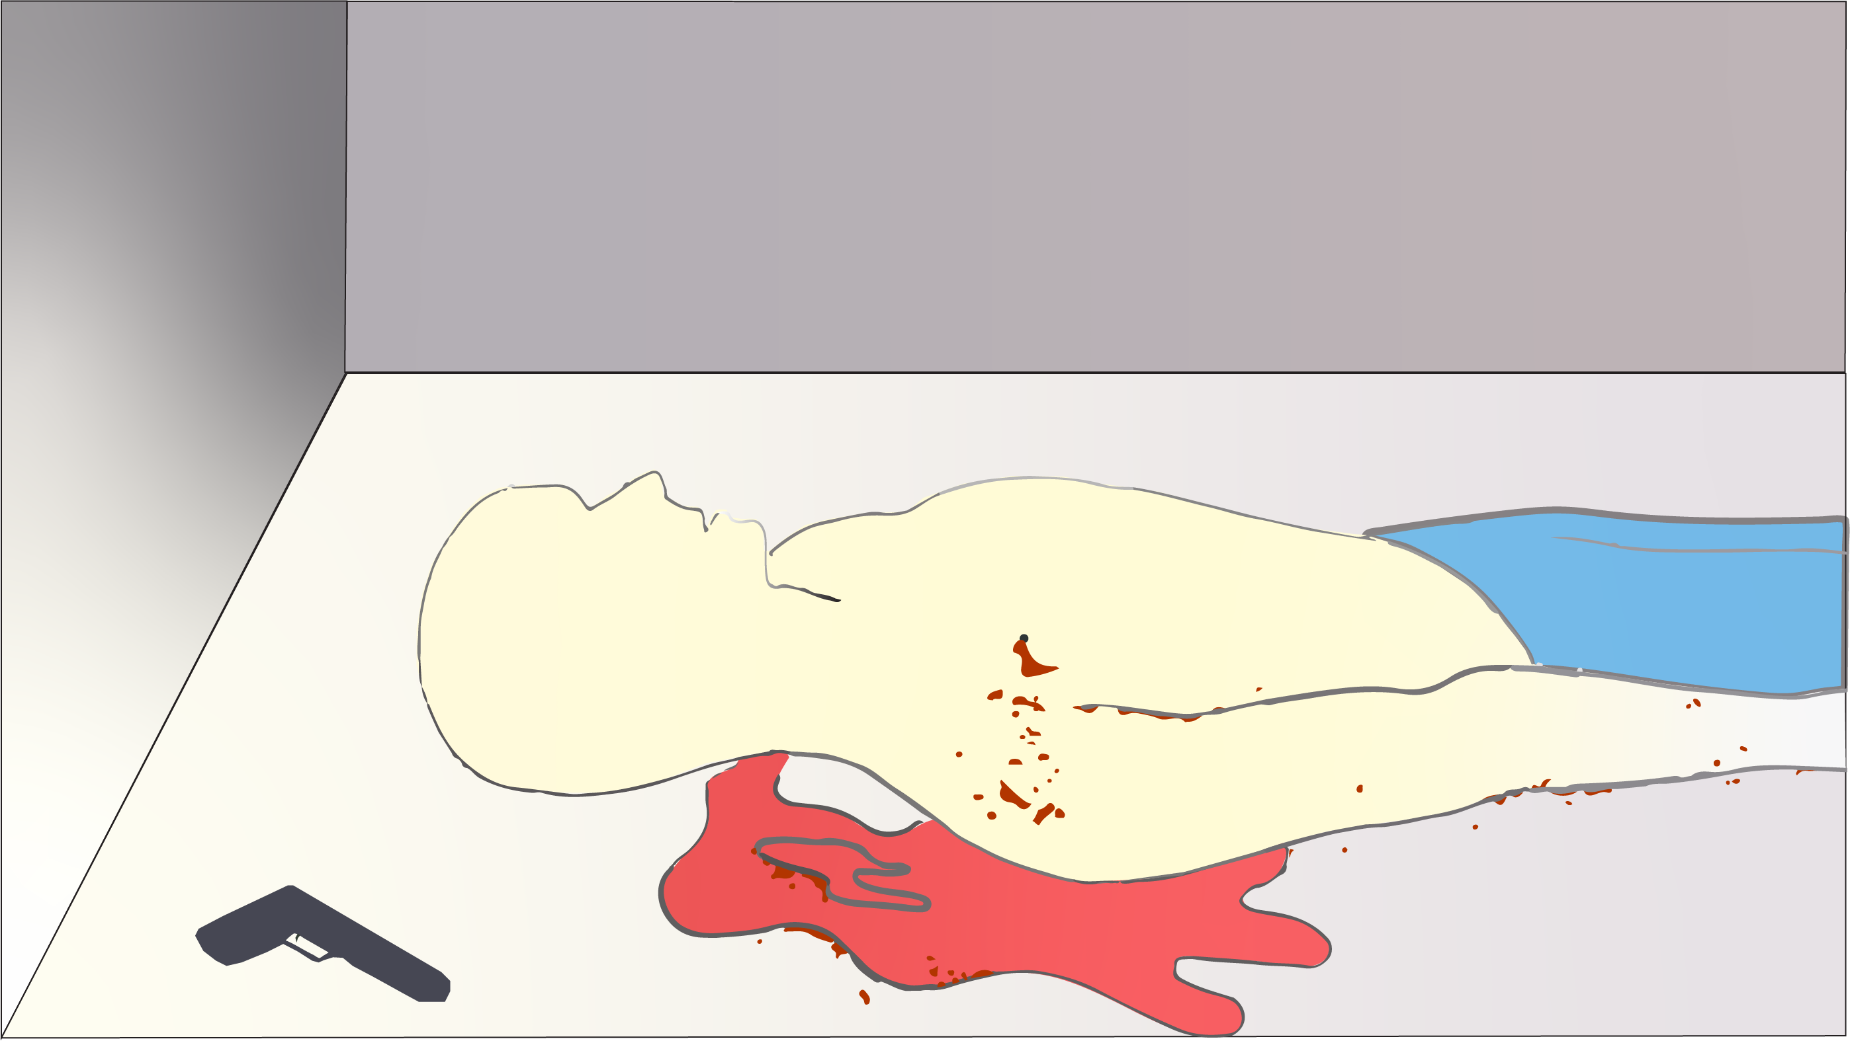

Slide 12
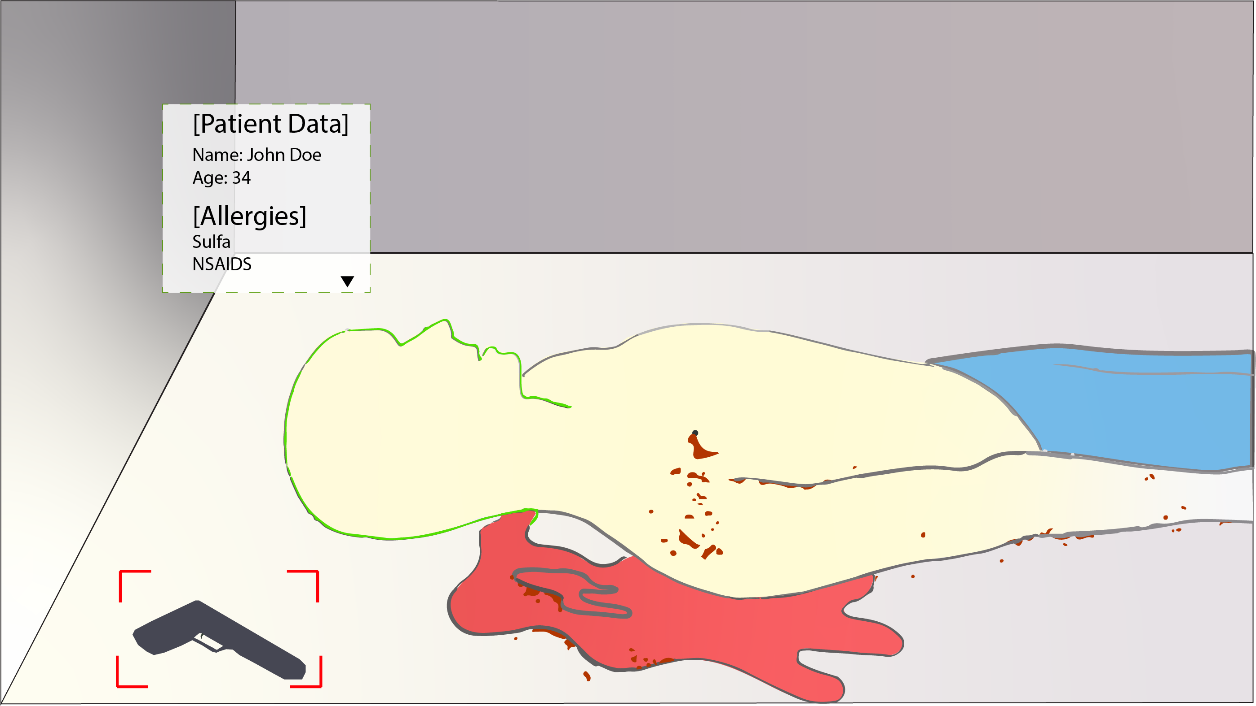

Slide 13
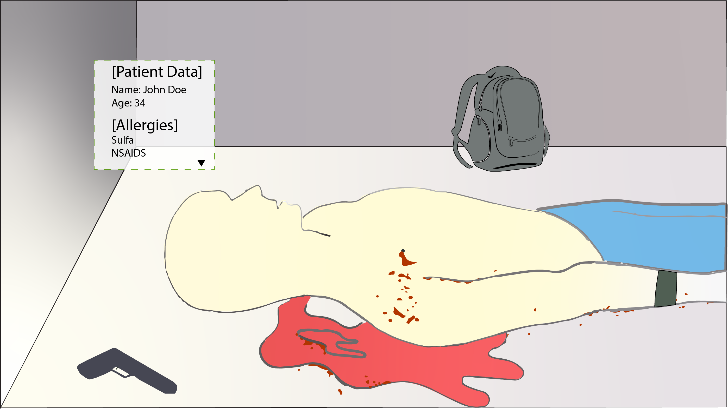

Slide 14
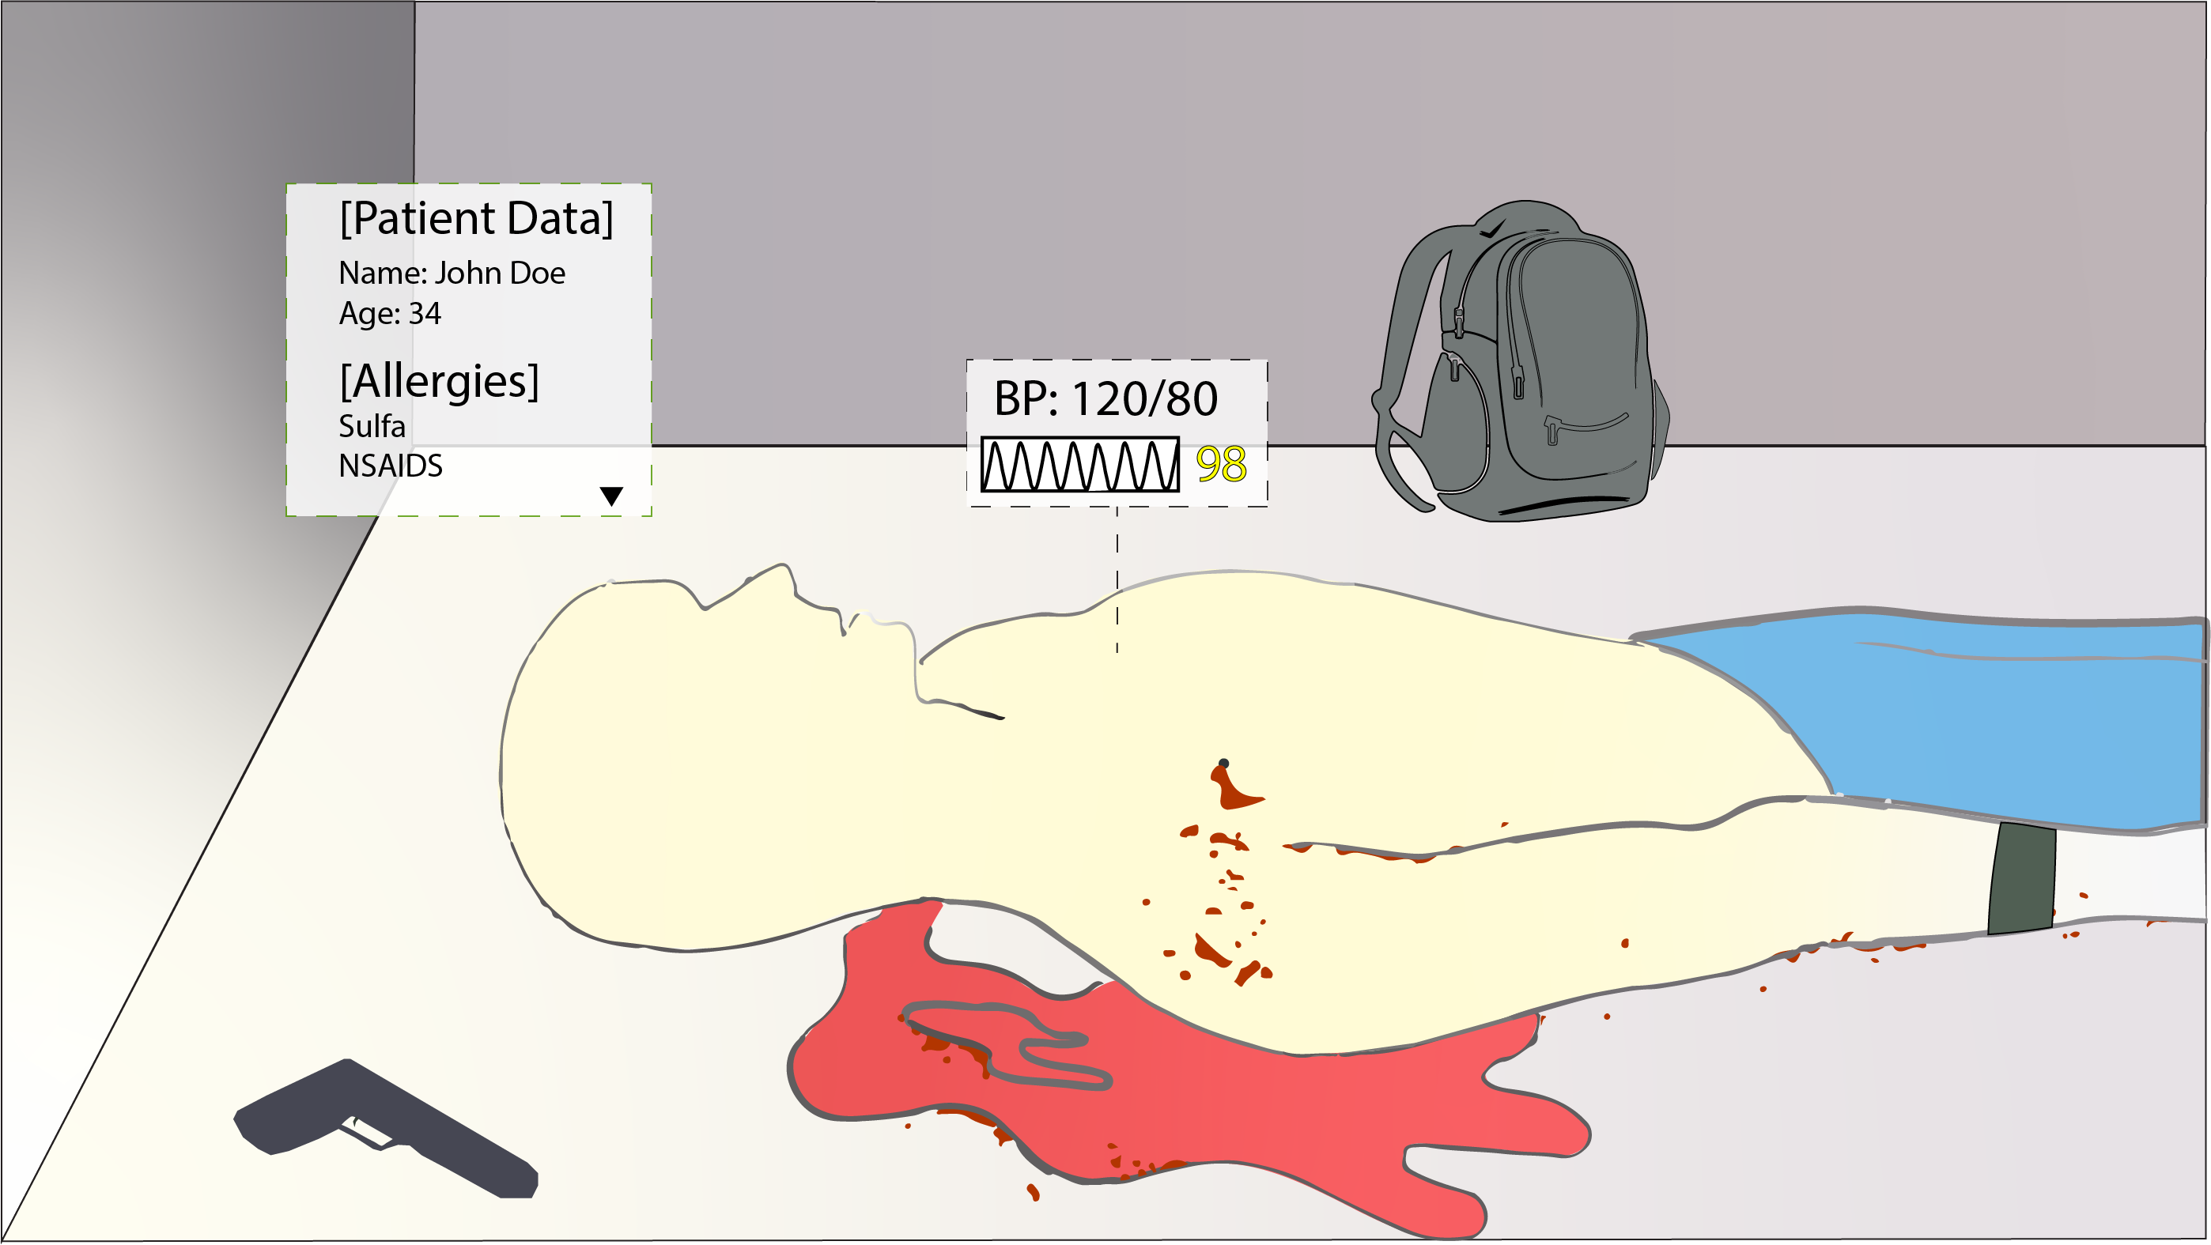

Slide 15
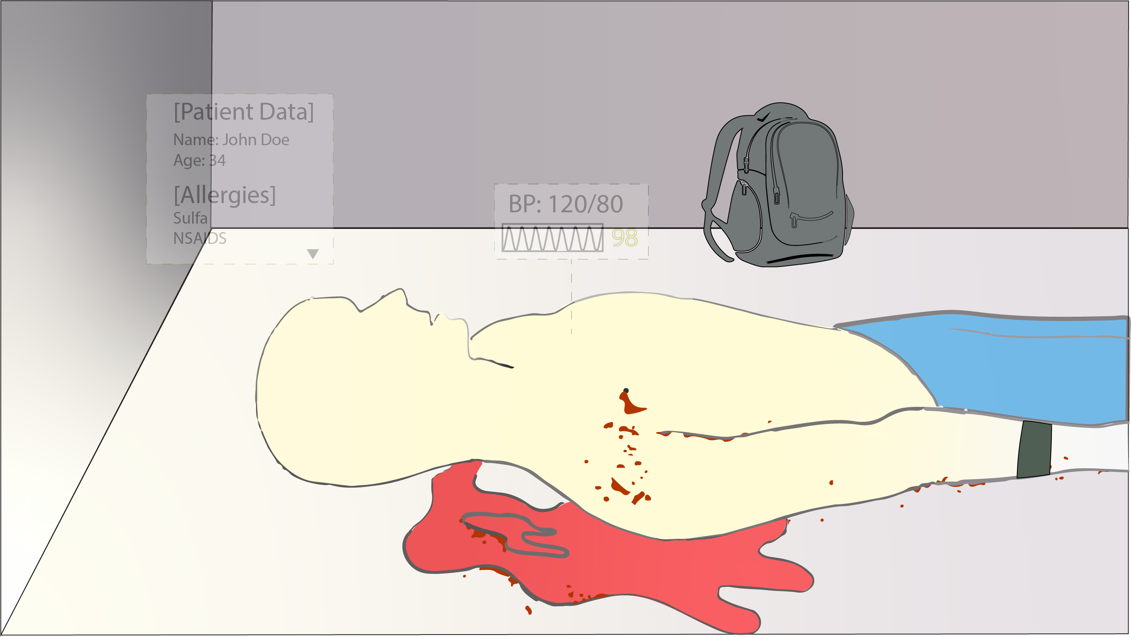

Slide 18
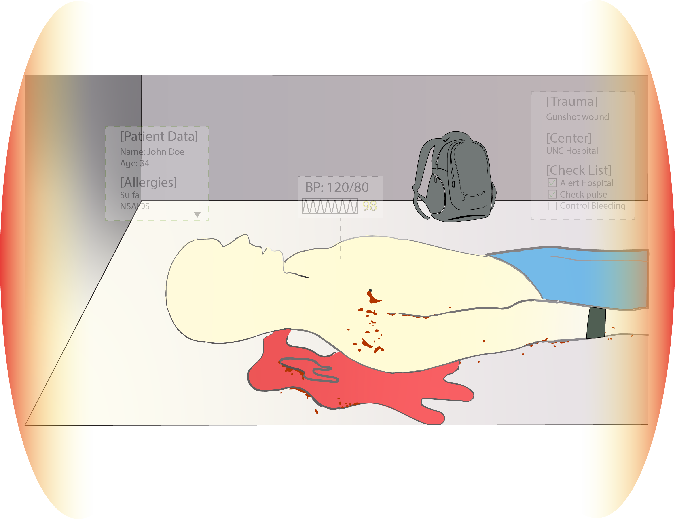

Slide 20
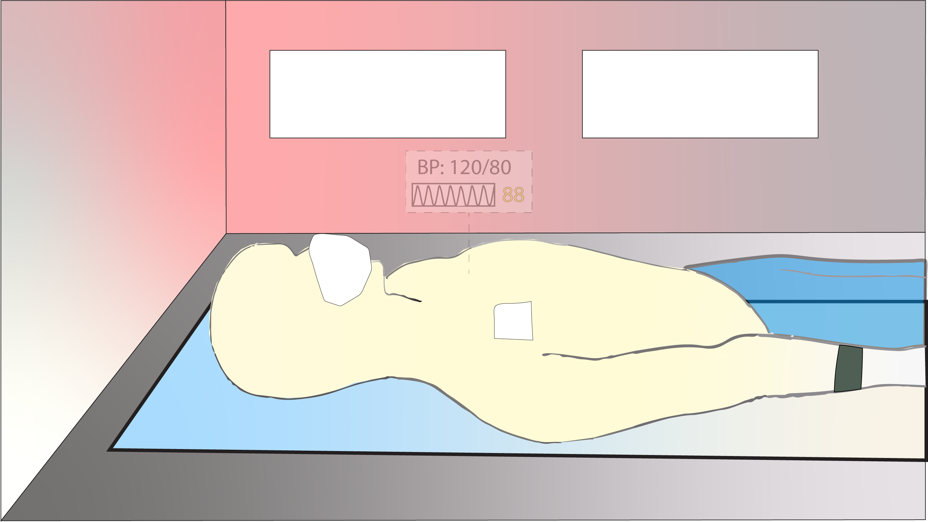

Slide 21
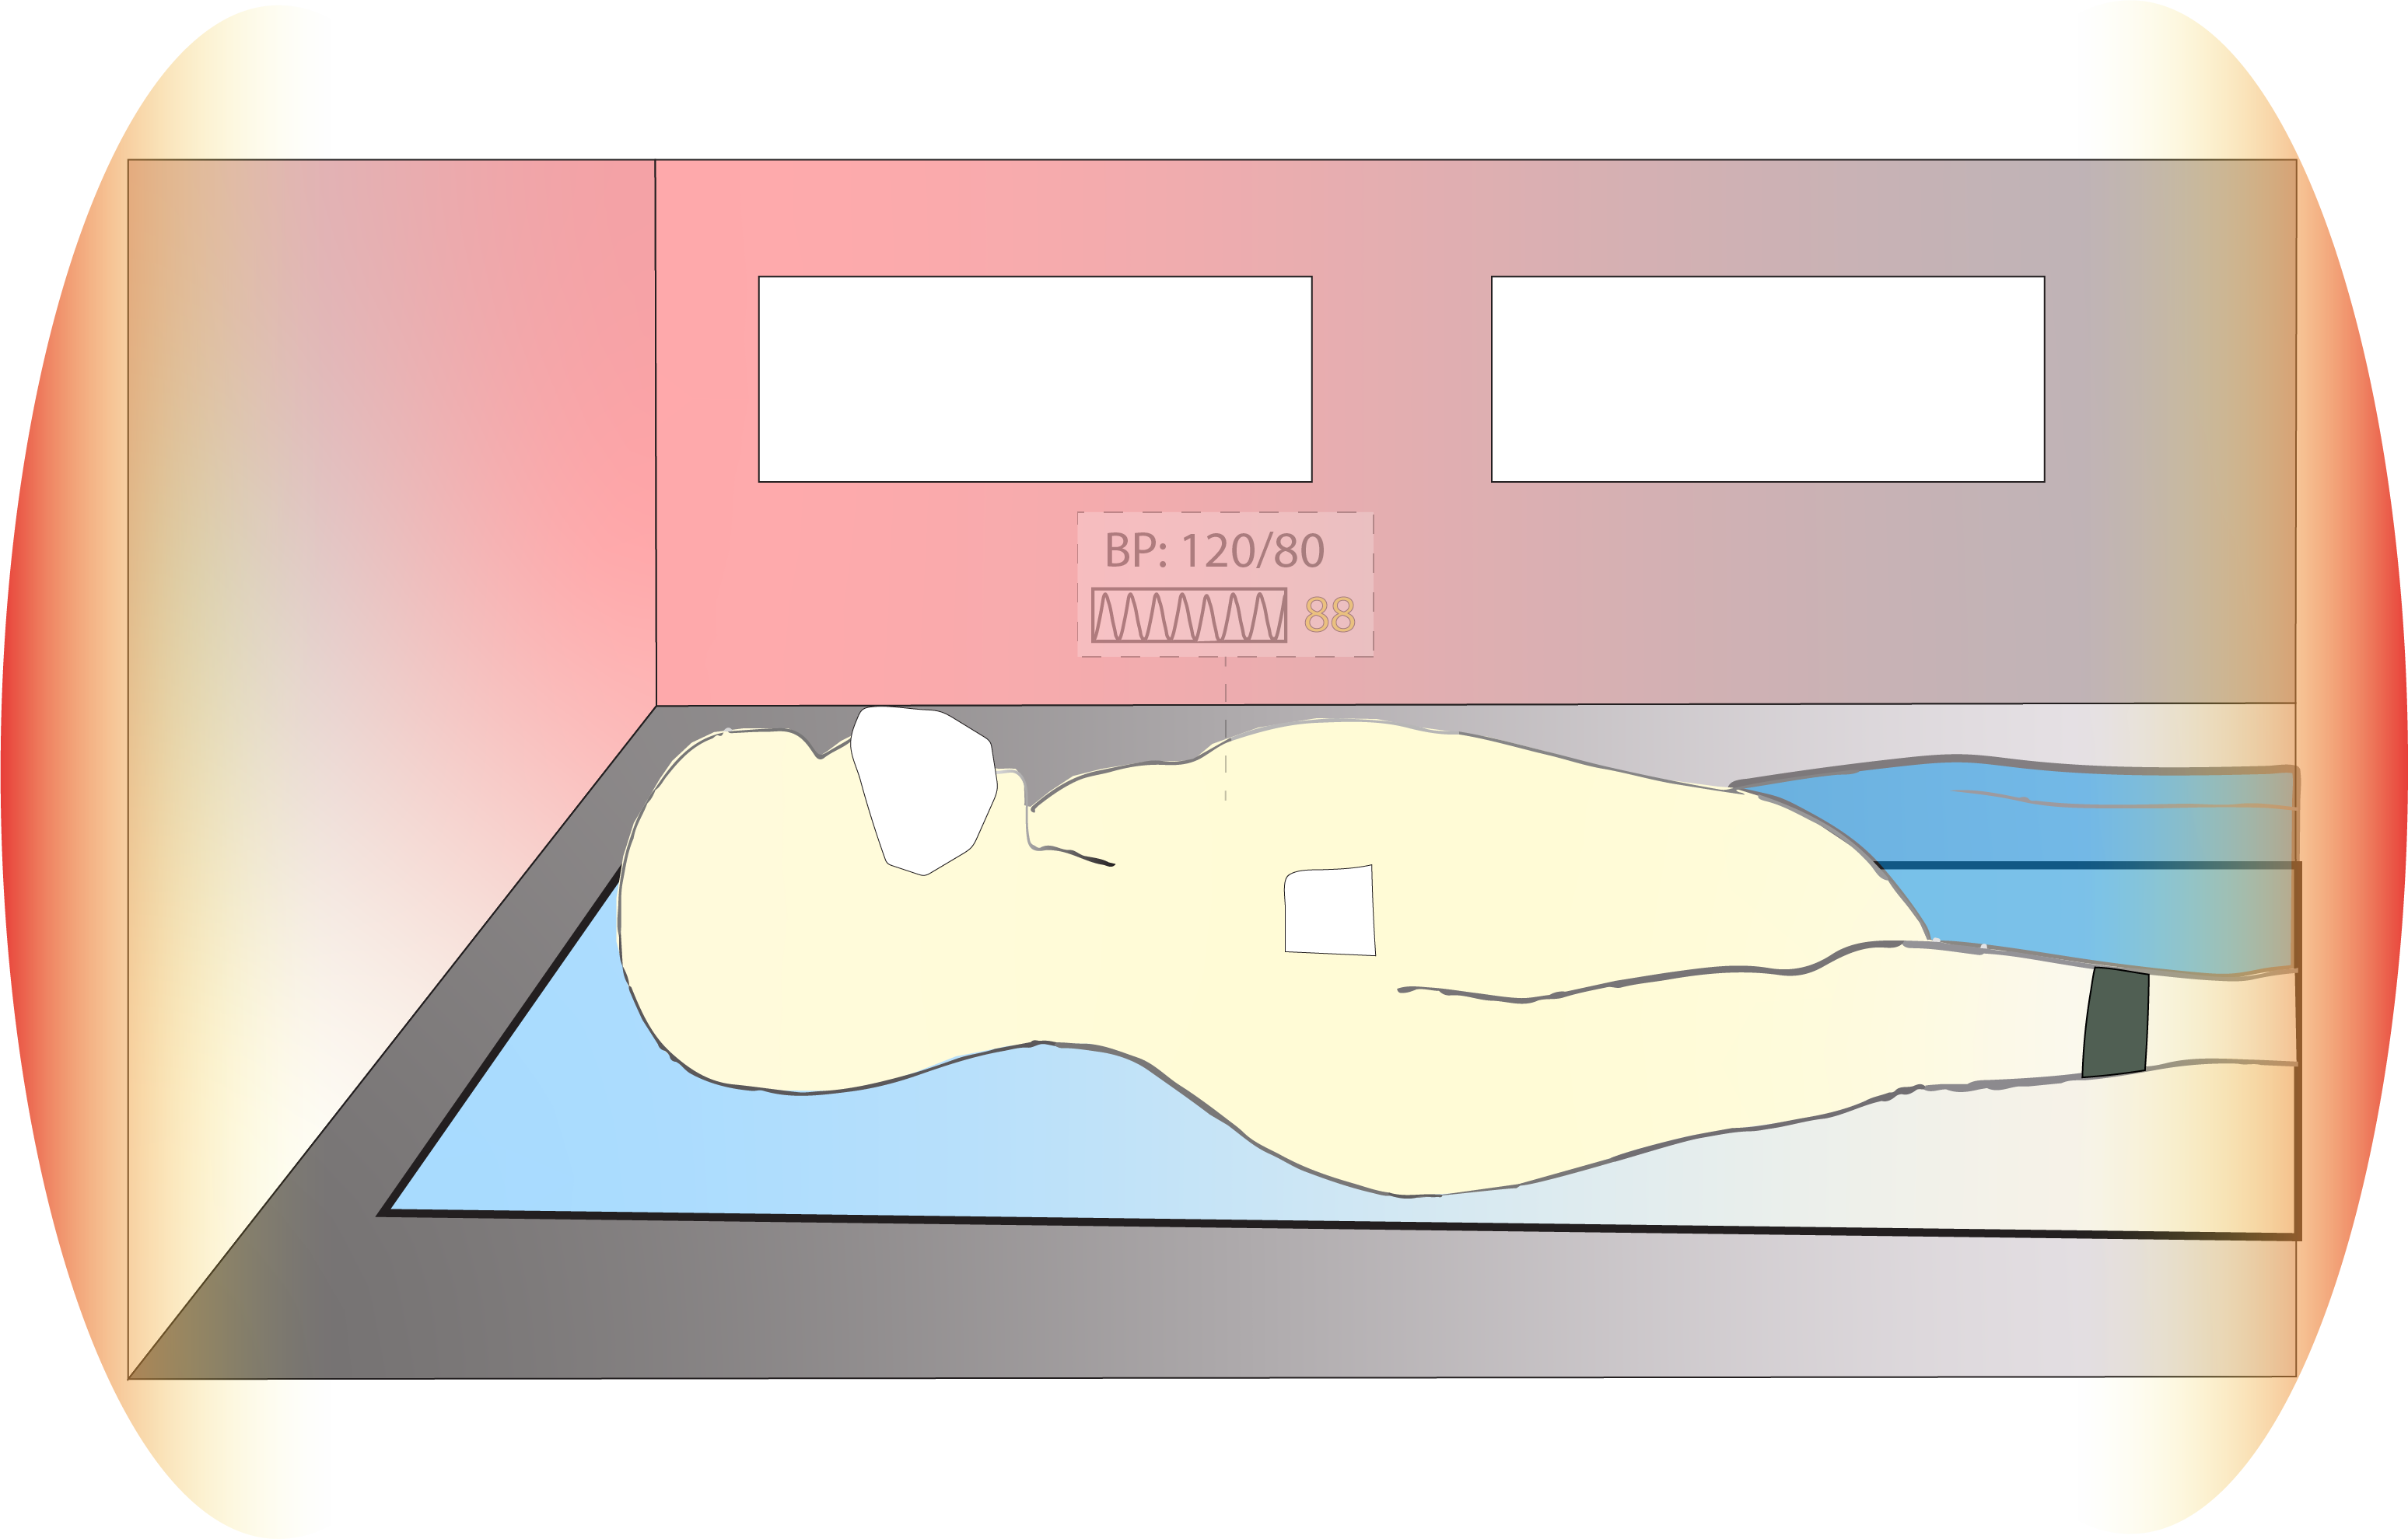

Slide 22
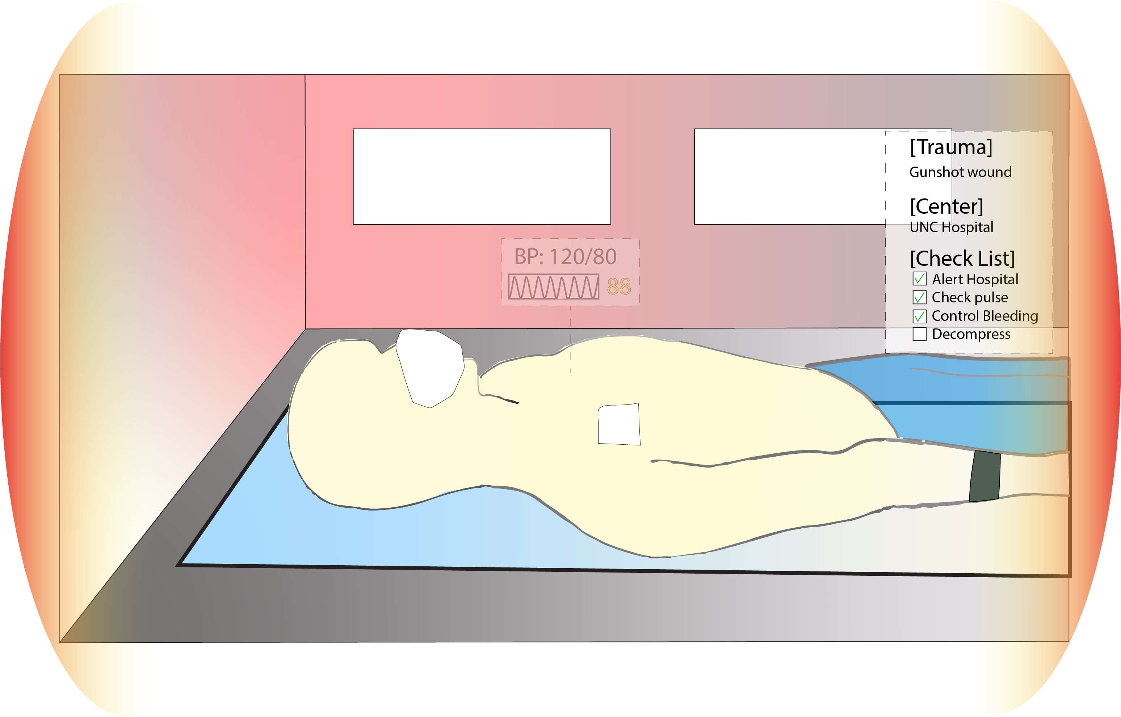

Slide 23
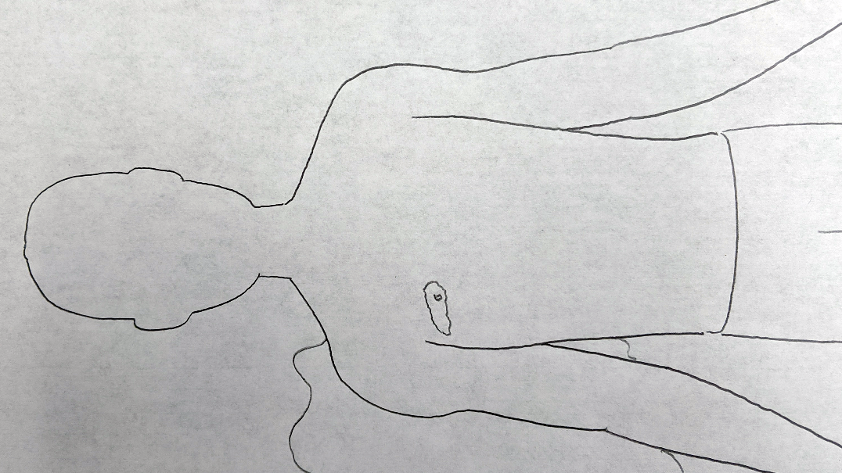

Slide 24
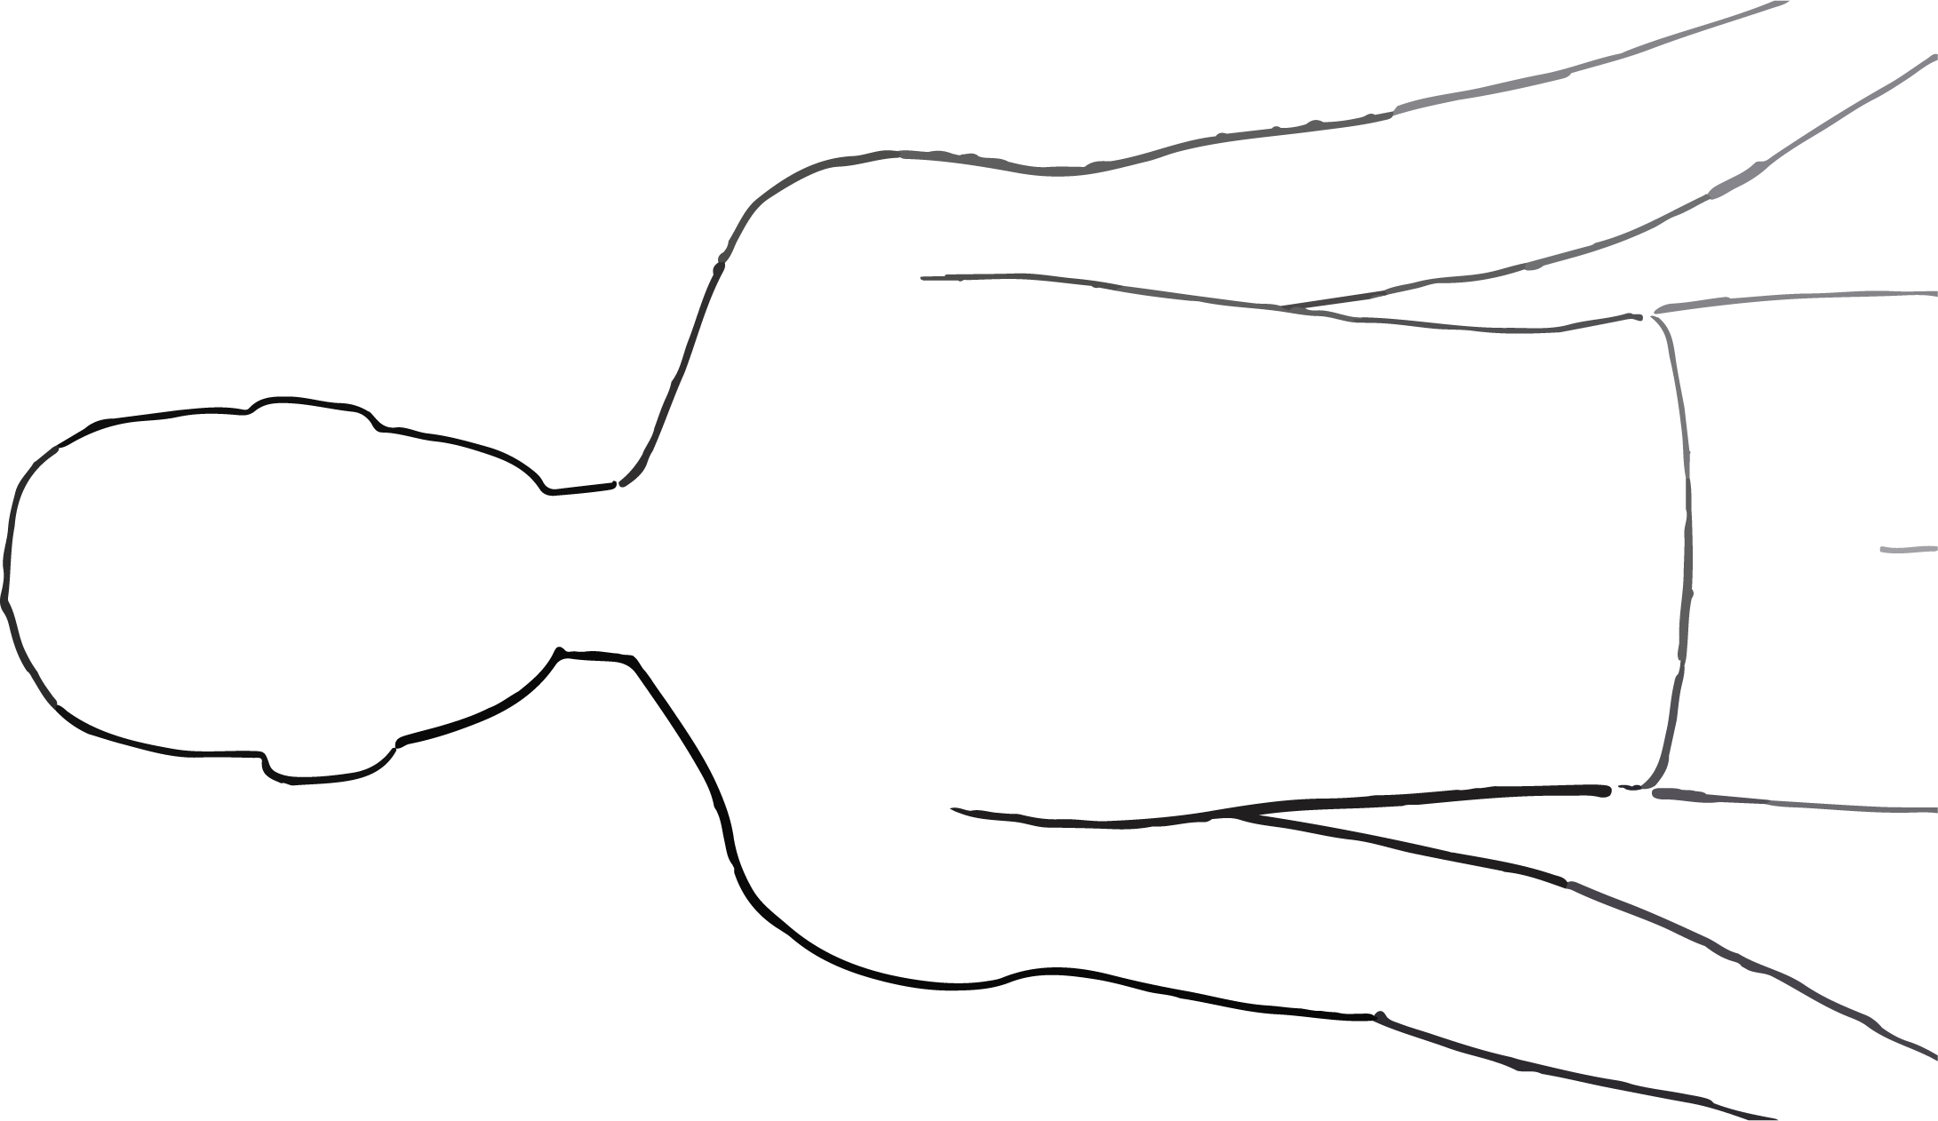

Slide 25
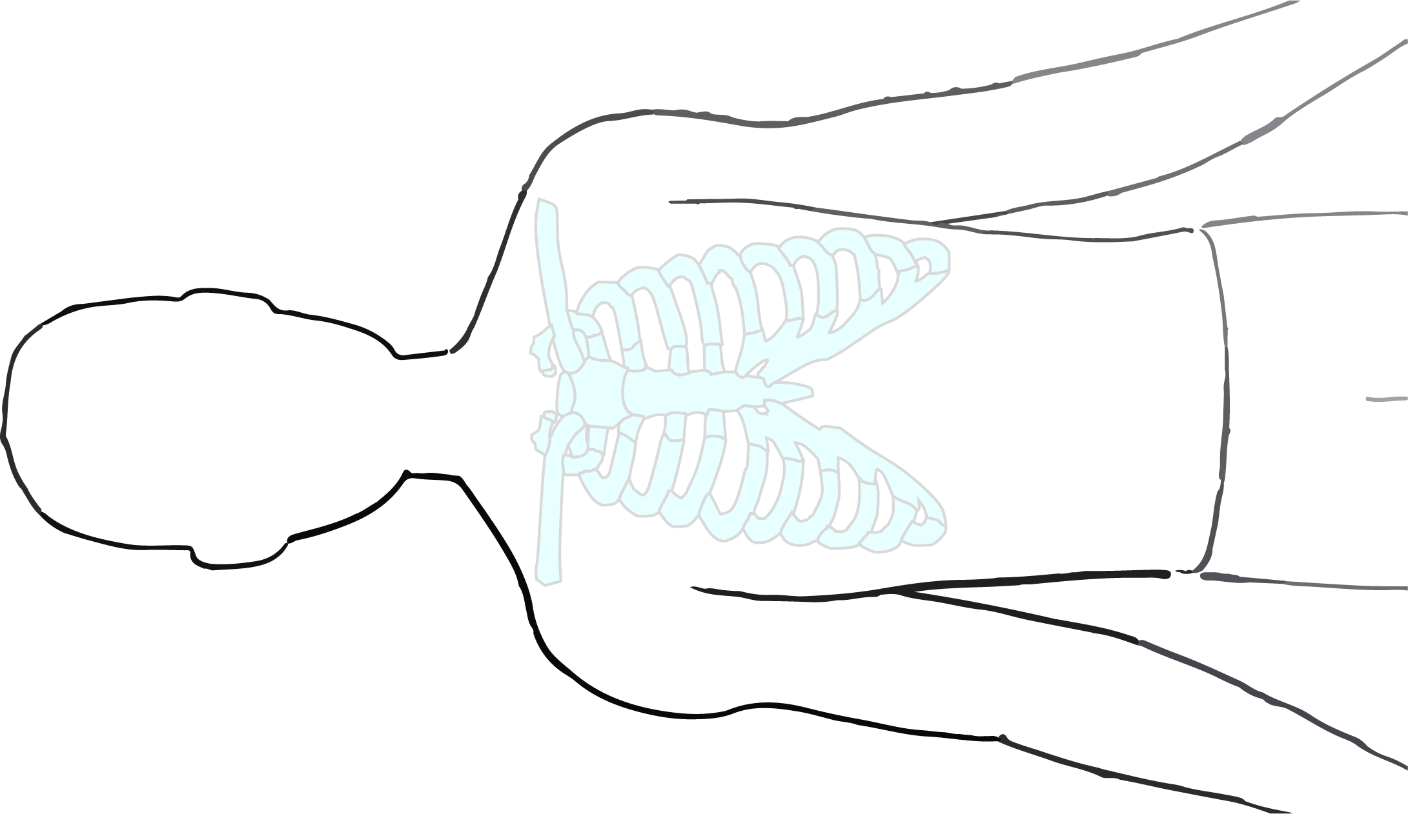

Slide 26
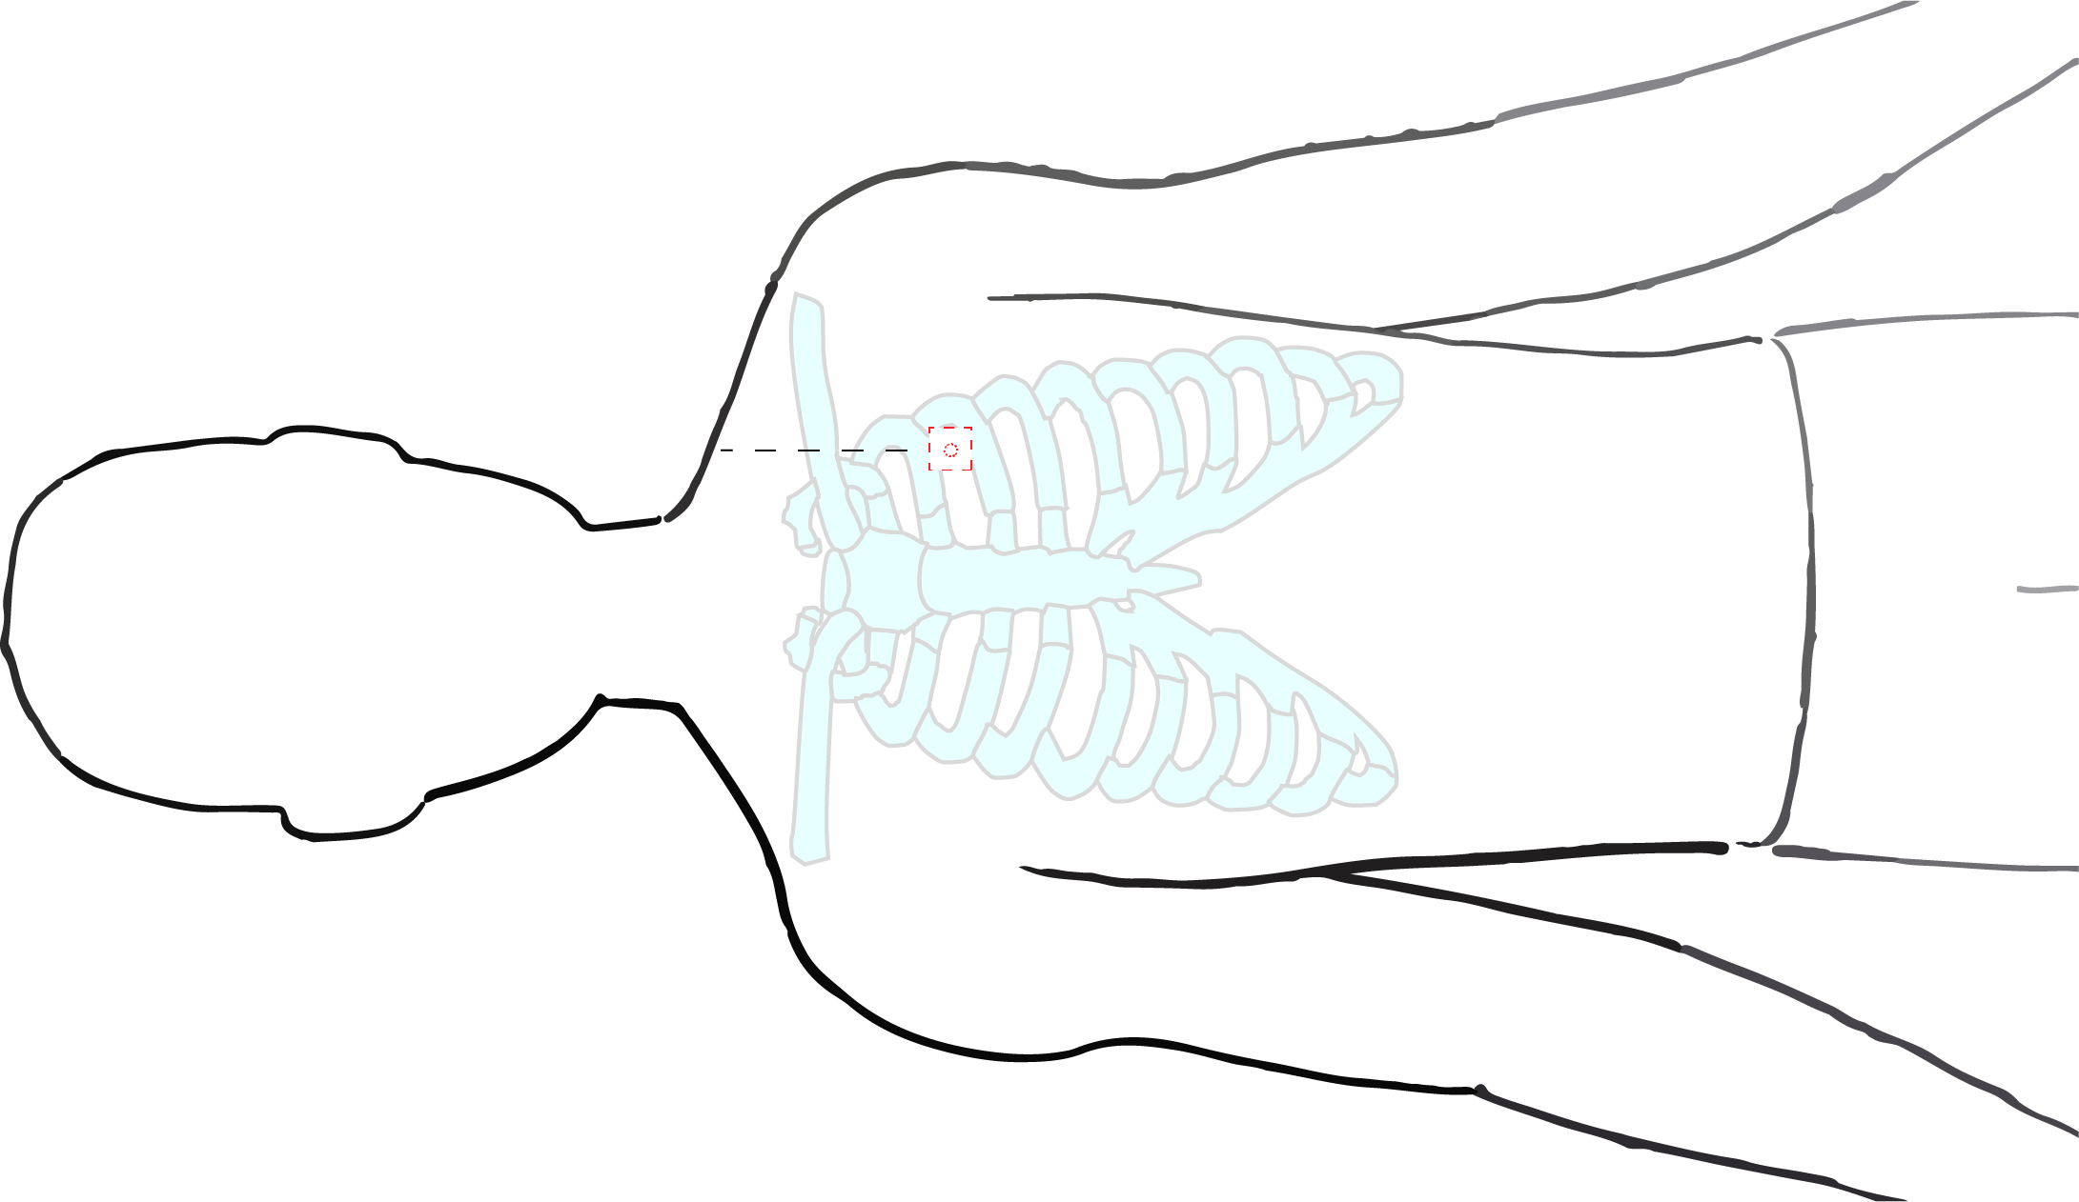

Slide 27
Questions for you
What are the information needed during a gunshot wound trauma?
How would you like the information presented?
How would you like to access the information?

