Slide 1
Prototyping Next-Generation User Interfaces
Wake County EMS
2nd Group Discussion

Slide 2
Goals
Present the methodology, possible scenarios and the decisions we have made
Present the possible user interface features we think could enhance the task in the chosen scenario
Discuss the procedures during the assessment and treatment of a trauma
Discuss the features that could be included and could be removed
Q&A

Slide 3
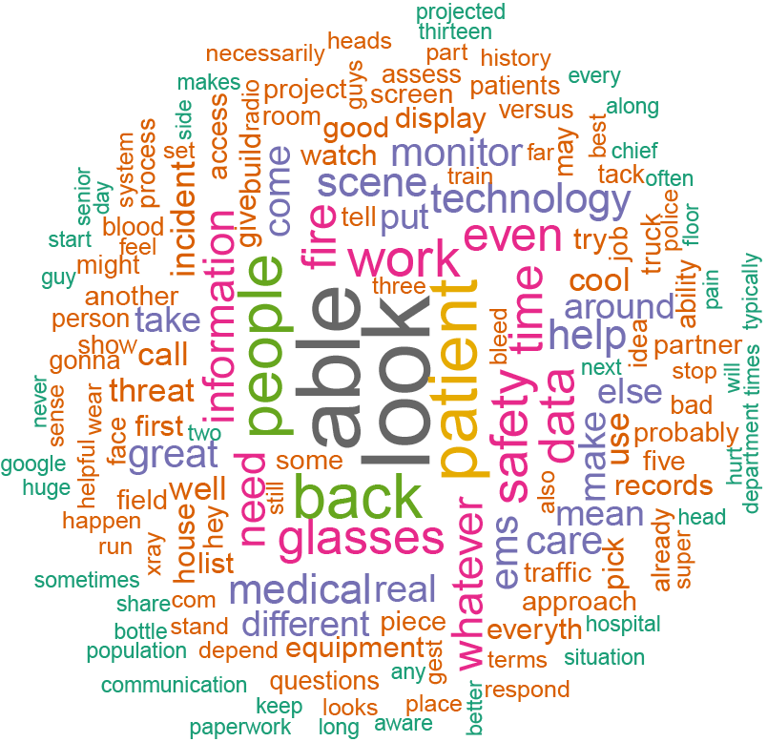
Methodology
Gather data through interviews and training observations
Speech to text conversion of the interviews
Analyze the answers and the video recordings of the training exercises
Brainstorm possible scenarios, task to simulate and user interfaces

Slide 4
Possible Scenarios
Basic Medical/Trauma Assessment
Gunshot
Conscious Patient with Head Injuries
Unresponsive Patient
Fractured bone
Overdose Patient
Burns
Car/motorcycle crash
Active Shooters

Slide 5
1st Chosen Scenario: Gunshot Wound to Upper Chest
Scenario
Gunshot Wound to Upper Chest
Key Role
EMS Paramedic
Task to simulate
Assess a trauma patient, control bleeding

Slide 6
2nd Chosen Scenario: Complicated Medical Call
Scenario
67-year-old burned while cooking at home
Key Role
EMS Paramedic
Task to simulate
Assess the patient, identify how much of the patient’s body is burned, decide if the burn is considered critical, initial burn care, control bleeding and other injuries due to the fall, notify the medical center

Slide 7
Complicated Medical Call – Use Case Scenario
You are responding to 67yo, male patient reported having burns on his right arm and right-side chest in a middle-low income area on Wednesday evening at about 10:00 PM. The victim got up too quickly to turn off the stove, became light-headed due to low blood pressure, and passed out while moving a pot full of boiling water. He fell to the floor, spilling boiling water on himself. The container was glass, and he sustained multiple laceration/cuts to his left arm.

Slide 8
Complicated Medical Call – Use Case Scenario
You arrive at the residence. You touch the side of your safety glasses to activate the built-in HUD. It automatically enhances your vision. The system scans the environment while you are going to the kitchen.
The system alerts you about a gun on top of a table on the hallway. In the kitchen, you see the man lying on the floor, conscious and breathing. While you get close to the victim, the system scans his face. After a few seconds, the HUD shows the patient information near to his body (Name, day of birth, allergies).
The system highlights that the patient has allergies to two medicines and automatically estimates the patient's body weight. You hook the monitoring equipment to the man. His vitals are shown in real time anchored to his body through your HUD display. A visual inspection reveals that he has red, blistered skin on the anterior or front of her body from the right arm to the chest.
Additionally, his head is bleeding due to the fall and the cuts caused by the pieces of glass. The system detects body burn percentage and recommends which hospital the patient should be taken to.
The system also shows where to apply a tourniquet to stop bleeding. You report out loud the situation. The system understands and shows in a virtual display on your left arm a checklist of the procedures and medication administration and dosage (based on the estimated body weight) that should be carried out.

Slide 9
Gunshot – Use Case Scenario
Meanwhile, his grandson appears in the hallway. Face recognition reveals that he is a known gang member. Grandson deals drugs and doesn’t want first-responders around. You discretely press a button, alerting the police.
The patient's vitals remain located by the patient, rather than following paramedic’s head. Eye tracking increases the opacity of patient data when looking at the patient. You are following the procedures on the checklist. You administer medicine that requires a dosage in every 10 minutes. The system keeps tracking the time, to alert you when it is time.
Meanwhile, you are taking care of the burns. You update the status via voice command when you finish the burn care. Blood pressure drops suddenly. Armband vibrates to alert you. An alert also appears on HUD, and the blood pressure is highlighted on the display.

Slide 10
Possible User Interface Features
Display
HUD
Forearm mounted display
Tablet, smartphone
Interactions
HUD on/off
Face scanner
Threat scanner
Ask backup
Voice commands
Haptics: touch in body parts to send information (danger, ask for help)
Audio: push-to-talk, radio
Information:
Patient’s info
Real-time patient’s vitals
Hospital recommendation based on location and trauma
Procedures checklist – dynamic
Procedures guidance
Alerts
Equipment location
Threat identification: guns, knifes, body language
Communication: voice, text, radio

Slide 11
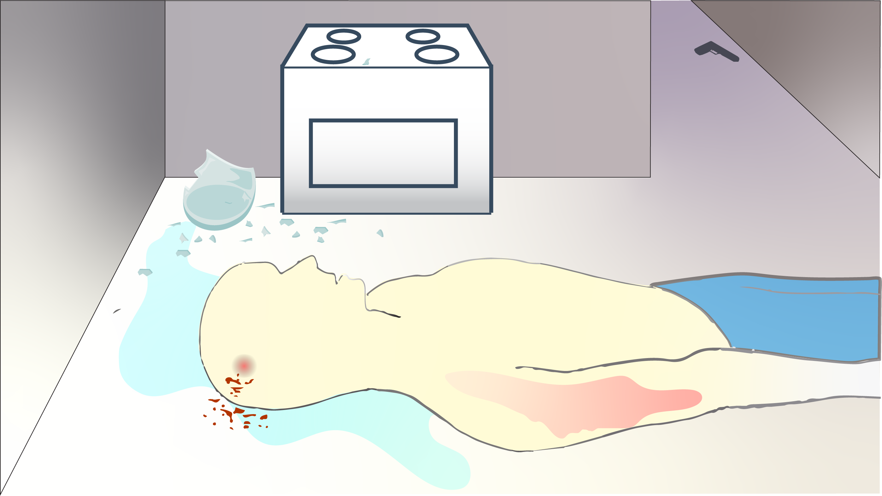

Slide 14
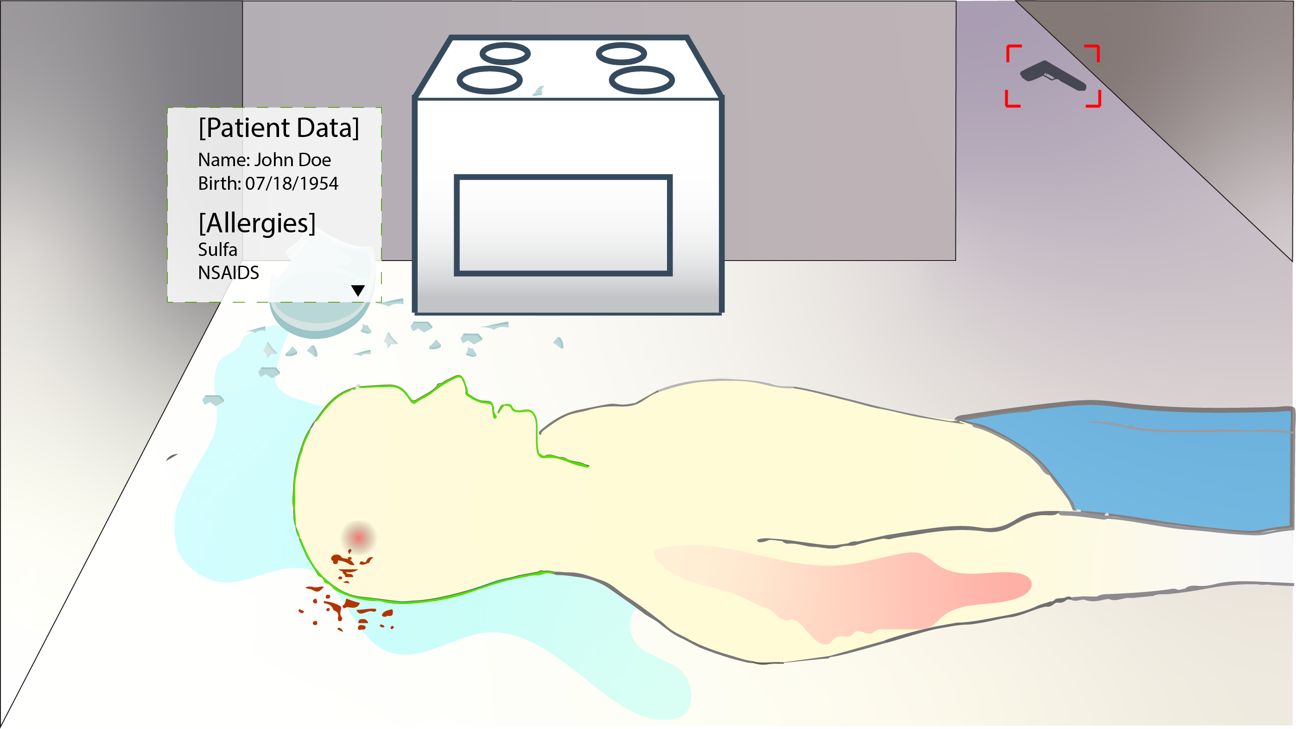

Slide 15
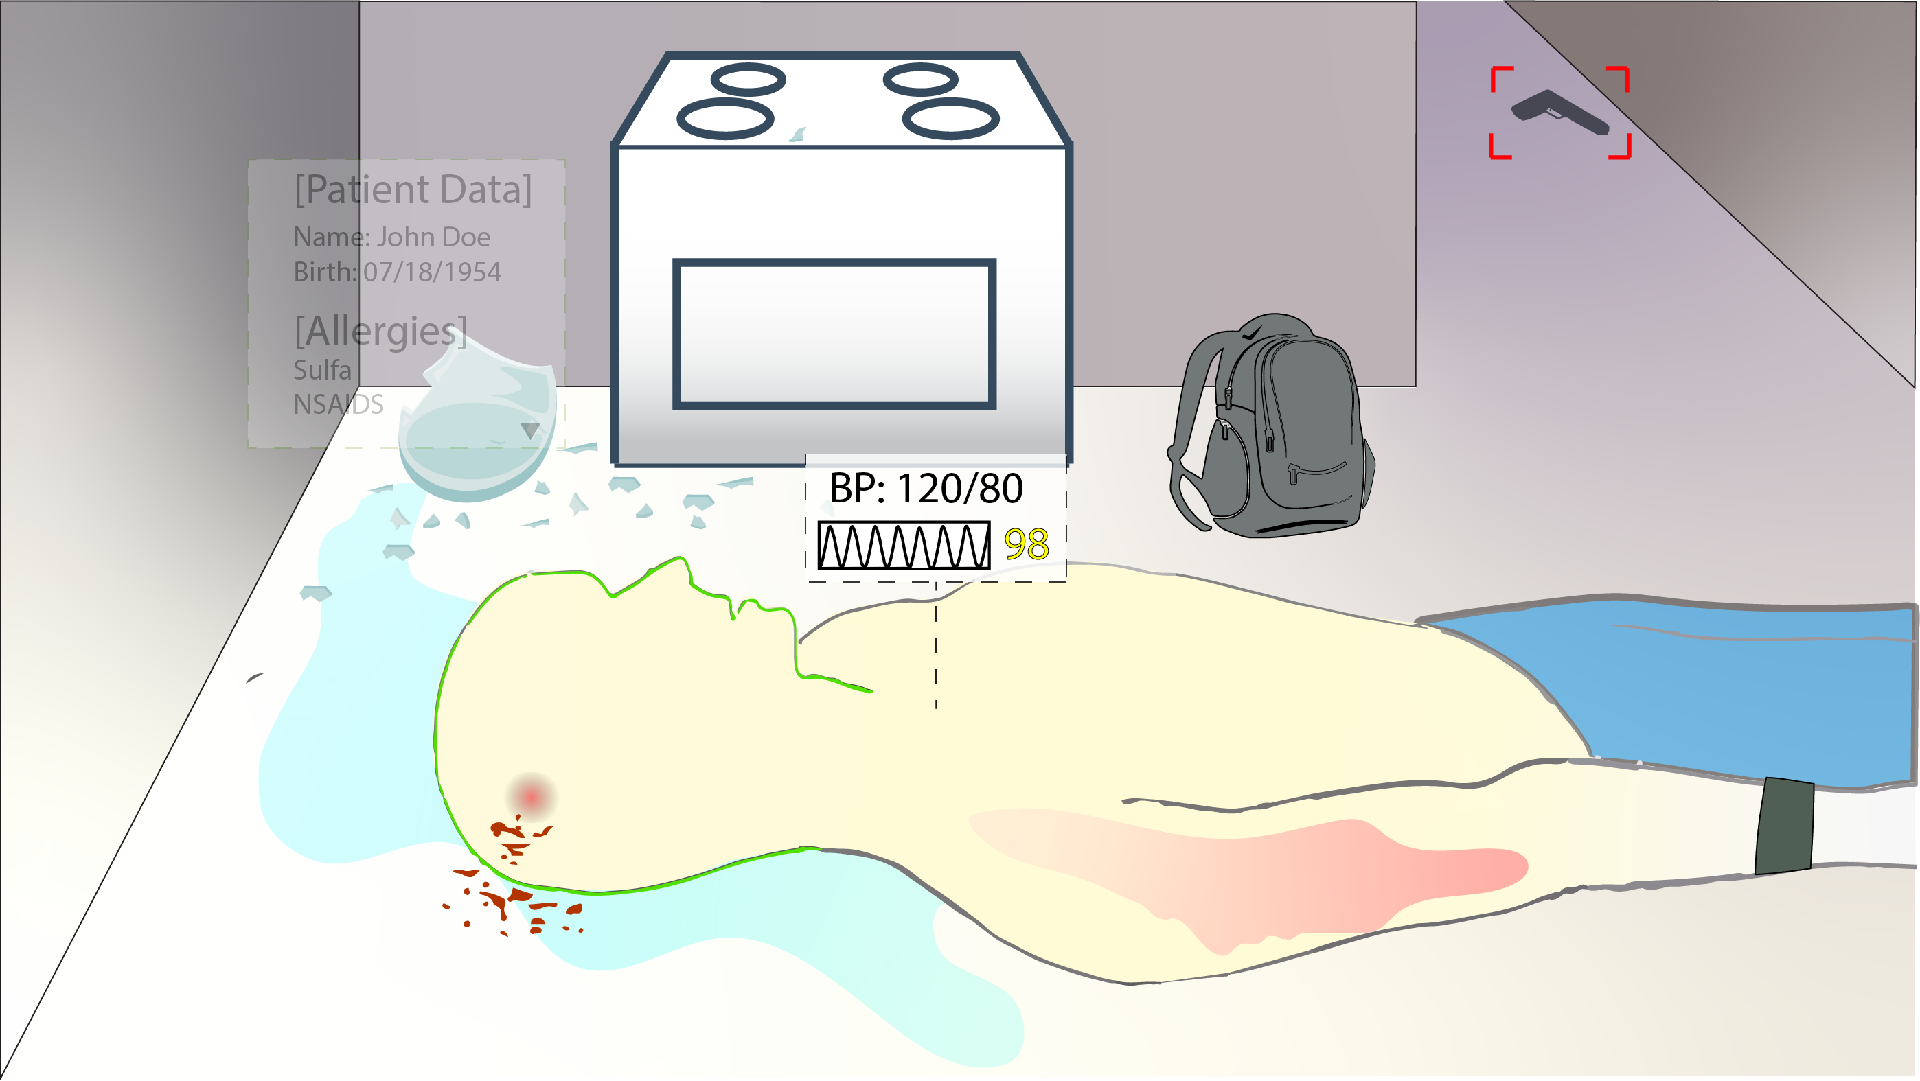

Slide 17
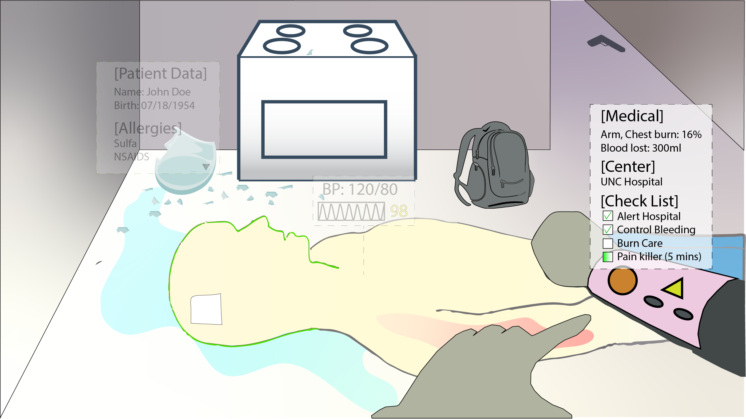

Slide 18
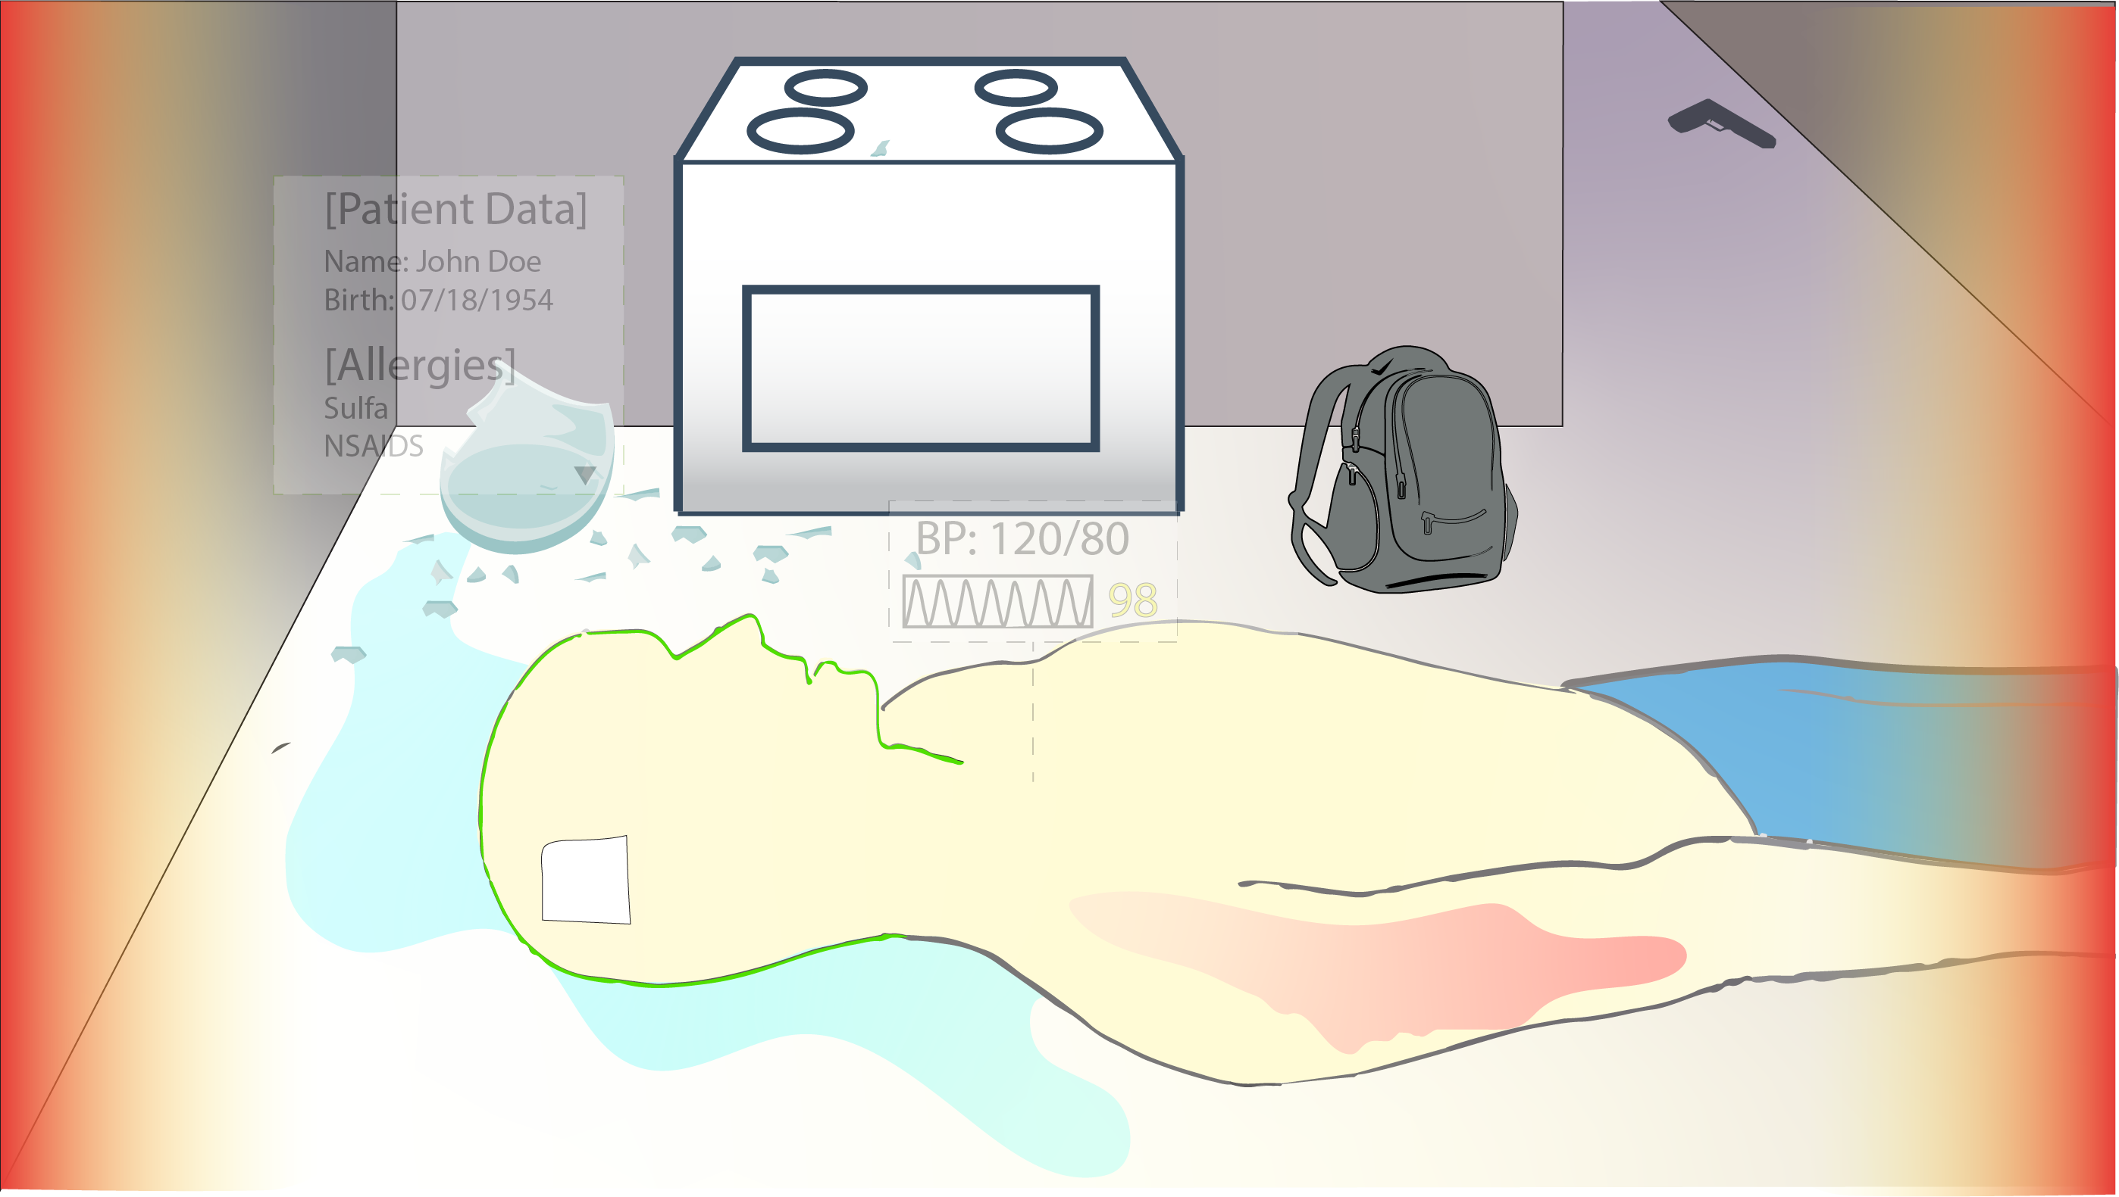

Slide 19
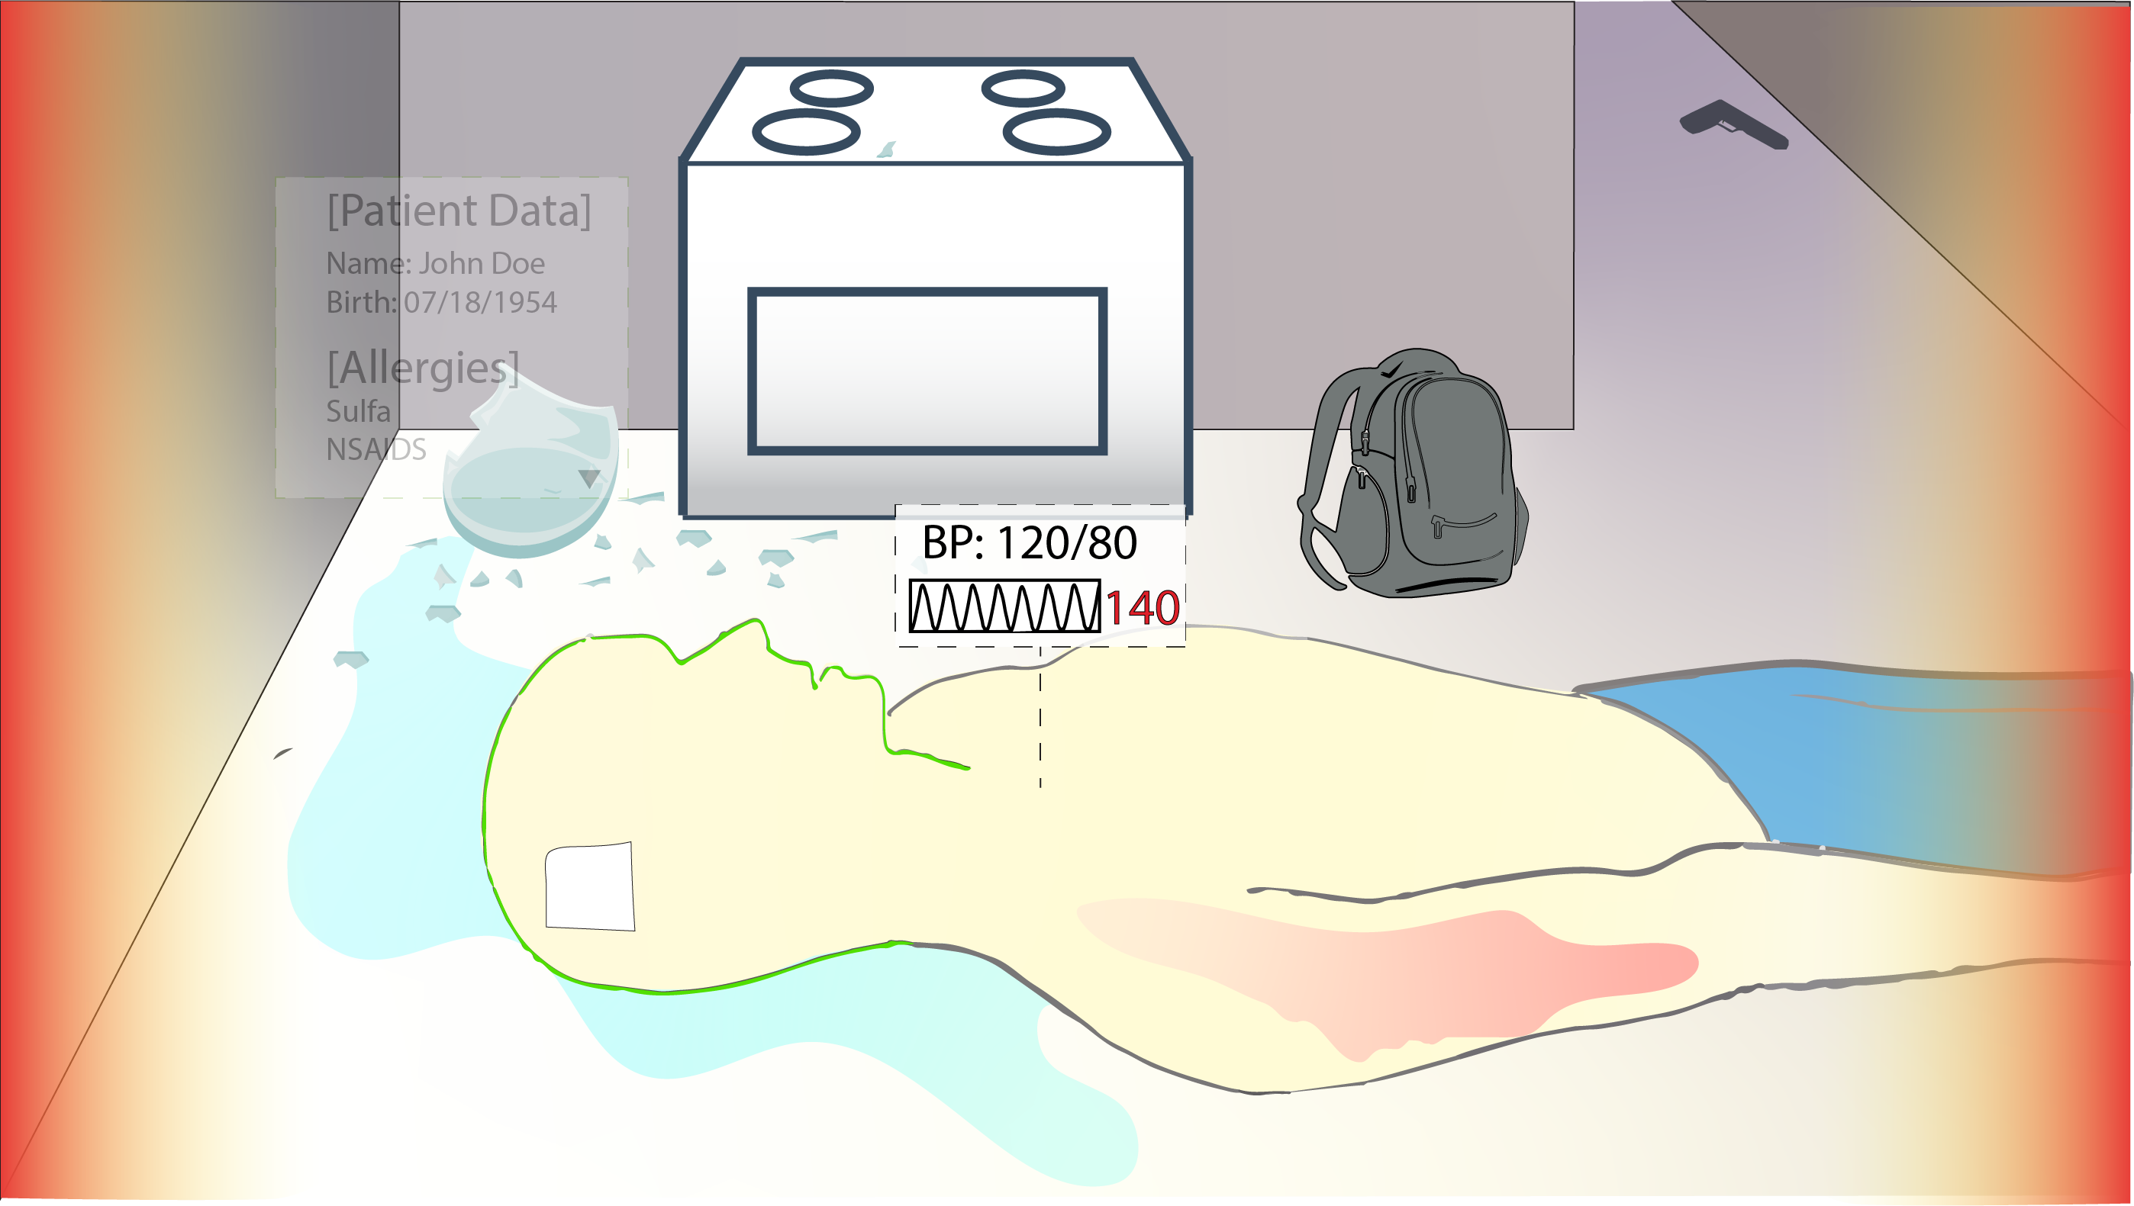

Slide 20
Questions for you
What are the information needed during a complicated medical call?
How would you like the information presented?
How would you like to access the information?

