Slide 1
Prototyping Next-Generation User Interfaces
Durham Fire Department
2st Group Discussion

Slide 2
Goals
Discuss details about interactions and features
Markers in the environment (hazards, information…)
Dynamic generated map
Information Exchange
Breadcrumbs
HUD elements
Role Assignment

Slide 3
Scenario
Burning commercial building
Key Role
Firefighter who’s tasked with finding the victim
Task to simulate
Search + rescue: Path finding (in and out), hazard detection
and avoidance, victim detection

Slide 6
Markers in the Environment - Classification
Danger: fire source, structural damage, gas leak
Information: power switches, possible way out (stairs, windows)
Victims
Crew location
Do you use specific symbols to represent these information?

Slide 7
Markers in the Environment - Classification
hazard
Information
Victim
Crew Member

Slide 8
Dynamic generated map
Auto generated while the firefighters are exploring the building
The map is shared among the crew
Activated by the eye gaze
Shows in the HUD

Slide 9
Breadcrumbs
Automatic path generation
Way out: based on the hazard markers, environmental changes and crew intel gathered during the search

Slide 10
Information exchange between the firefighter and the central commander
Firefighters: generate the blueprint while exploring the building, add a hazard marker (or request the commander to add), request a new path
Commander sees the map, add hazard markers and other info (such as windows), trace and send a path, assign roles
What else the firefighter could request and inform?
What could be the commander’s actions?

Slide 11
Dynamic generated map
The map is generated in real-time

Slide 12
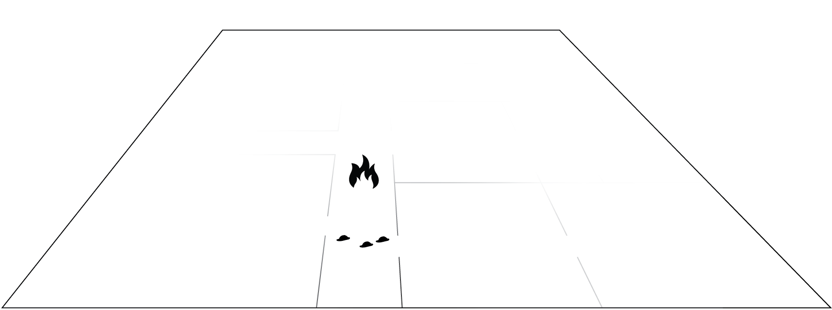
Dynamic generated map
Fire marker added

Slide 13
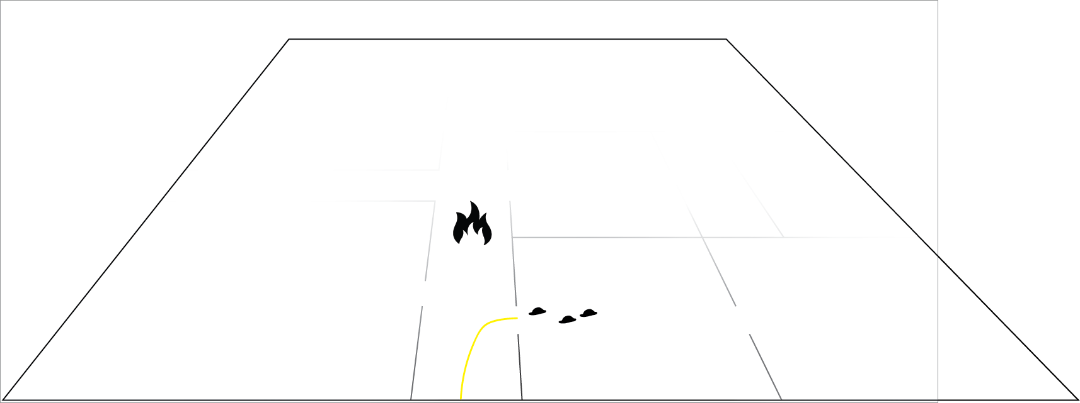
Dynamic generated map

Slide 14
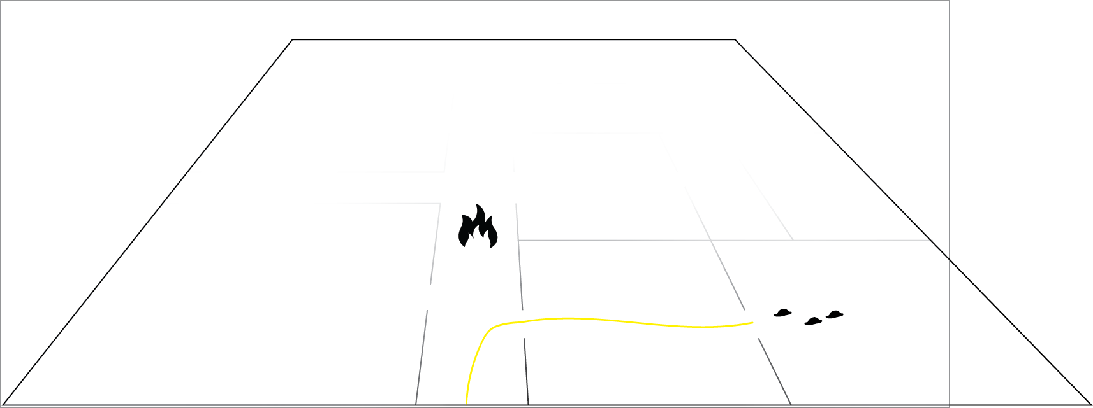
Dynamic generated map

Slide 15
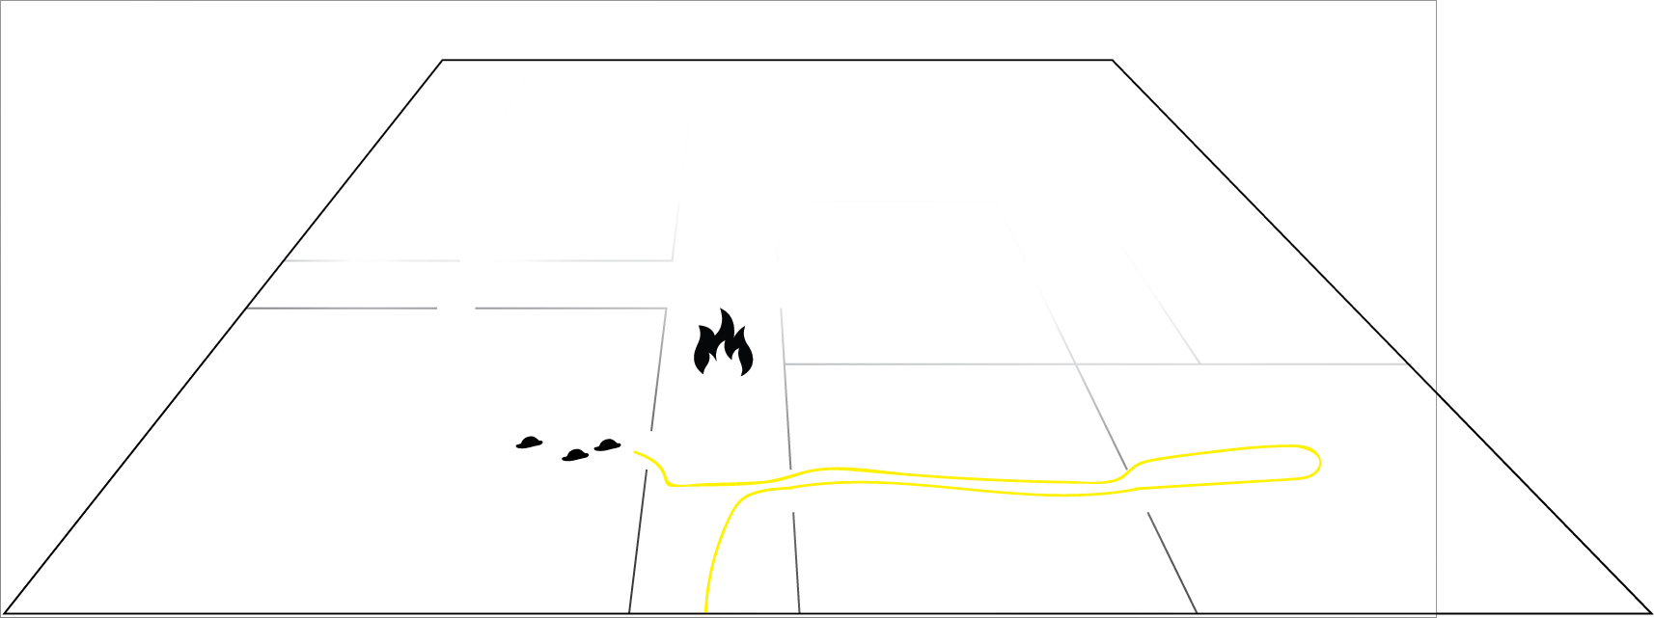
Dynamic generated map

Slide 16
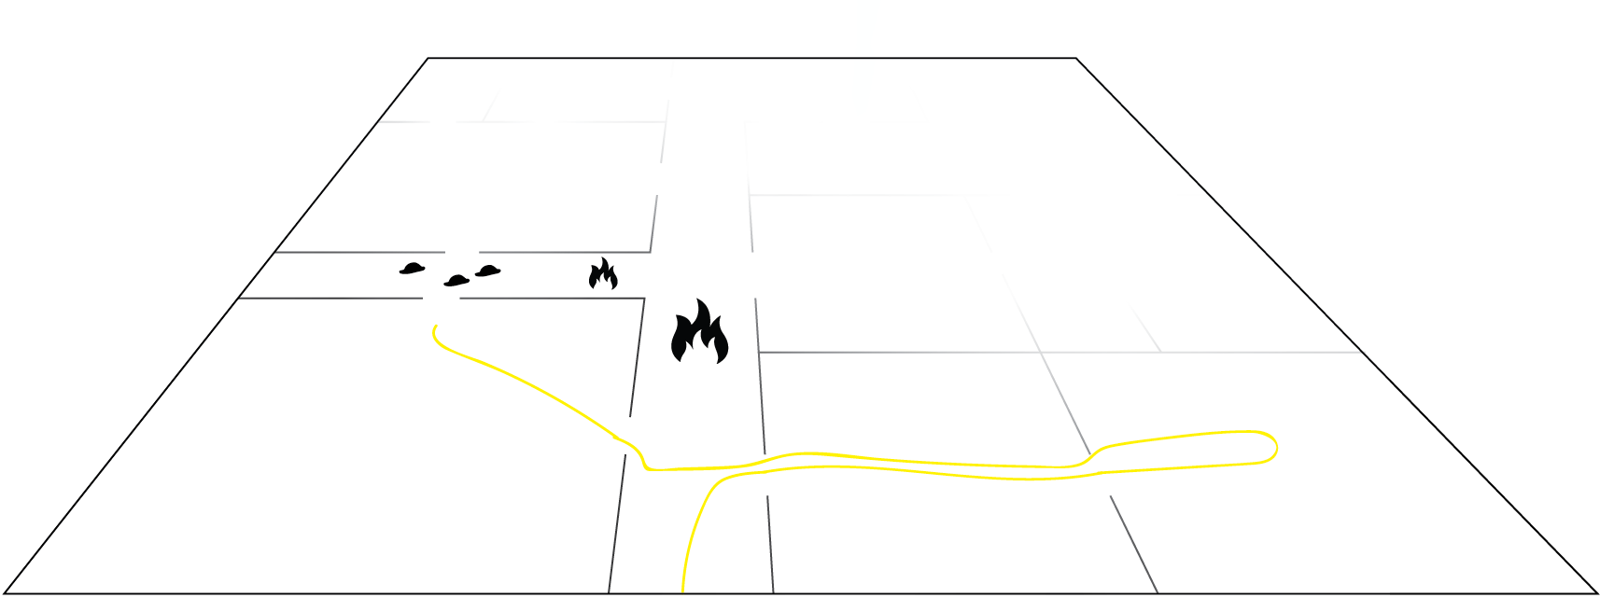
Dynamic generated map
New fire marker added

Slide 17
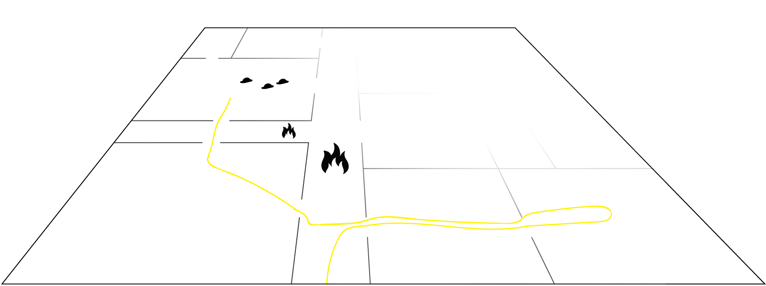
Dynamic generated map

Slide 18
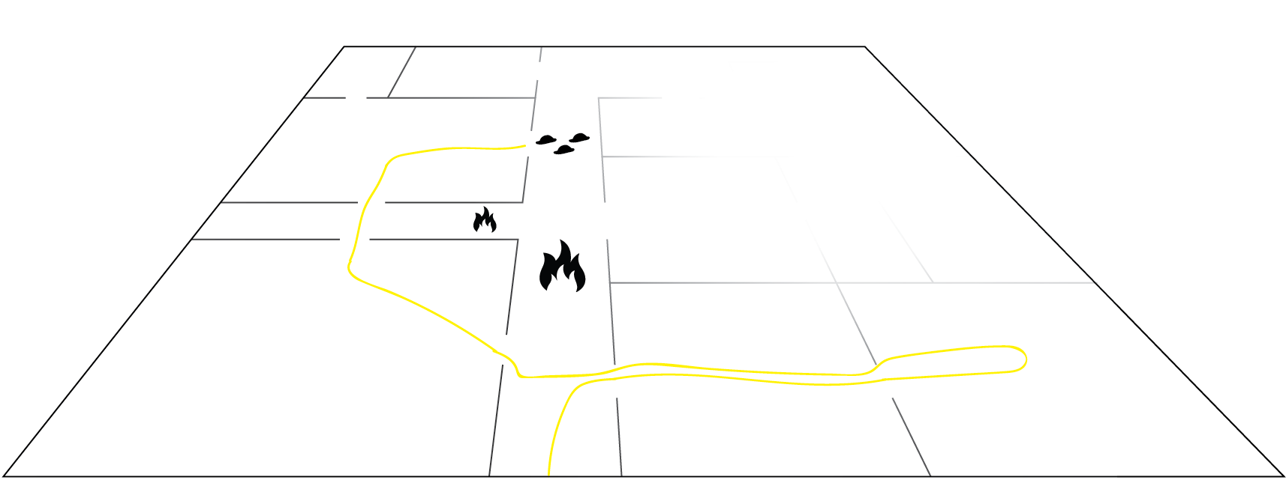
Dynamic generated map

Slide 19
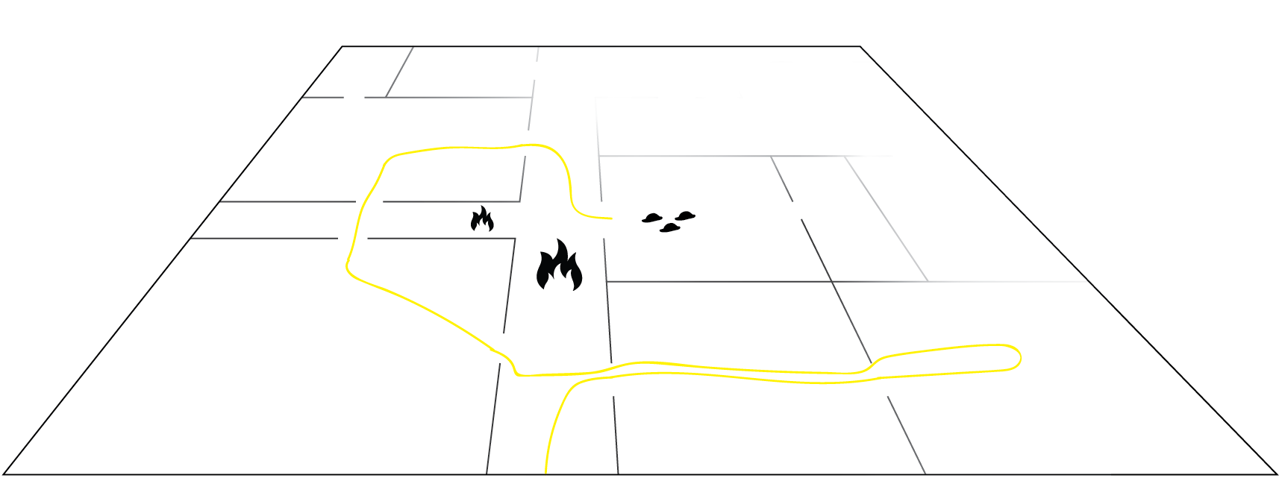
Dynamic generated map

Slide 20
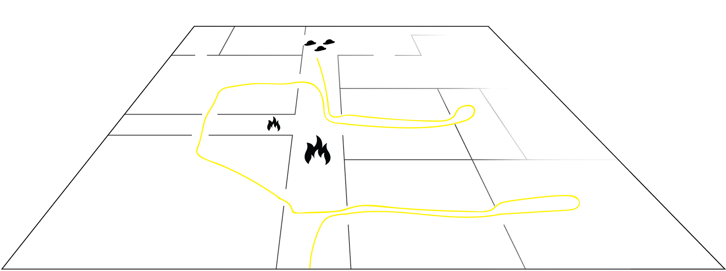
Dynamic generated map

Slide 21
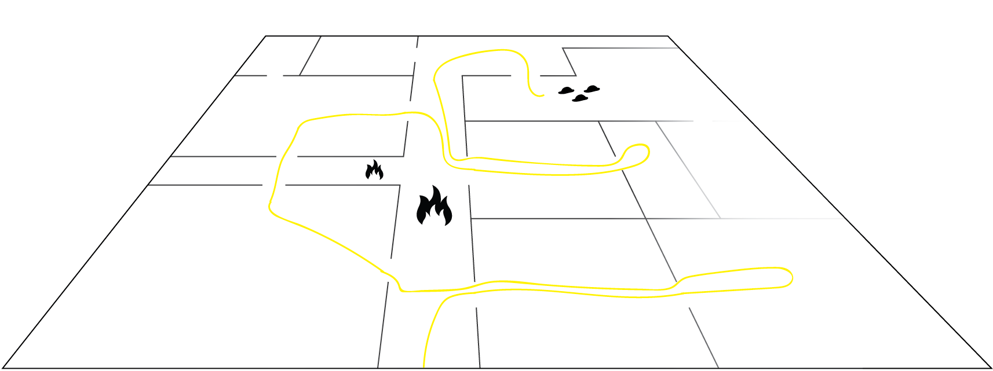
Dynamic generated map

Slide 22
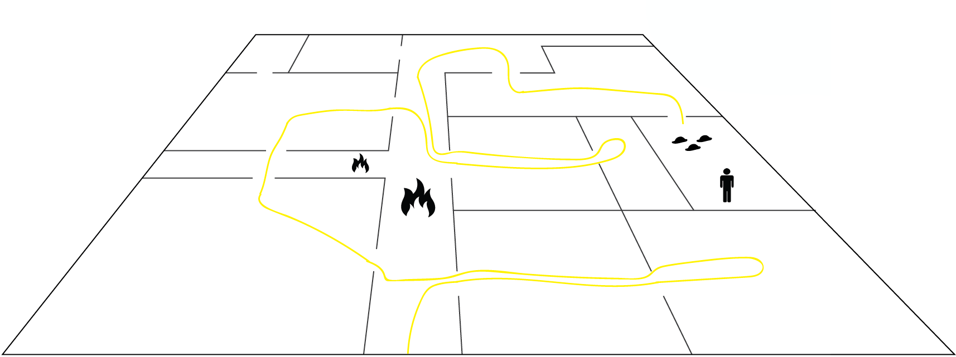
Dynamic generated map
Victim found

Slide 23
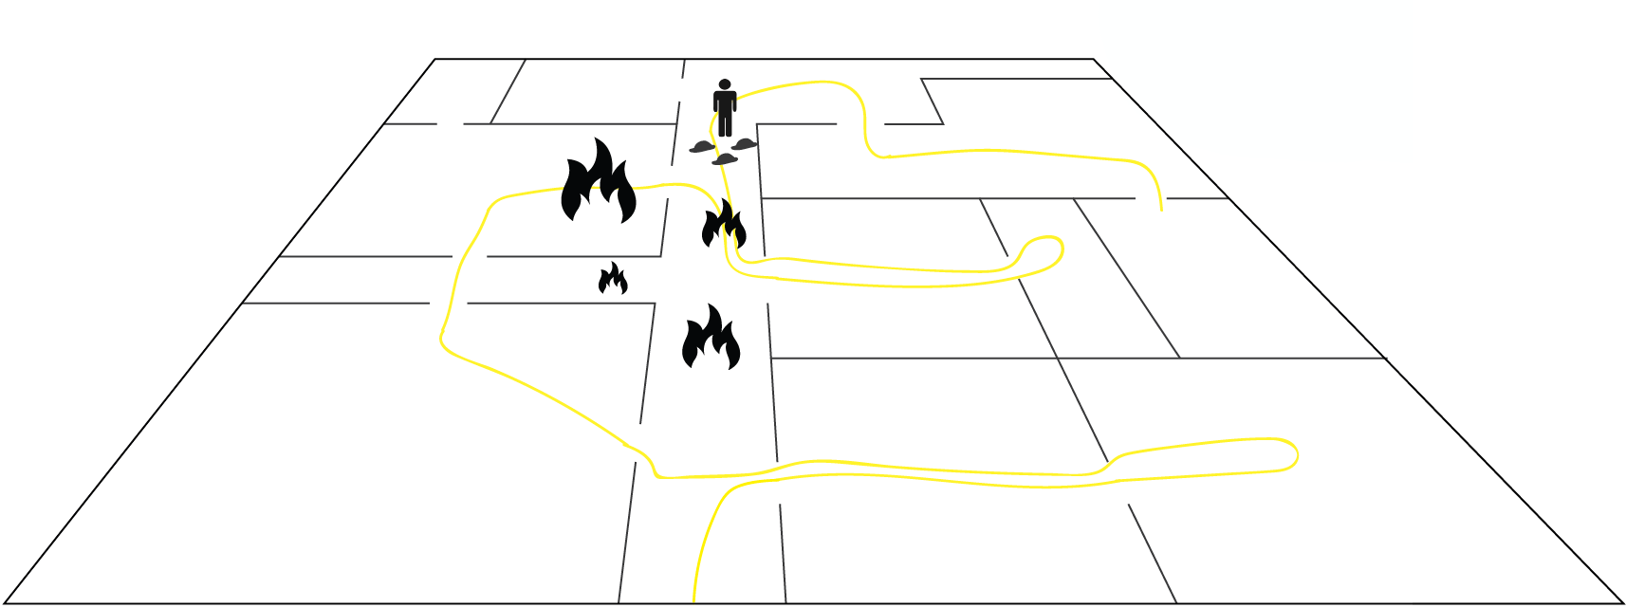
Dynamic generated map
the fire spread
Blocking the way out

Slide 24
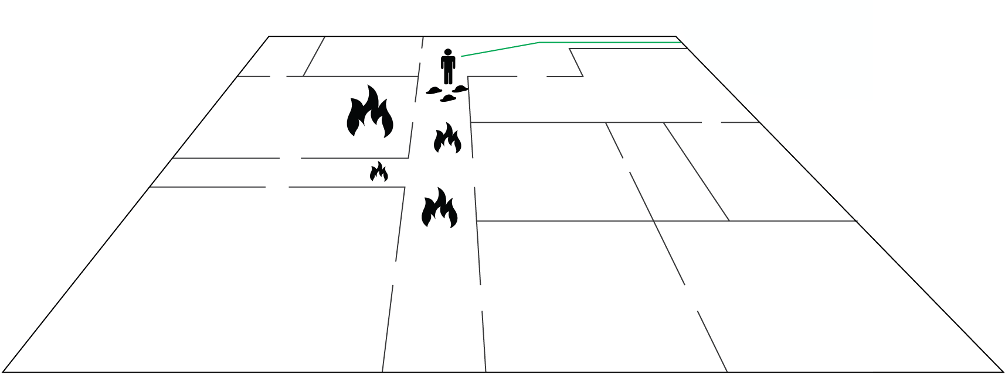
Dynamic generated map
Central commander sends a new path

Slide 25
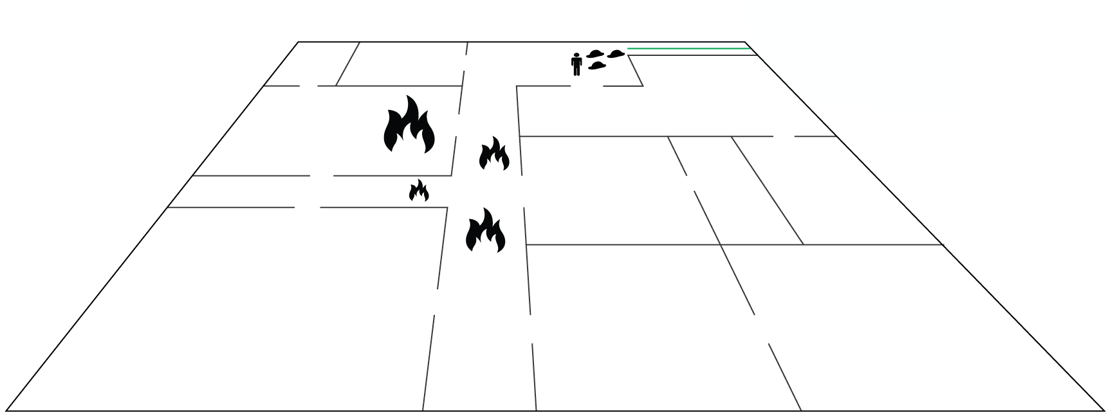
Dynamic generated map

Slide 26
HUD Elements
<Search and Rescue>

Slide 27
Role assignment
Search + Rescue
Mitigation
Commander
Safety
Ventilation

