Slide 1
Prototyping Next-Generation User Interfaces
Durham Fire Department
1st Group Discussion

Slide 2
Goals
Present the methodology, possible scenarios and the decisions we have made
Present the possible user interface features we think could enhance the task in the chosen scenario
Discuss
Discuss the features that could be included and could be removed
Q&A

Slide 3
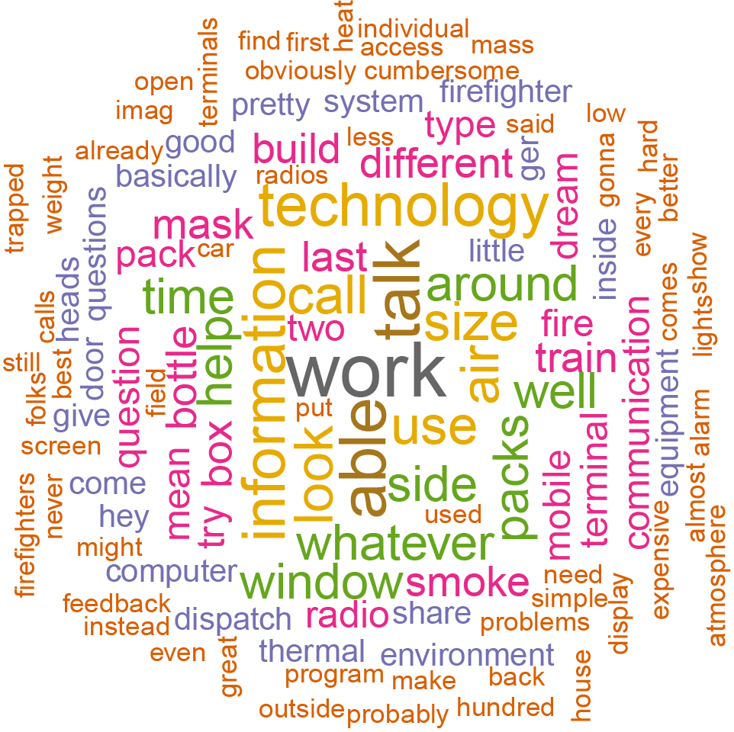
Methodology
Gather data through interviews and training observations
Speech to text conversion of the interviews
Analyze the answers and the video recordings of the training exercises
Brainstorm possible scenarios, task to simulate and user interfaces

Slide 4
Possible Scenarios
Burning building: trapped person, extinguish fire
Residential
Commercial
Rescue with no fire
Car crash
Earthquake
Wind storm
Patient removal
Trapped pets
Active shooter

Slide 5
Possible Scenarios
Burning building: trapped person, extinguish fire
Residential
Commercial
Rescue with no fire
Car crash
Earthquake
Wind storm
Patient removal
Trapped pets
Active shooter

Slide 6
Chosen Scenario: Search and Rescue
Scenario
Burning commercial building
Key Role
Firefighter who’s tasked with finding the victim
Task to simulate
Search + rescue: Path finding (in and out), hazard detection
and avoidance, victim detection

Slide 7
Search and Rescue – Use Case Scenario
You’ve been dispatched to a commercial structure fire on a Wednesday evening at about 7:00 PM. The information is that a 45 yo female employee is trapped inside the building. The smoke is dense and the visibility is low. You were informed that the person has locomotion disability and maybe in her office that is located on the second floor.

Slide 8
Search and Rescue – Use Case Scenario
You enter the building and go towards the stairs for the second floor. The visibility is moderate, with a thin layer of smoke coming from the hallway that connects with the stairs. You approach the stairs and the smoke starts to become denser.
The visibility is very low when you get to the second floor. You look back to the downstairs and sees that a directional line on the floor that represents the path you took until that point. You look back to the hallway on the second floor.
You double tap the left side of your mask and activate the thermal imaging overlay on your mask. Now, you can see through the smoke. The thermal overlay also highlights the edges of the walls, doors and furniture. On the left side of the mask display, you can see the room temperature and the air level of your air bottle. The room temp is about 95F and the air level indicator is high.
You proceed duck walking through the hallway, searching the rooms. The ambient temperature is much higher now. Your mask indicates 250F. Temps higher than 250F are plotted directly on the environment. You look back and continue to see the line path on the ground.
Further, in the hallway to your left, you find the fire source. You mark the area with a caution mark. The mark is automatically shared with the central commander.
In the next room, you find the woman laying on the floor. You report that you have found the victim. The system automatically indicates the fastest way out based on your path until that point, avoiding the hazard marks added by yourself and by others.

Slide 9
Possible User Interface Features
Display
HUD
Forearm mounted display
Tablet, smartphone
Interactions
HUD on/of
Mobile beacons: anchor points, air quality, room temp, makes clicks, beeps, vibration
Haptics: touch in body parts to send information (danger, ask for help)
Audio: push-to-talk, mask voice amplification.
Information:
Room temperature
Location: self location, location of teammates
Air level
Battery
Breadcrumbs
Thermal imaging
Time
Hazards: fire, structural integrity, air quality, gas
Victims: location, personal info
Firefighters: men down alert, assistance request, location
Communication: voice, text, radio
Floor coverage

Slide 11
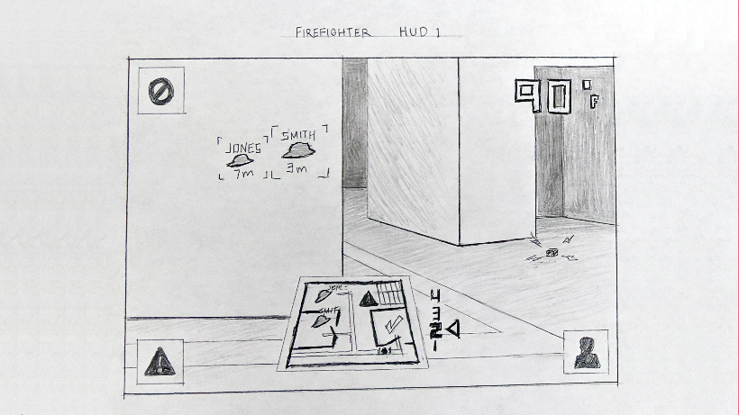

Slide 12
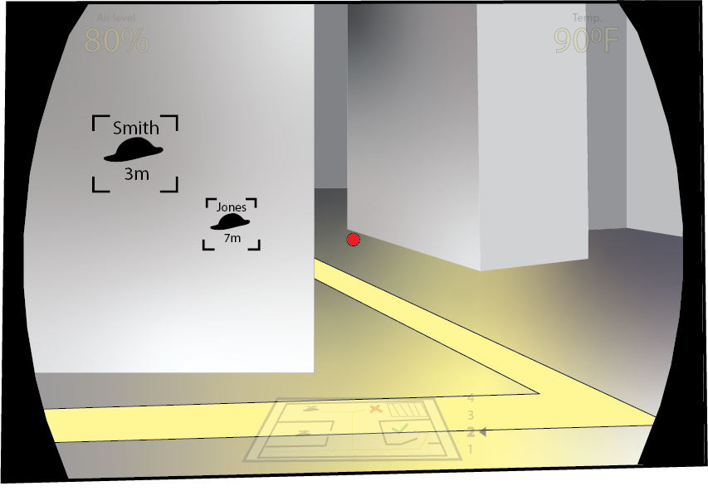

Slide 13
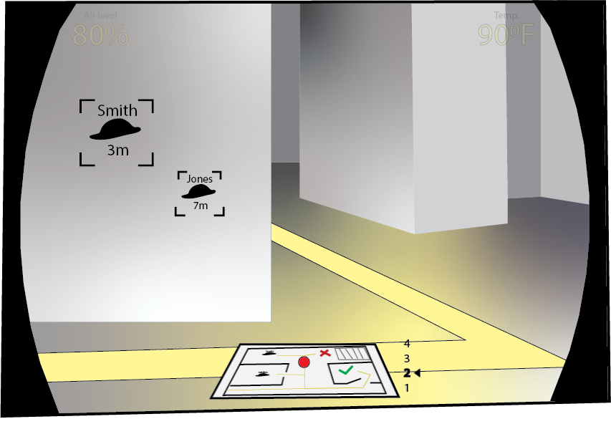

Slide 14
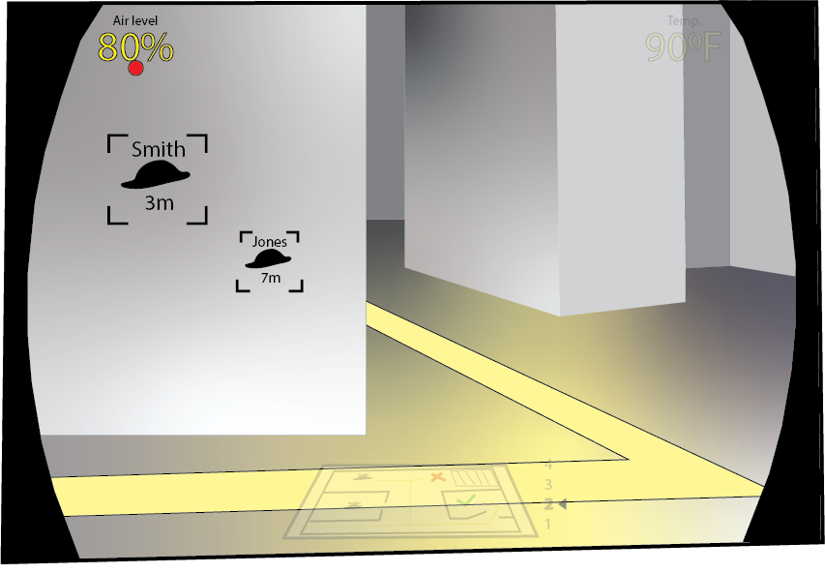

Slide 17
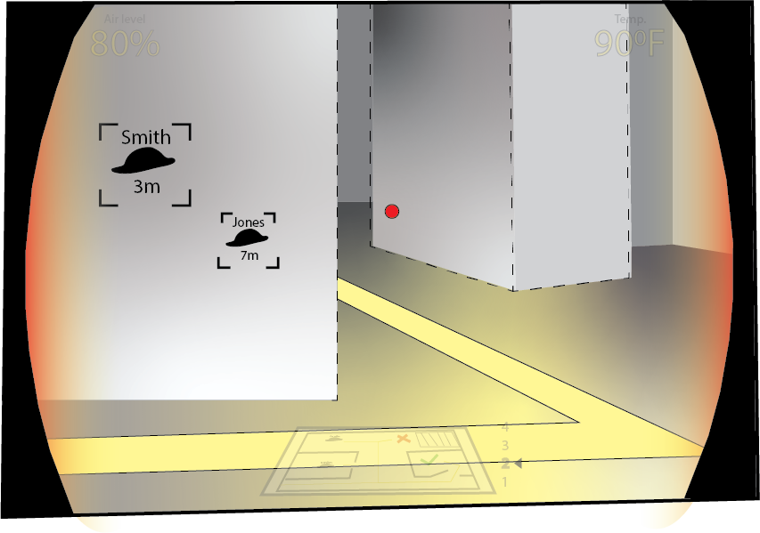

Slide 20
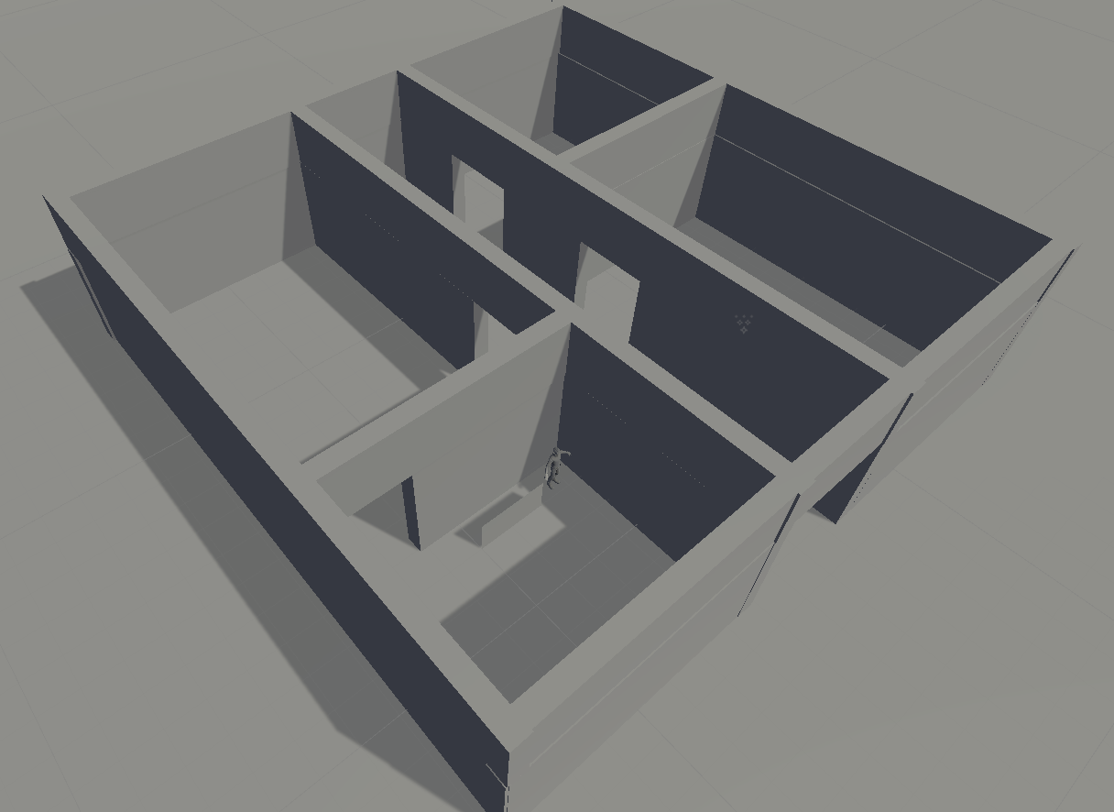
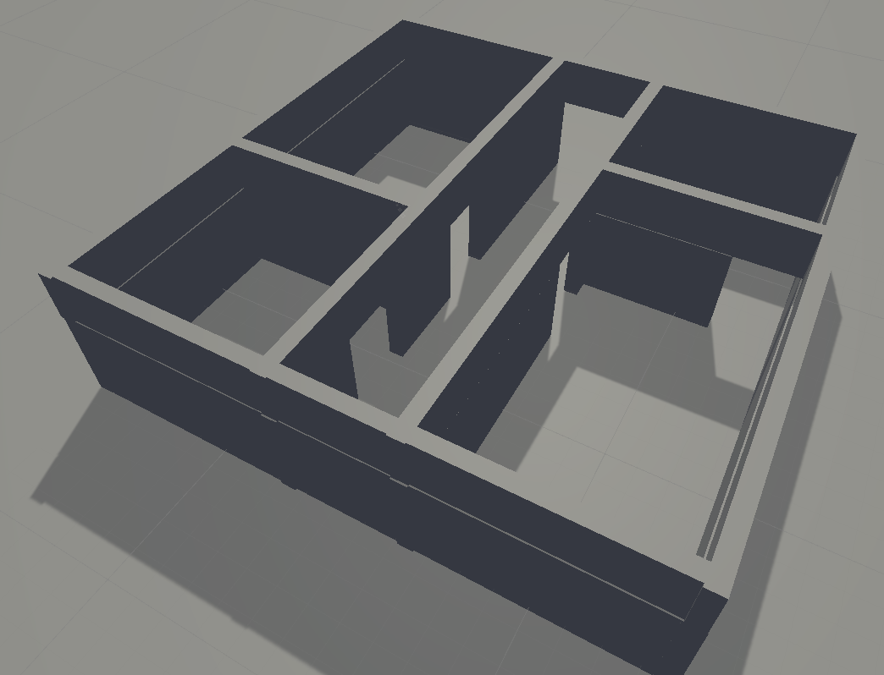

Slide 21
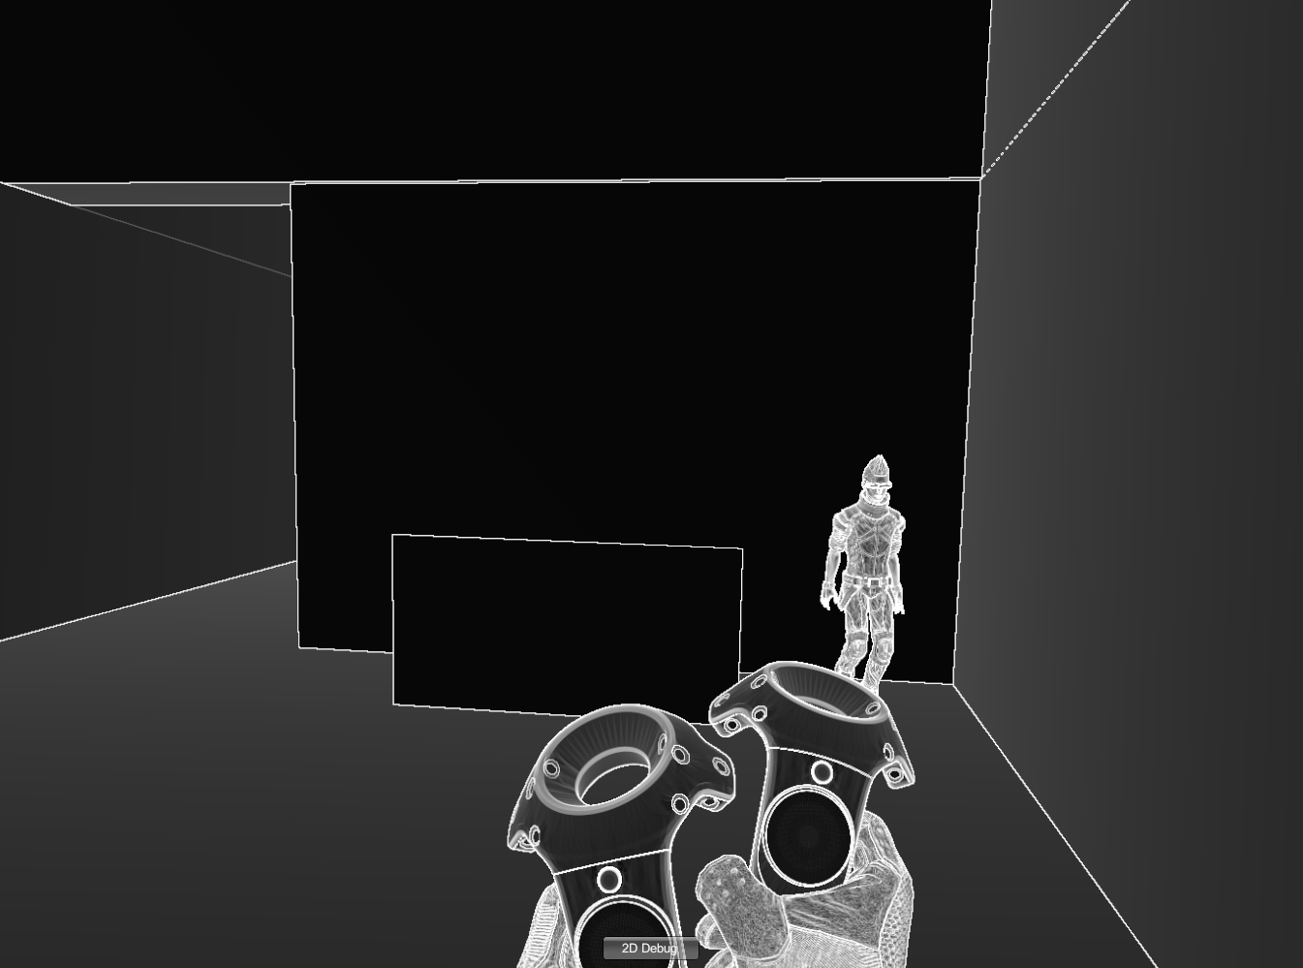

Slide 23
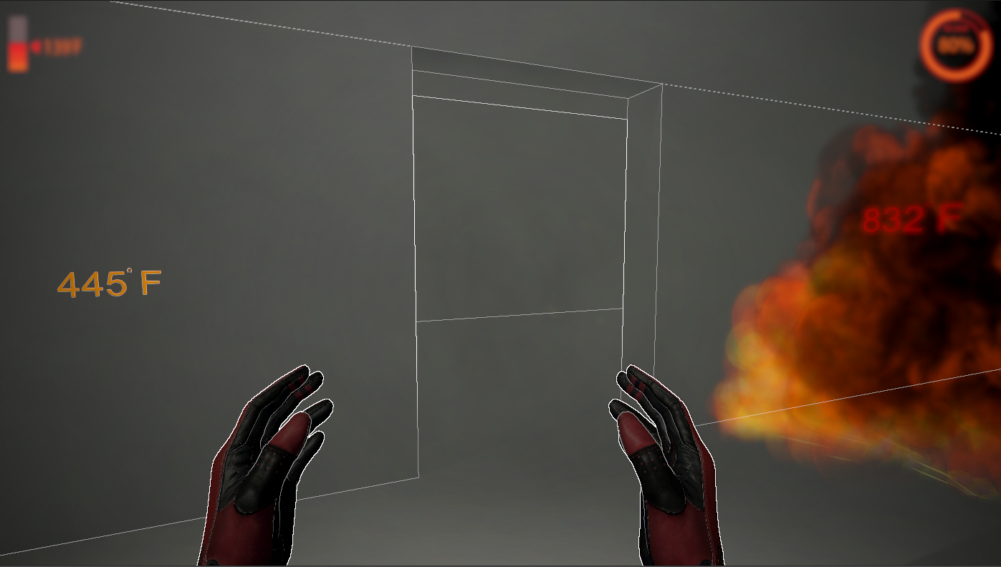

Slide 24
Questions for you
Do you have a protocol on how many people go inside the building?
What are their roles?
How they proceed the search inside the building?
Do firefighters have communication with a commander outside of the building when they are in a search and rescue?

