Slide 1
Prototyping Next-Generation User Interfaces
Hillsborough Police Dept.
1st Group Discussion

Slide 2
Goals
Present the methodology, possible scenarios and the decisions we have made
Present the possible user interface features we think could enhance the task in the chosen scenario
Discuss the procedures during a traffic stop
Discuss the features that could be included and could be removed
Q&A

Slide 3
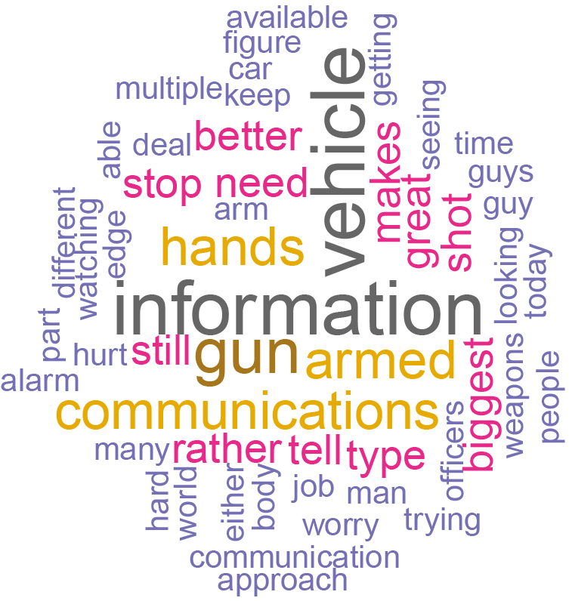
Methodology
Gather data through interviews and training observations
Speech to text conversion of the interviews
Analyze the answers and the video recordings of the training exercises
Brainstorm possible scenarios, task to simulate and user interfaces

Slide 4
Possible Scenarios
Traffic Accident Investigation
Crime Scenes
Active Shooter
Traffic Stop
Terrorism Attacks
Domestic Violence
Hostage Situations
Property Crimes
Search and Seizure
Traffic Enforcement

Slide 5
Chosen Scenario: Traffic stop
Scenario
Traffic Stop
Key Role
Police Officer who’s on duty patrolling the streets
Task to simulate
Execute the traffic stop, assess the vehicle and the occupants,
Proceed with warning, ticket or severe actions

Slide 6
Traffic Stop – Use Case Scenario
You are on patrol Saturday night at about 10:00 PM, driving along a lower‐middle‐class commercial road when you see a car with an occupant turn without signaling, causing the following car to brake suddenly. Although the action does not result an accident, you decide to pull the car over for unsafe movement. The car pulls over promptly.

Slide 7
Traffic Stop – Use Case Scenario
While you are still inside the car, the system automatically scans and runs a checking on the car's plate. After a few seconds, the HUD on the windshield displays the information about the car. (What kind of info do you receive when checking the license plate?).
The car is clear. The system also checked the owner of the vehicle. It is a male, 45yo. He is clear, as well. (it doesn't mean that the current driver is the owner of the car). Based on this information the system classifies the
Furthermore, the system automatically sends an alert to the central informing that you are proceeding a traffic stop on the car. All information (car's plate and owners is shared with the central command).
You step out of the vehicle and walk towards the car that was pulled over. Meanwhile, you tap the left side of your glass. The action activates the glass HUD. Since the traffic stop is at night time, the HUD automatically enhances your vision. You are in high alert, even if nothing seems suspicious. The HUD detected sudden movements inside the vehicle and gave you an alert.

Slide 8
Traffic Stop – Use Case Scenario
You approach the driver. You ask the driver to place his hands on the steering wheel. The driver looks at you, and the system automatically scans his face and send the picture to the central commander. You realize that the driver is not the owner of the vehicle. You proceed with the usual questions. The system automatically scans the inside of the vehicle for guns, knives, open beer bottles.
(1) The borders of the HUD become green, meaning that the driver is clear.
(2) The borders of the HUD become yellow, meaning that something requires attention with the driver, but nothing dangerous. You look at your arm display and see that his driver's license expired.
(3) The borders of his HUD become red, meaning that you should be cautious. You look at your arm an see that the driver is a criminal. You press a button on your arm, asking for backup.

Slide 9
Possible User Interface Features
Display
HUD
Forearm mounted display
Tablet, smartphone
Interactions
HUD on/off
Face scanner
Car’s plate scanner
Threat scanner
Ask backup
Haptics: touch in body parts to send information (danger, ask for help)
Audio: push-to-talk, radio
Information:
Car’s info
Owner’s info
Driver’s info
General area threat (bank robbery…)
Location: self location, location of other patrol officers
Threat identification: guns, knifes, body language
Other identification: open bottles, kidnapping…
Communication: voice, text, radio

Slide 10
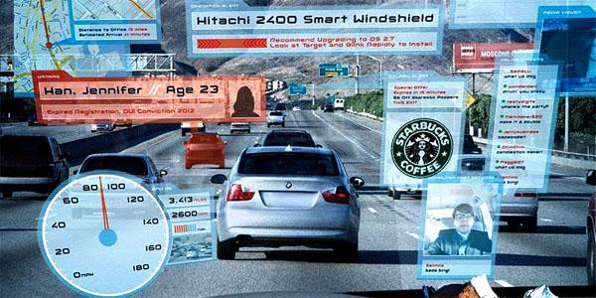
Bad Example

Slide 12
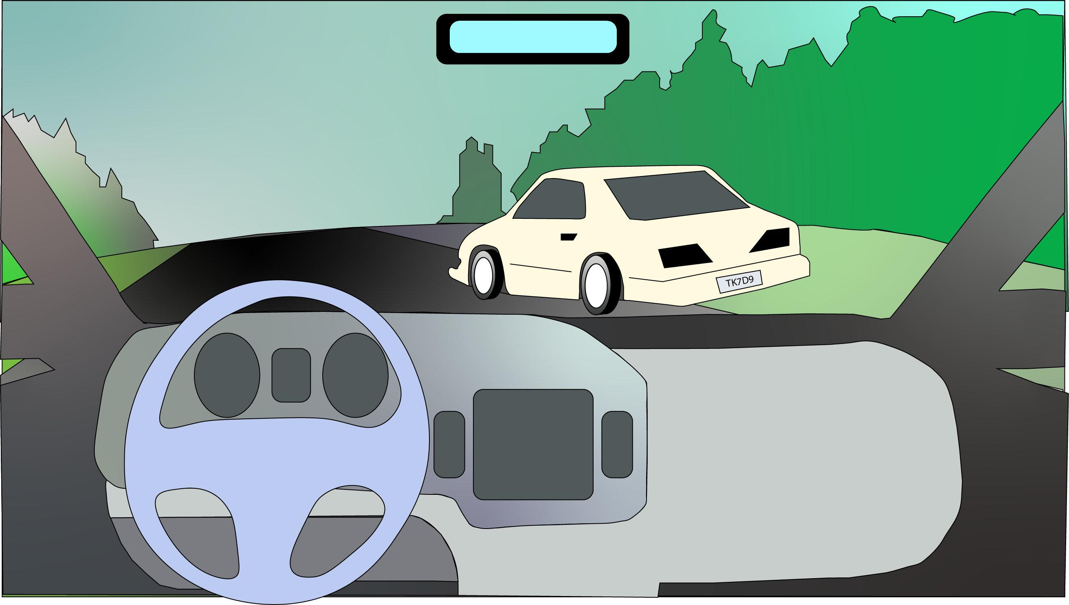

Slide 13
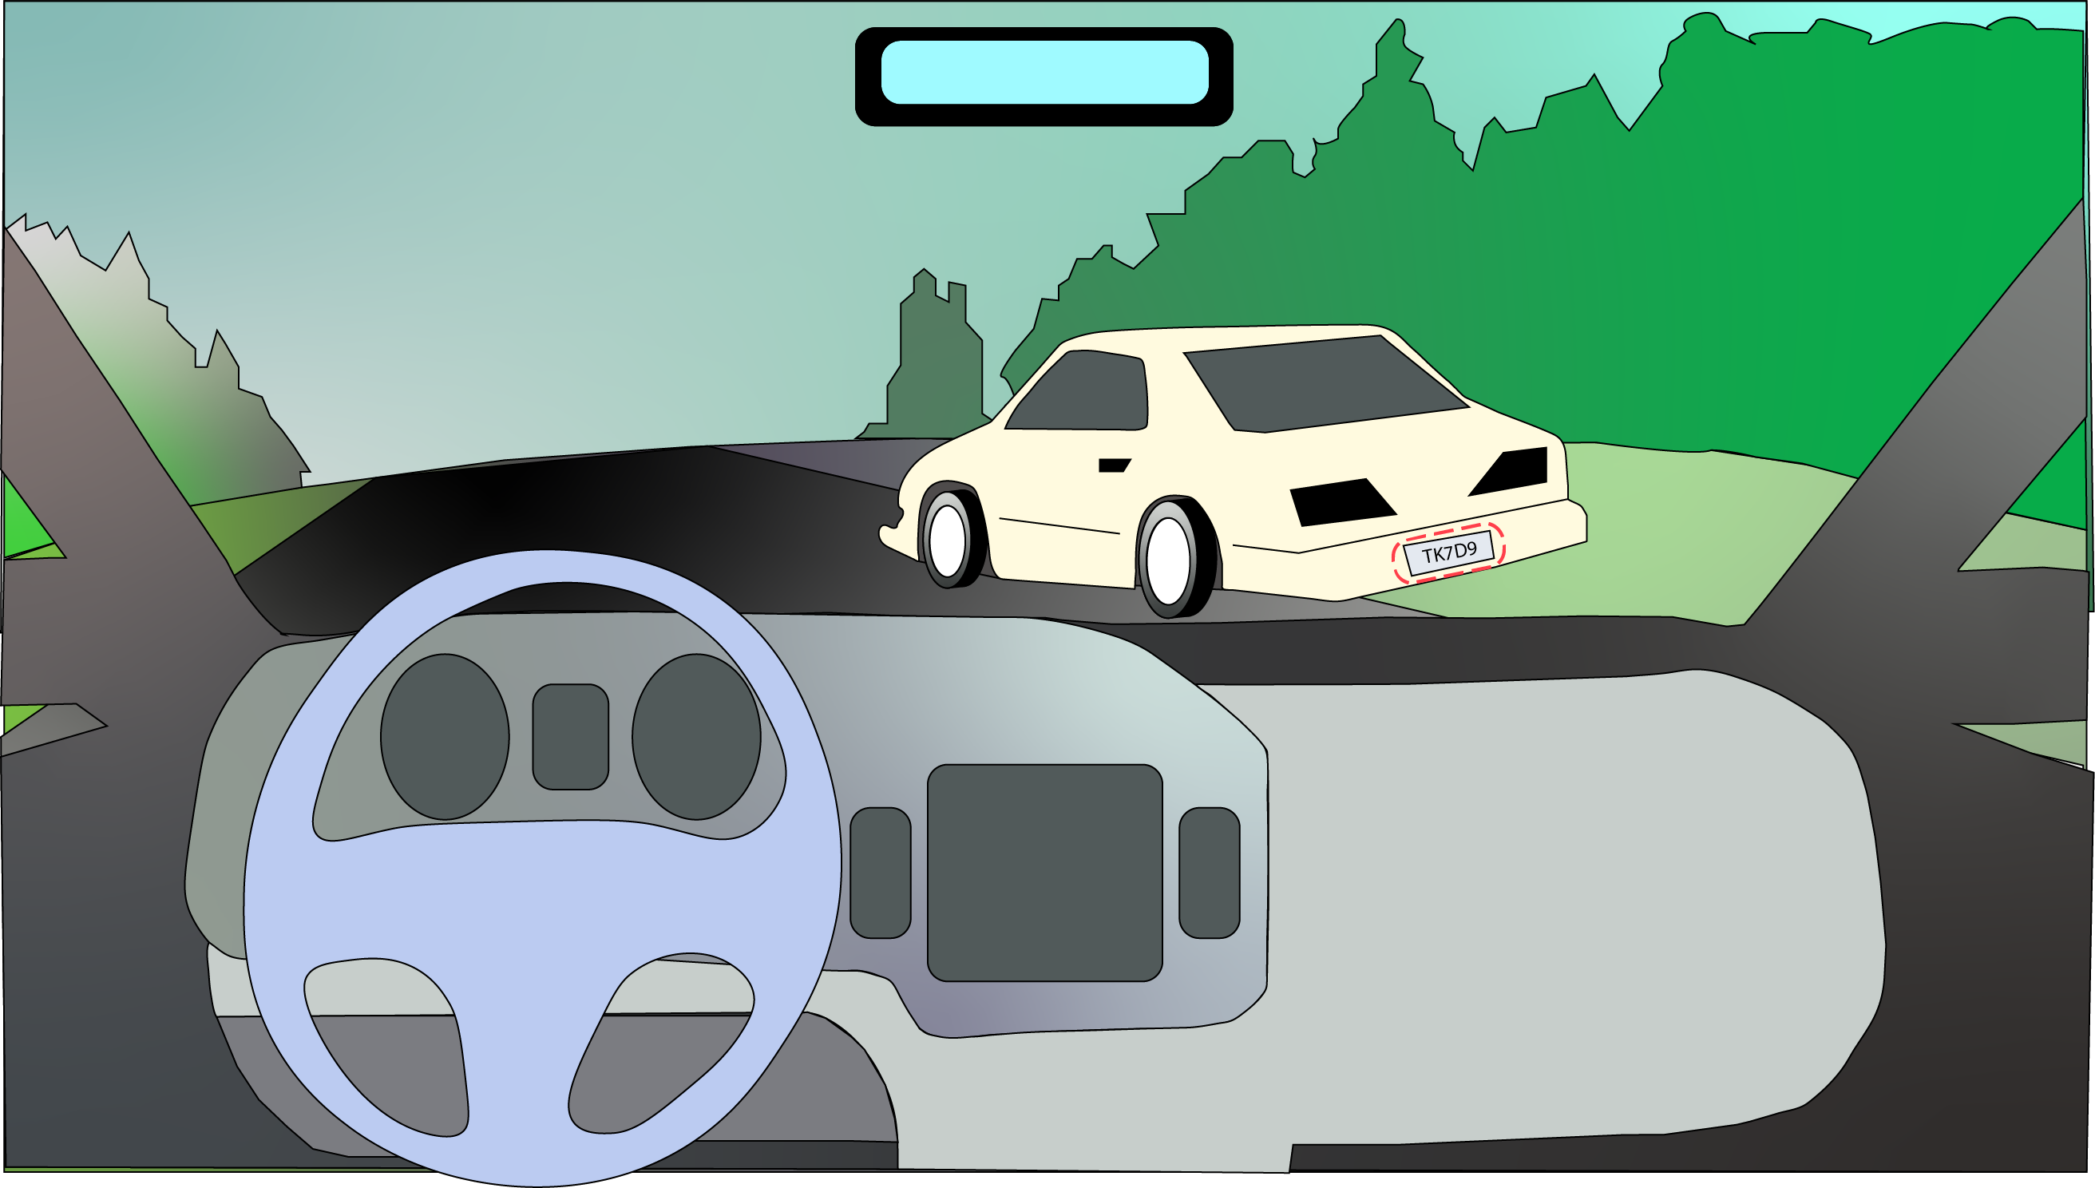

Slide 14
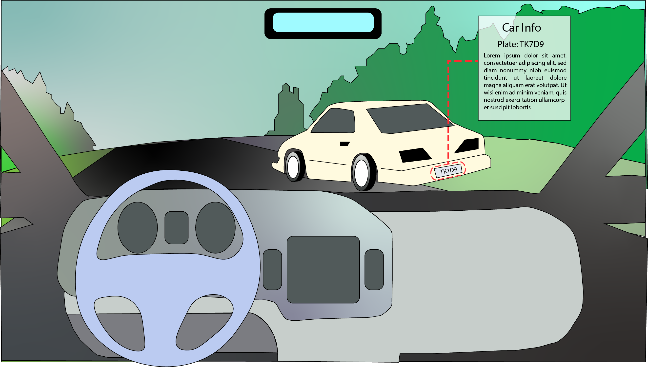

Slide 15
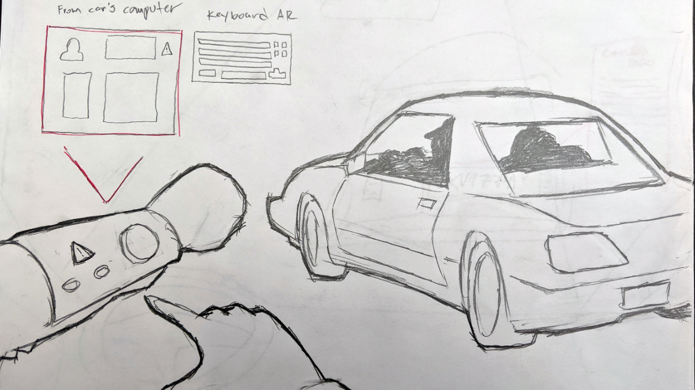

Slide 16
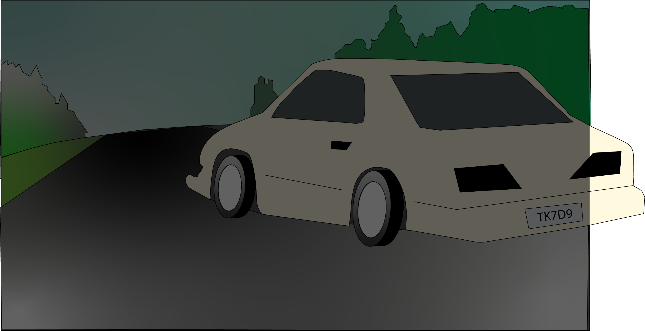
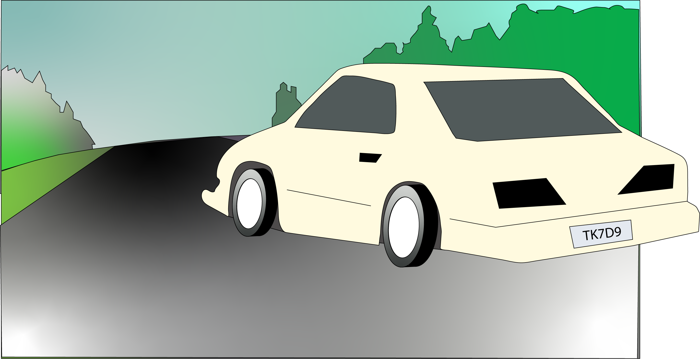

Slide 18
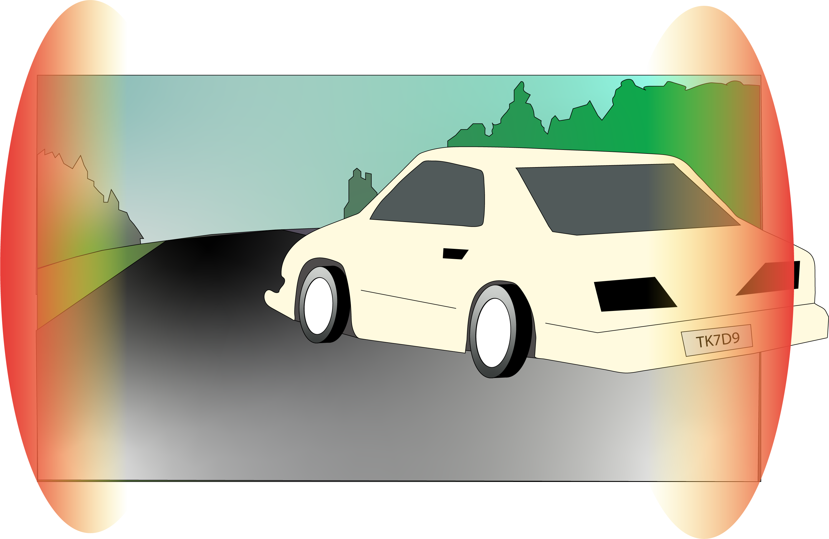

Slide 19
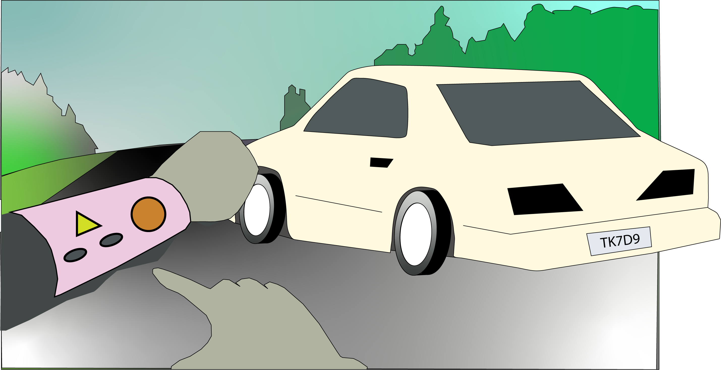

Slide 20
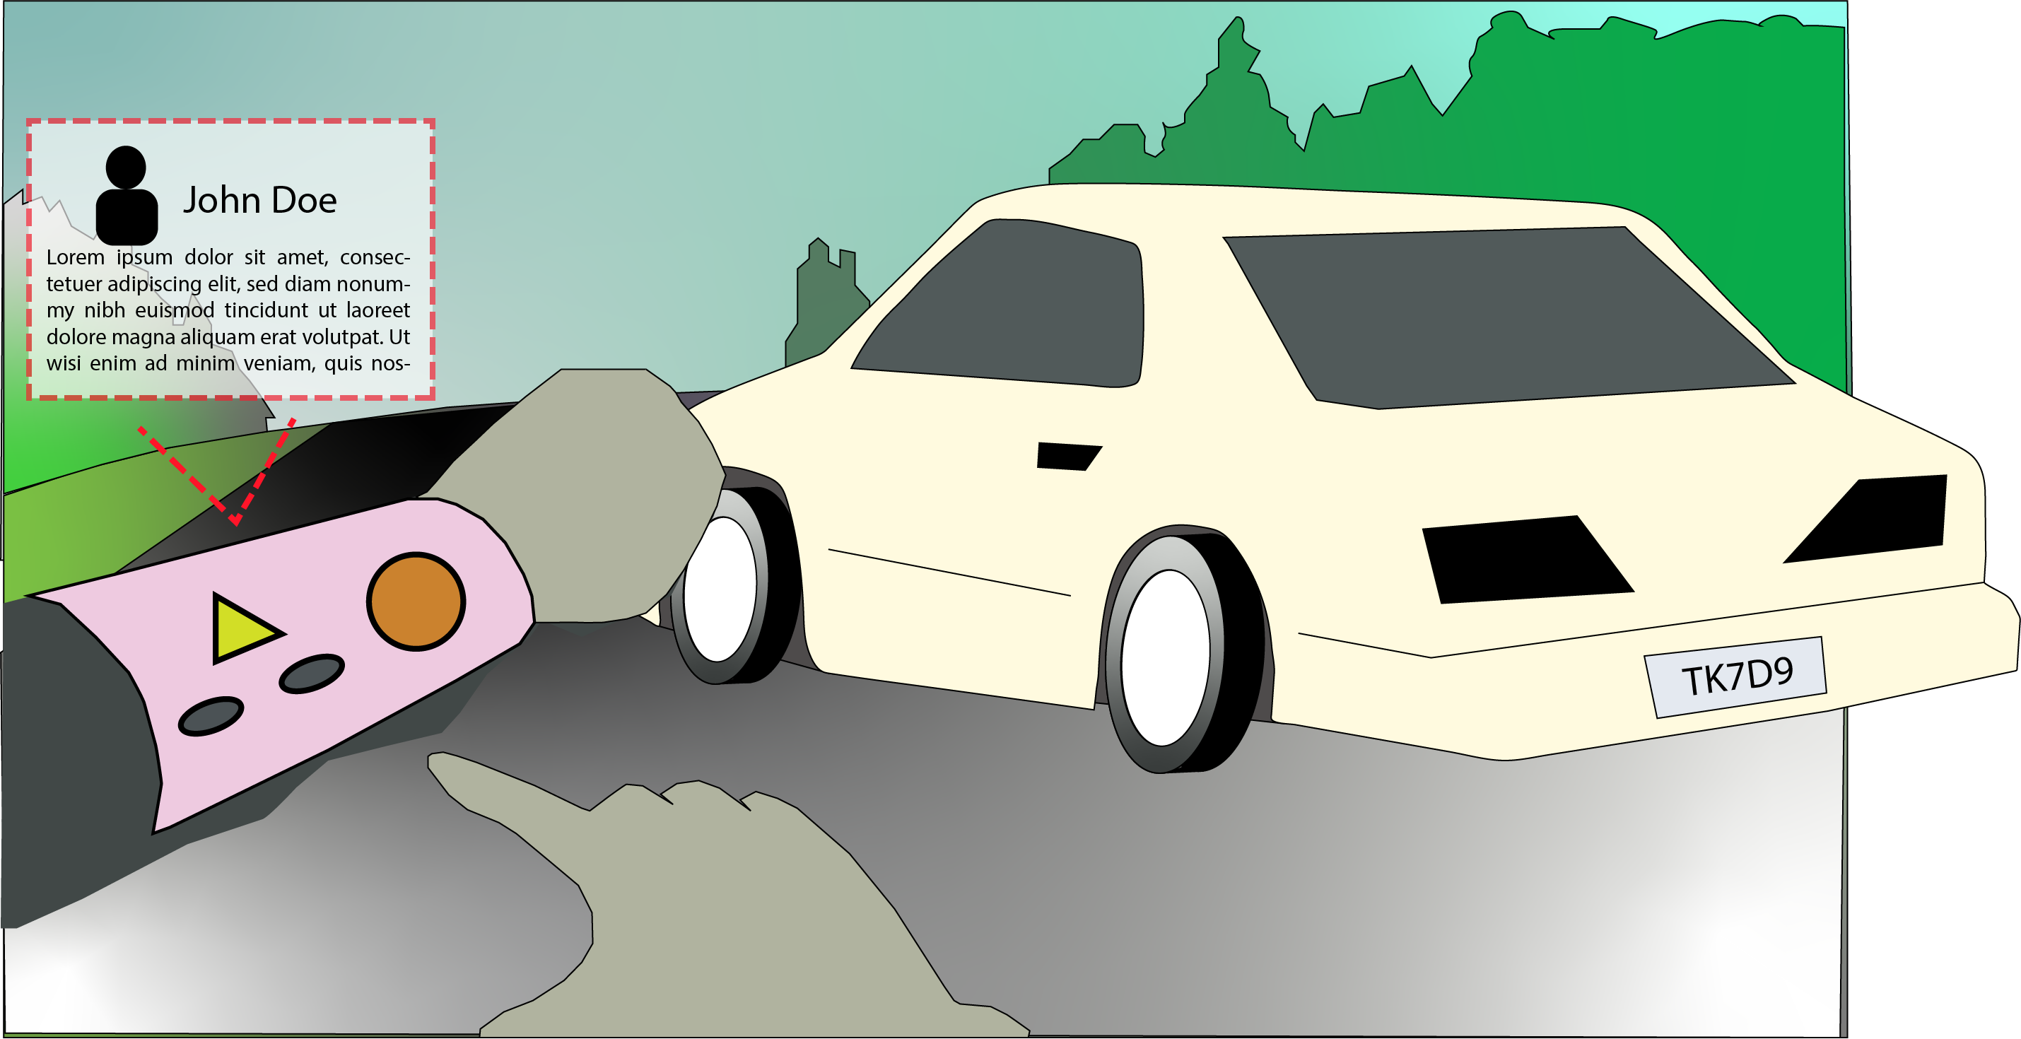

Slide 21
Questions for you
Describe the process of a traffic stop. What is the process?
What are the information you need while you are in a traffic stop?
Do you use body cameras?

