Slide 1
Prototyping Next-Generation User Interfaces
Hillsborough Police Dept.
2nd Group Discussion

Slide 2
Goals
Discuss details about interactions and features
Reasons to stop the vehicle
Interactions with the system while driving
Alerts and information while interacting with the driver

Slide 3
Chosen Scenario: Traffic stop
Scenario
Traffic Stop
Key Role
Police Officer who’s on duty patrolling the streets
Task to simulate
Execute the traffic stop, assess the vehicle and the occupants,
Proceed with warning, ticket or severe actions

Slide 4
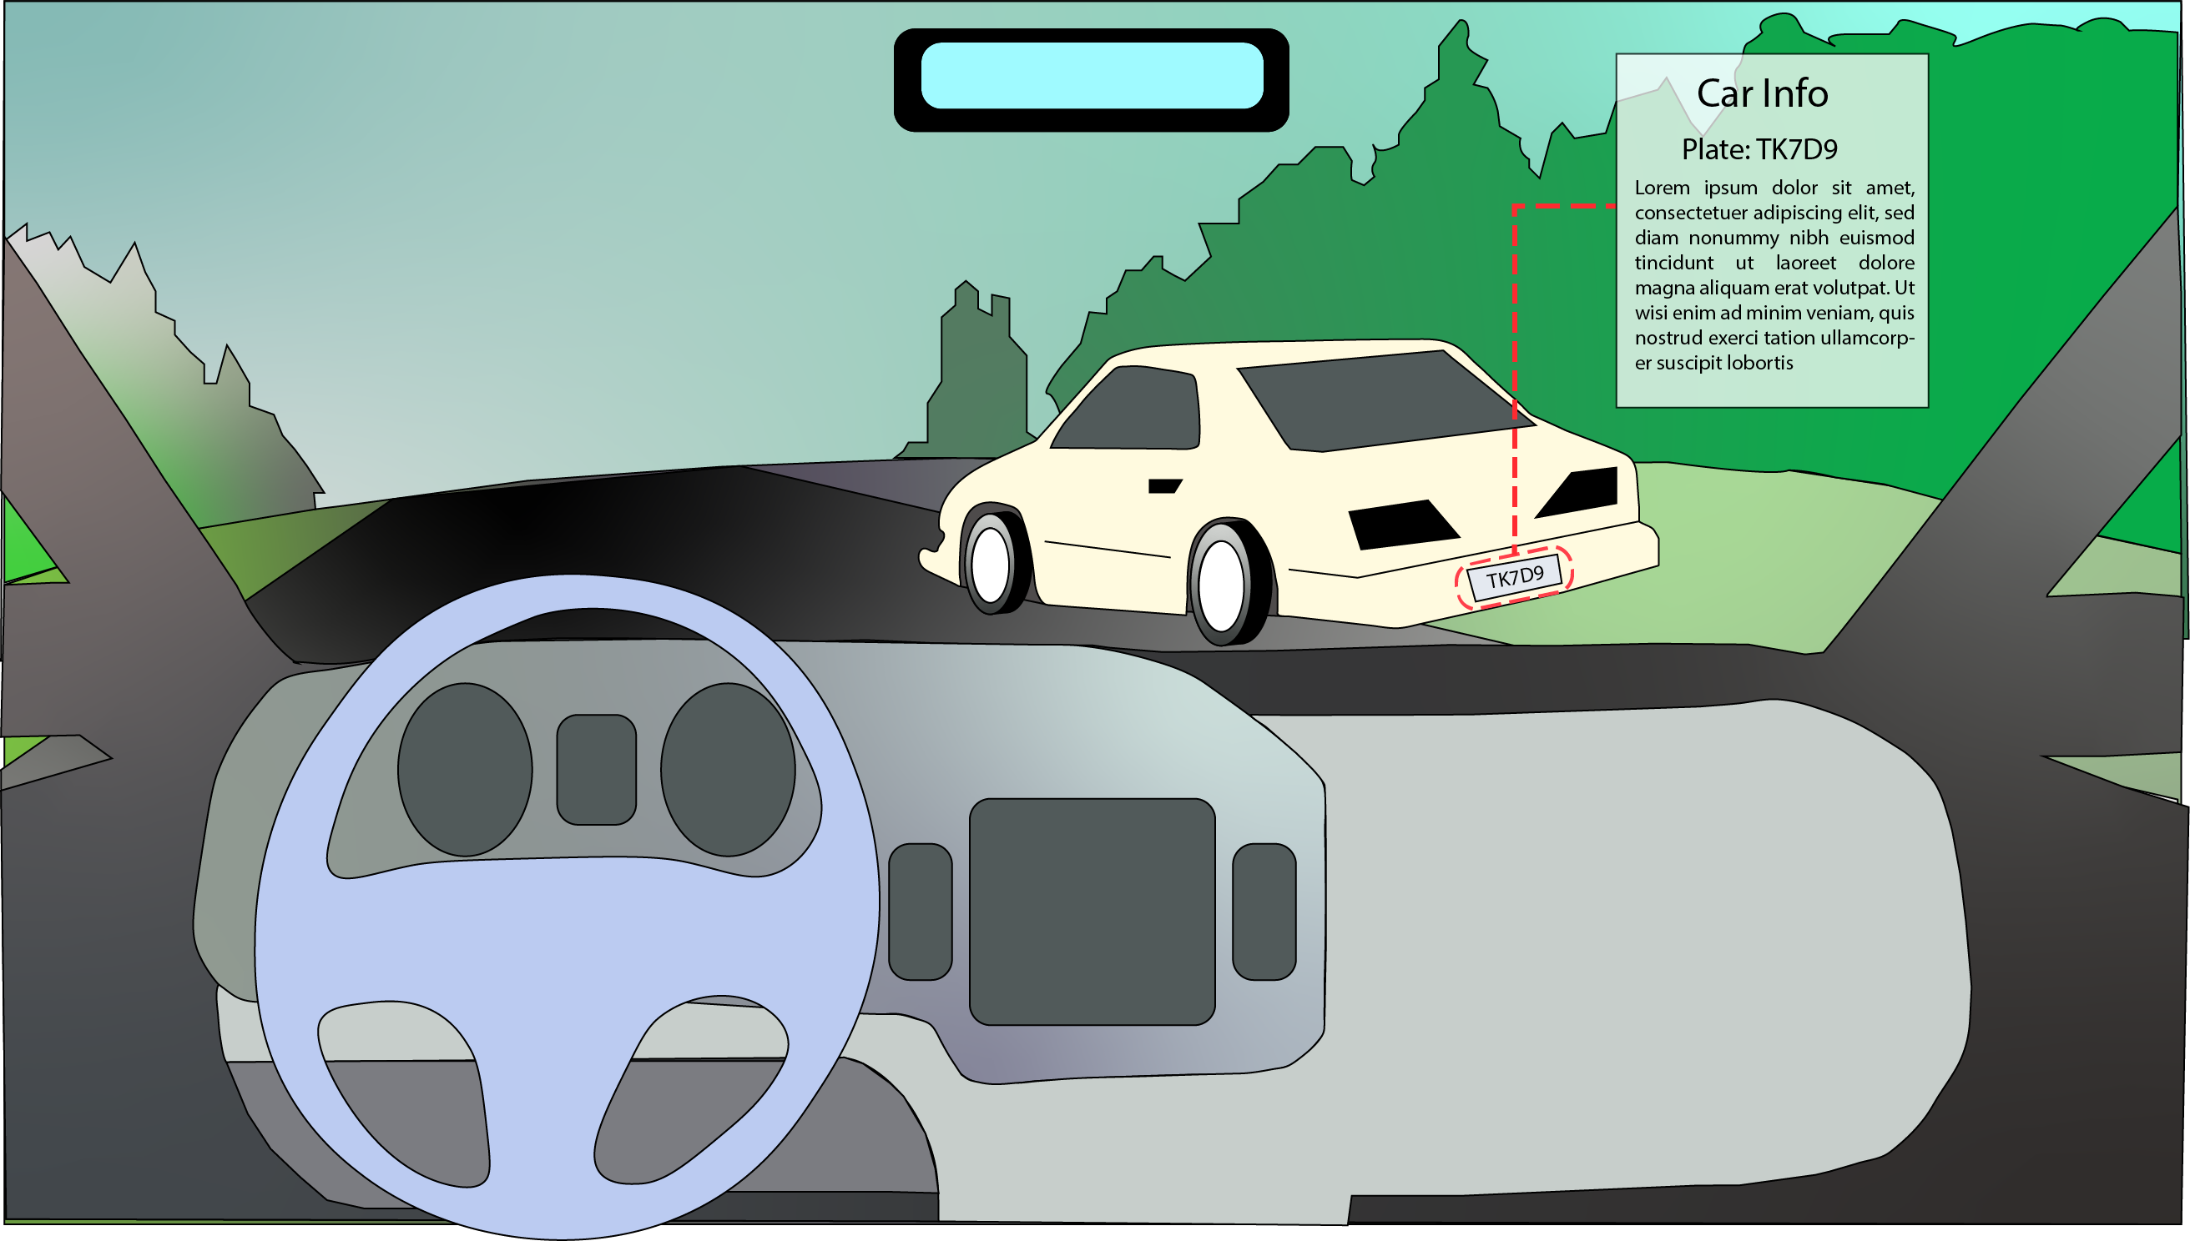

Slide 5
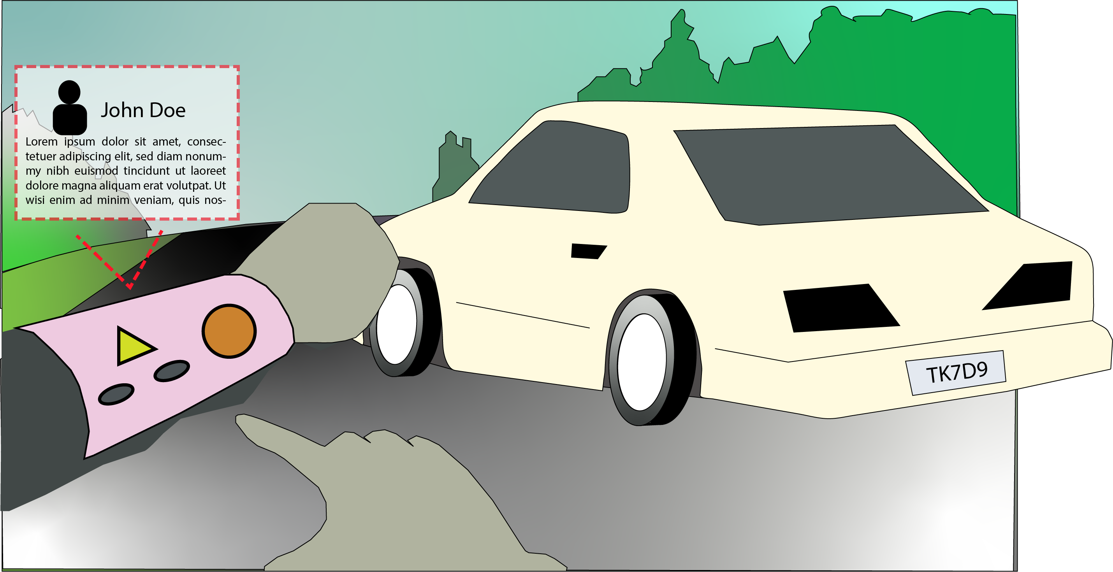

Slide 6
Reasons to stop the vehicle
Apparent reasons
Vehicle: it has irregularities (lights not working, no plates…)
Driver: broke the law
“Hidden” reasons
Vehicle:
Is the license plate valid?
Does it belong on the vehicle?
Has vehicle been involved in criminal activity?
Is the vehicle insured?
Owner: Is the owner wanted? DOC, Gang Member, Criminal Record
Driver: Is the driver wanted? DOC, Gang Member, Criminal Record

Slide 7
Reasons to stop the vehicle
Apparent reasons
Vehicle: it has irregularities (lights not working, no plates…)
Driver: broke the law
“Hidden” reasons
Vehicle:
Is the license plate valid?
Does it belong on the vehicle?
Has vehicle been involved in criminal activity?
Is the vehicle insured?
Owner: Is the owner wanted? DOC, Gang Member, Criminal Record
Driver: Is the driver wanted? DOC, Gang Member, Criminal Record
Direct observation and
judgement
Need system assistence

Slide 8
Reasons to stop the vehicle
“Hidden” reasons
Vehicle:
Is the license plate valid?
Does it belong on the vehicle?
Has vehicle been involved in criminal activity?
Is the vehicle insured?
Owner: Is the owner wanted? DOC, Gang Member, Criminal Record
Driver: Is the driver wanted? DOC, Gang Member, Criminal Record
Need system assistence
How the system could be activated to check for irregularities?

Slide 9
Reasons to stop the vehicle
How the system could be activated to check for irregularities?
Active and Passive system mode
Active: The system is automatically reading plates and alerting the officer when it identifies a problem.
Passive: The system is activated upon request by the officer when he wants to check a vehicle that he is interested in.

Slide 10
Interact with the system while driving
Problem:
It is not possible to press more than one button on the computer
Ask the central to run the plate takes a long time
Possible Solution:
Voice commands
(In case of running plates) Automatic plate recognition
Possible problems added with this interface
One more “voice device” to interact.
What would be the possible commands requests while driving?
“Run plate: BAC-5359”

Slide 11
Silent Passive mode
It only shows information alerts when there is something urgent

Slide 12
Active system
Vehicle
Owner
Driver
Plate: BAC-5359
Tag expired

Slide 13
Passive system
“Run plate: BAC-5359”
Vehicle
Owner
Driver
Plate: BAC-5359
Tag expired

Slide 14
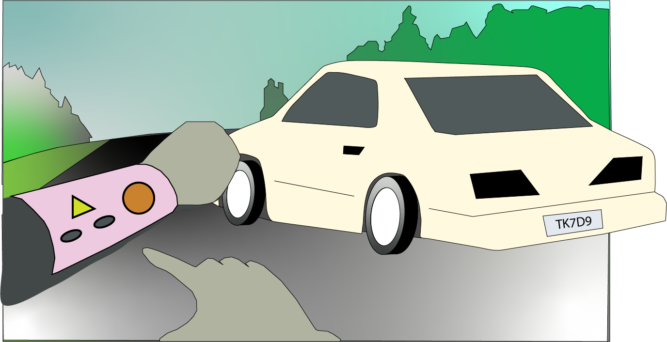
When interacting with the driver
Vehicle
Owner
Driver
John Doe
Date of birth: 06/13/1984
Driver’s License: Valid
Outstanding Warrant

