Slide 1
Requirement Analysis and Participatory Design of Next Generation Public Safety User Interfaces
DiVE Lab- Duke University
Regis Kopper, Ph.D. – Principal Investigator
Jerônimo G. Grandi, Ph.D. – Postdoctoral Associate
Mark Ogren – IT Analyst, Research Volunteer

Slide 2



About us
Regis Kopper
Jeronimo G. Grandi
Mark Ogren
Project Principal Investigator
Director of the DiVE Lab
Postdoctoral Associate – DiVE Lab
Ph.D. in Computer Science
IT Analyst at Duke
User Services Specialist
Volunteer

Slide 3
Project Motivation
Project title: Design, Prototyping and Evaluation of Next Generation Public Safety User Interfaces
The project addresses Goal 2 of the NIST Public Safety Innovation Accelerator Program – User Interface (PSIAP-UI): Research on the Effectiveness and Transferability of AR/VR Simulations.
Enabled by FirstNet: new era of crisis management
  Interoperable high-speed broadband LTE network
  Handle critical situations that goes beyond a common voice communication channel
First responders will have the opportunity to:
  Learn the precise location of indoor and outdoor points of interest
  Receive real-time data analytics that are relevant to the mission
  Have assurances for clear and reliable mission critical voice communications

Slide 4
Project Motivation
The reality of public safety involves complex scenarios with many factors at play
PSOs equipment and interfaces are not currently designed to take advantage from the possibilities enabled by FirstNet
Effective interactions need to be developed into novel systems operated by first responders
These technologies need to help the first responders to solve their real problem and not add another layer of complexity in their workflow.

Slide 5
Project Goals
To Design, prototype and evaluate user interfaces for the next generation public safety ecosystem and its first responders.
For three main disciplines
Emergency Medical Services
Law Enforcement
Fire Fighting

Slide 6
Project Goals
To Design, prototype and evaluate user interfaces for the next generation public safety ecosystem and its first responders.
How?
User-centered approach that can make the deployment and adoption of next-generation user interfaces reflect the first responders requirements and contexts of use.

Slide 7
Project Goals
To Design, prototype and evaluate user interfaces for the next generation public safety ecosystem and its first responders.
How?
Partner with local PSOs in order to fully understand the needs and expectations of first responders
  First responders contribute through their feedback and experience
Immersive Virtual Reality (VR) as a simulation platform to evaluate UI designs.
  Through VR, we can achieve high levels of realism with computer simulation.
  There are no risks to the user
  Simulations can be repeated and tweaked as many times as necessary with little effort
Notes:
Our goal is to design and test new user interfaces that leverage upcoming technology.

Slide 8
Projected Outcomes
The final outcome of the project will have a transformative impact on all public safety disciplines by offering a collection of user interfaces that have been demonstrated to be effective and efficient in the context of each PSO specific requirements.
When technology becomes available, the designed PSUIs will be instrumental for the adoption of next generation user interfaces by the public safety community.

Slide 9
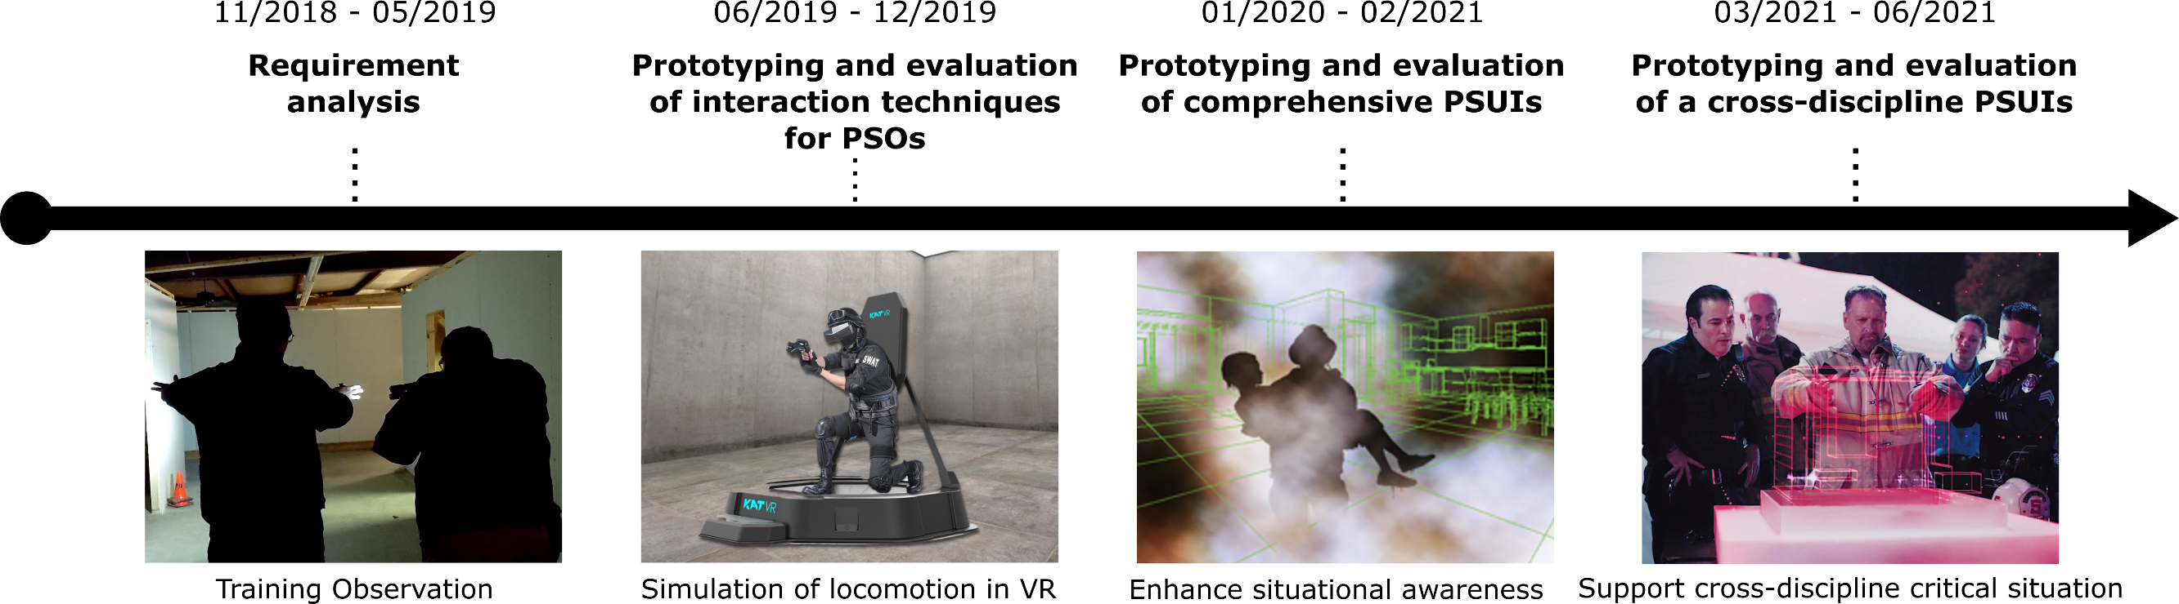
Project Overview
Notes:
The project contains 4 phases. Each phase is incremental on each other. So we can advance toward the final goal
Here we present an overview of the phases.

Slide 10

Project Overview
Close observation and documentation of the culture at each of the PSOs
  Participatory Design: meetings and interviews, training observation, shadow operations
Notes:
We have completed the requirement analysis phase of the project and we will detail its results in this presentation.

Slide 11
Project Overview
Travel, selection and manipulation tasks in VEs in the context of identified critical elements for each public safety disciplines
The main goal of this phase is to establish what techniques are most efficient
Notes:
After understanding the critical tasks for each public safety discipline, we will implement UIs that aim specifically at addressing the identified demands.

Slide 12
Project Overview
Combine most effective interaction techniques with cognitive aids for enhanced situational awareness and wayfinding
Notes:
we will use the findings from phase 2 as input in the design of comprehensive UIs for fire fighting, EMS and law enforcement.

Slide 13
Project Overview
Leverage the interfaces designed in the previous phases in to simulation of a critical situation that needs a response from Fire, EMS and Law Enforcement

Slide 14
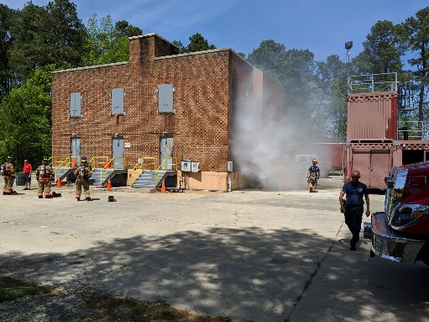
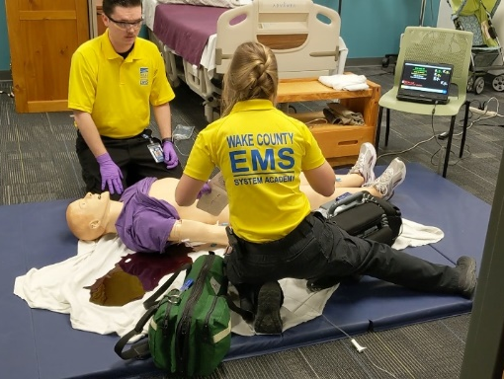
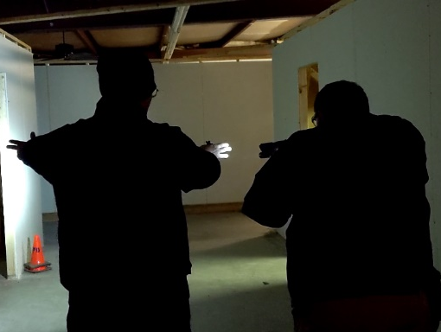
Requirement Analysis

Slide 15


Requirement Analysis
Methodology - PSOs
Since each public safety discipline has unique requirements and protocols, we have partnered with three PSOs:
Wake County EMS
Hillsborough Police Department
Durham Fire Department
Through participatory design, these PSOs helped us understand their processes and find opportunities for the design of next generation user interfaces
Formative feedback on initial UI prototypes.

Slide 16
Requirement Analysis
Methodology - Phases
Information Gathering
Design and Prototyping of UIs
Meetings
Data analysis
Research team brainstorming
Interviews
User interface designs
Training observation
Group discussions
Ride-alongs
Prototype refinement

Slide 17
Requirement Analysis
Methodology - Phases
Information Gathering
Meetings
Meeting with PSO Chiefs
  Project presentation
  Plan for interviews and training observations
  Assignment of core group of first responders (4-6 people)
Meeting with the core group
  Project presentation
  Approach to accomplish the objectives
  First responders roles in the project
  Q&A
Interviews
Training observation
Ride-alongs

Slide 18
Requirement Analysis
Methodology - Phases
Information Gathering
Meetings
1-1 Interviews with first responders of the core group.
Demographic questionnaire
Semi-structured interviews
Interview questions based on the “Voice of First Responders” (Dawkins et al. 2018)
  Emphasis on the technology that they think would be helpful in their context
IRB protocol for interviews
Interviews
Training observation
Ride-alongs

Slide 19
Requirement Analysis
Methodology - Phases
Firefighters
Search and Rescue training in a burning building
Information Gathering
Meetings
EMS
Gunshot wound trauma
Interviews
Training observation
Law Enforcement
Search for suspicious subjects inside a house
Ride-alongs

Slide 20
Requirement Analysis
Methodology - Phases
Information Gathering
Meetings
Capture first responders’ procedures and environmental conditions
Equipment and devices used
Difficulties with the use of current technology
Interviews
Training observation
Ride-alongs

Slide 21
Requirement Analysis
Methodology - Phases
Information Gathering
Design and Prototyping of UIs
Meetings
Data analysis
Research team brainstorming
Interviews
User interface designs
Training observation
Group discussions
Ride-alongs
Prototype refinement

Slide 22
Requirement Analysis
Methodology - Phases
Information Gathering
Design and Prototyping of UIs
Meetings
Data analysis
Research team brainstorming
Interviews
User interface designs
Training observation
Group discussions
Ride-alongs
Prototype refinement

Slide 23
Requirement Analysis
Methodology - Phases
Design and Prototyping of UIs
Data analysis
Tabulate the demographic data
Speech-to-text transcription of interview recordings
  IBM Watson (70%-98% confidence)
  Human revision
Text analysis tools
  Terms frequency
  Word cloud
Research team brainstorming
User interface designs
Group discussions
Prototype refinement

Slide 24
Requirement Analysis
Methodology - Phases
Design and Prototyping of UIs
Data analysis
Scenario selection
Key role identification
Task identification
Next-generation UI to support identified task
Research team brainstorming
User interface designs
Group discussions
Prototype refinement

Slide 25
Requirement Analysis
Methodology - Phases
Design and Prototyping of UIs
Data analysis
Each PSO has their own needs
Display technology
  HUD, Handheld, arm-mounted,…
Interactions
  Gestures, buttons, eye-gaze, haptics,…
Information
  Patient data, criminal background, risk assessment, general situational awareness,…
Research team brainstorming
User interface designs
Group discussions
Prototype refinement

Slide 26
Requirement Analysis
Methodology - Phases
Design and Prototyping of UIs
Data analysis
Re-engage with first responders’ core group
Present the chosen scenario
Introduce the UI elements through a use case narrative
Discuss UI designs
Collect feedback
Research team brainstorming
User interface designs
Group discussions
Prototype refinement

Slide 27
Requirement Analysis
Methodology - Phases
Design and Prototyping of UIs
Data analysis
Analyze audio recordings of the group meetings
Identify points that need improvement
Refine interactions and interfaces
Add new elements for a second group discussion
Research team brainstorming
User interface designs
Group discussions
Prototype refinement

Slide 28
Requirement Analysis
Methodology - Phases
Information Gathering
Design and Prototyping of UIs
Meetings
Data analysis
Research team brainstorming
Interviews
User interface designs
Training Observation
Group discussions
Ride-along
Prototype refinement

Slide 29
Requirement Analysis
Results

Slide 30
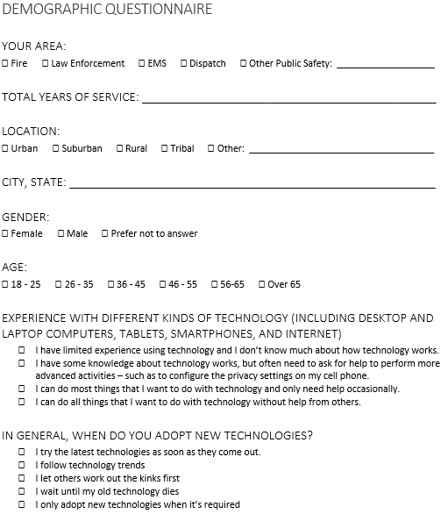
Requirement Analysis
Results – 1-1 Interviews
Demographics Questionnaire
13 first responders interviewed (2 female)
  Durham Fire: 4
  Wake County EMS: 5
  Hillsborough Police: 4
Years of service average: M=18 (SD=8.11)
  One first responder with only 2 years of service
100% work at urban area
  4 also work in suburban area
  3 also work in rural area
Experience with tech (1-4): M=2.7 (SD=0.69)
Willingness to adopt new tech (1-5): M=3 (SD=1.03)

Slide 31
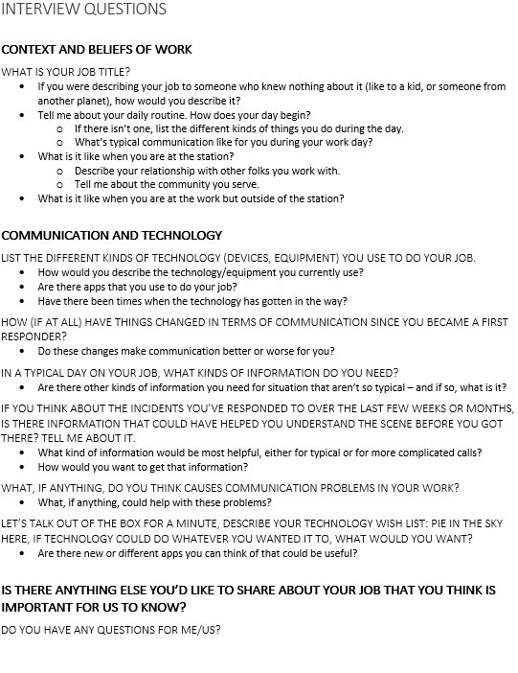
Requirement Analysis
Results – 1-1 Interviews
Semi-structured Interviews
~6h of recordings (~25 minutes each interview)
Audio to text transcripts: IBM Watson Text to Speech
  Good accuracy, but need an extra revision step
  Allows for text analysis
Identification of possible use-case scenarios
Identification of desired user interfaces

Slide 32
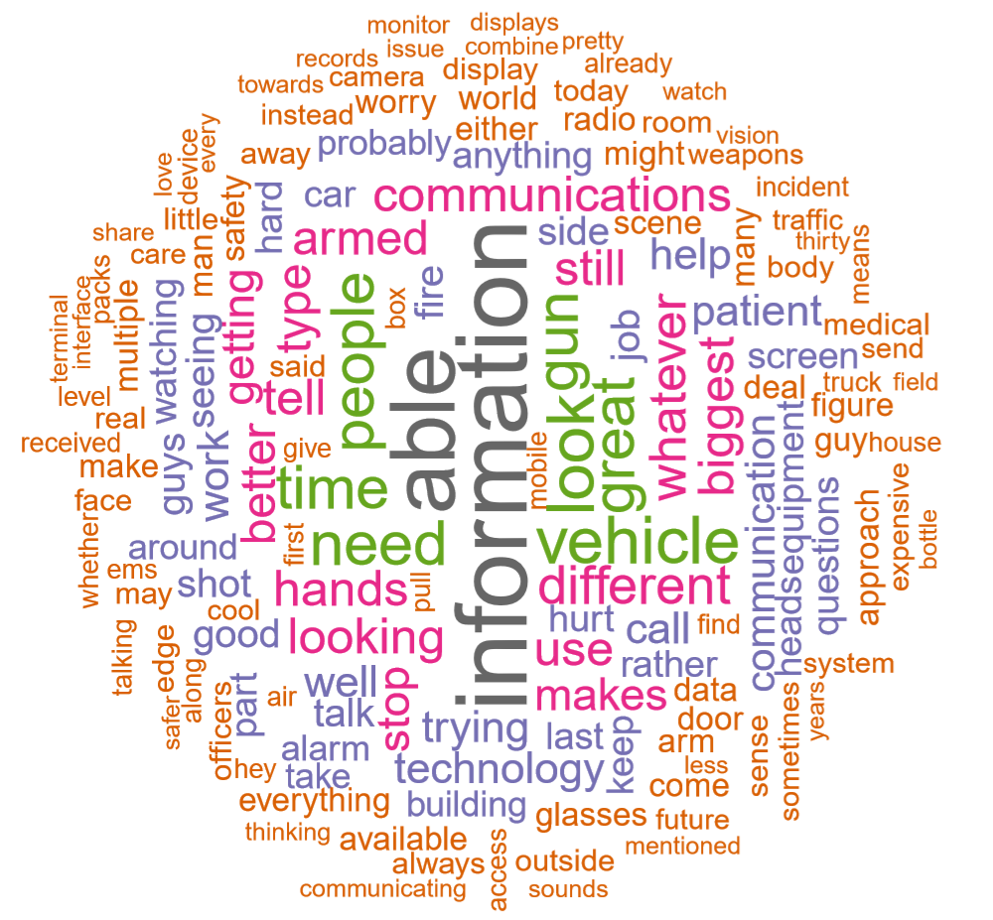
Requirement Analysis
Results – Text Analysis

Slide 33
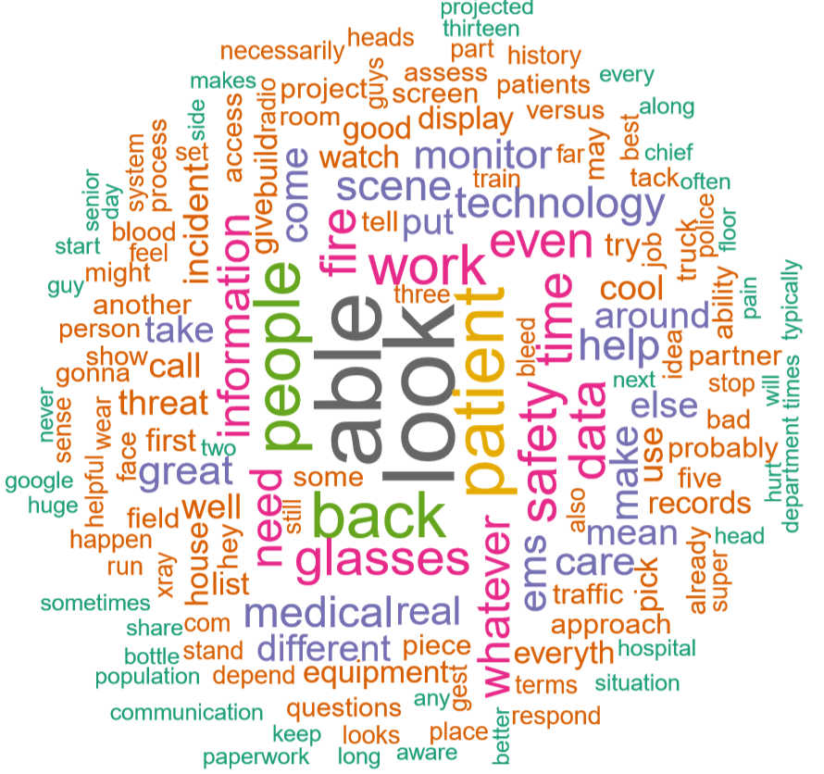
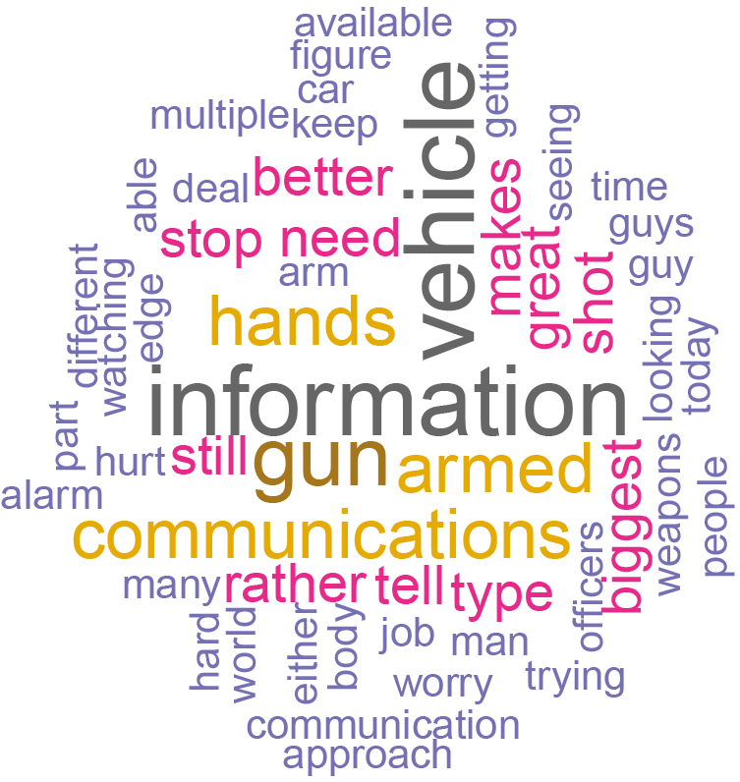
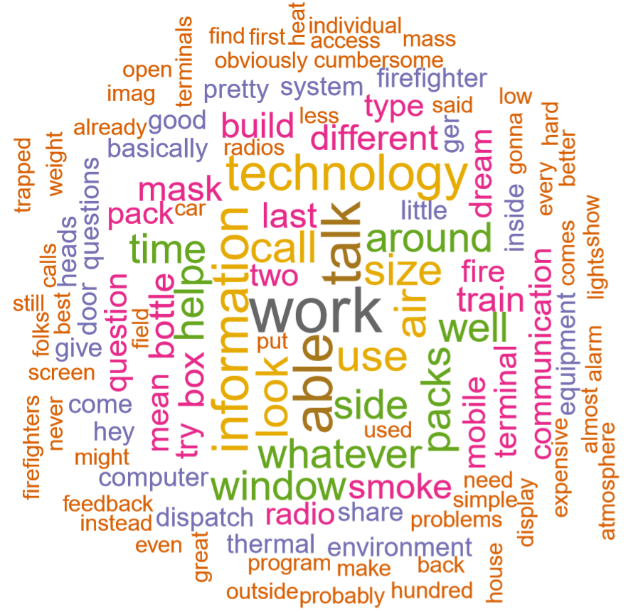



Requirement Analysis
Results – Text Analysis for each PSO
EMS
LE
FF

Slide 34
Activities done with PSOs
Emergency Medical Services
Law Enforcement
Firefighters
1-on-1 Interviews: 5
Training observations: 2
Group discussions: 2
1-on-1 Interviews: 4
Training observations: 1
Group discussions:2
Ride-alongs: 1
1-on-1 Interviews: 4
Training observations: 1
Group discussions: 2

Slide 35
Requirement Analysis
Challenges
Logistic Challenges
Research Challenges
Although PSOs were excited about the project and willing to contribute, they have a busy schedule.
Scheduling of meetings, interviews, training observations required some negotiation
Re-scheduling
Collect the first responders perception without the influence of our ideas about the project
Capture their needs and requests

Slide 36

Public Safety User Interfaces Resource Library
https://sites.duke.edu/psui/
The knowledge generated by this project will be maintained and made available to the public.
PSOs around the country and industry providers will be able to leverage the materials and methods used in the design, prototyping and evaluation of next generation user interfaces.

Slide 37
Next Steps

Slide 38
Project Overview

Slide 39

Design, Prototyping and Evaluation of
Next Generation Public Safety User Interfaces
DiVE Lab- Duke University
Regis Kopper, Ph.D. – regis.kopper@duke.edu
Jerônimo G. Grandi, Ph.D. – jeronimo.grandi@duke.edu
Mark Ogren – mark.ogren@duke.edu

Slide 40
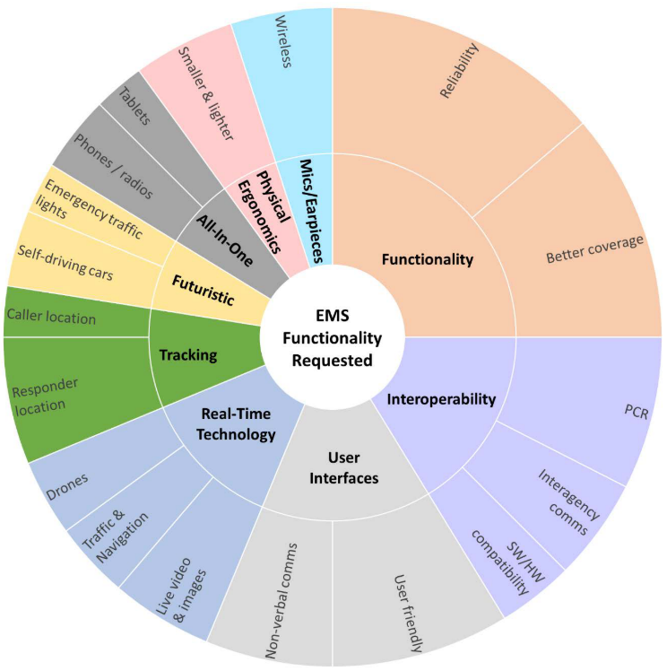
Requirement Analysis - EMS
Functionality Requested
(“Voices of First Responders” Dawkins et al. 2018)
“Trauma glasses”: body scanner for injuries, patient vital info
Safety: discrete way to communicate with the partner to inform a dangerous situation while assessing the patient.
Real time traffic
Better way to communicate with other PSOs
Information about the patient: medical history, allergies,…–fast assessment
Equipment portability

Slide 41
Requirement Analysis - EMS
1st Chosen Scenario: Gunshot Wound to Upper Chest
Scenario
Gunshot Wound to Upper Chest
Key Role
EMS Paramedic
Task to simulate
Assess a trauma patient, control bleeding

Slide 42
Requirement Analysis - EMS
1st Chosen Scenario: Gunshot Wound to Upper Chest
Issues identified with first responders
10-minute window
Removal to hospital ASAP
Limited Assessment

Slide 43
Requirement Analysis - EMS
1st Chosen Scenario: Gunshot Wound to Upper Chest
Issues identified with first responders
10-minute window
Removal to hospital ASAP
Limited Assessment
Better scenario: first responder on scene for an extended period of time

Slide 44
Requirement Analysis - EMS
2nd Chosen Scenario: Complicated Medical Call
Scenario
65-year-old burned while cooking at home
Key Role
EMS Paramedic
Task to simulate
Assess the patient, identify how much of the patient’s body is burned, decide if the burn is considered critical, initial burn care, control bleeding and other injuries due to the fall, notify the medical center
Notes:
You are responding to 67yo, male patient reported having burns on his right arm and right-side chest in a middle-low income area on Wednesday evening at about 10:00 PM. The victim got up too quickly to turn off the stove, became light-headed due to low blood pressure, and passed out while moving a pot full of boiling water. He fell to the floor, spilling boiling water on himself. The container was glass, and he sustained multiple laceration/cuts to his left arm.

Slide 45
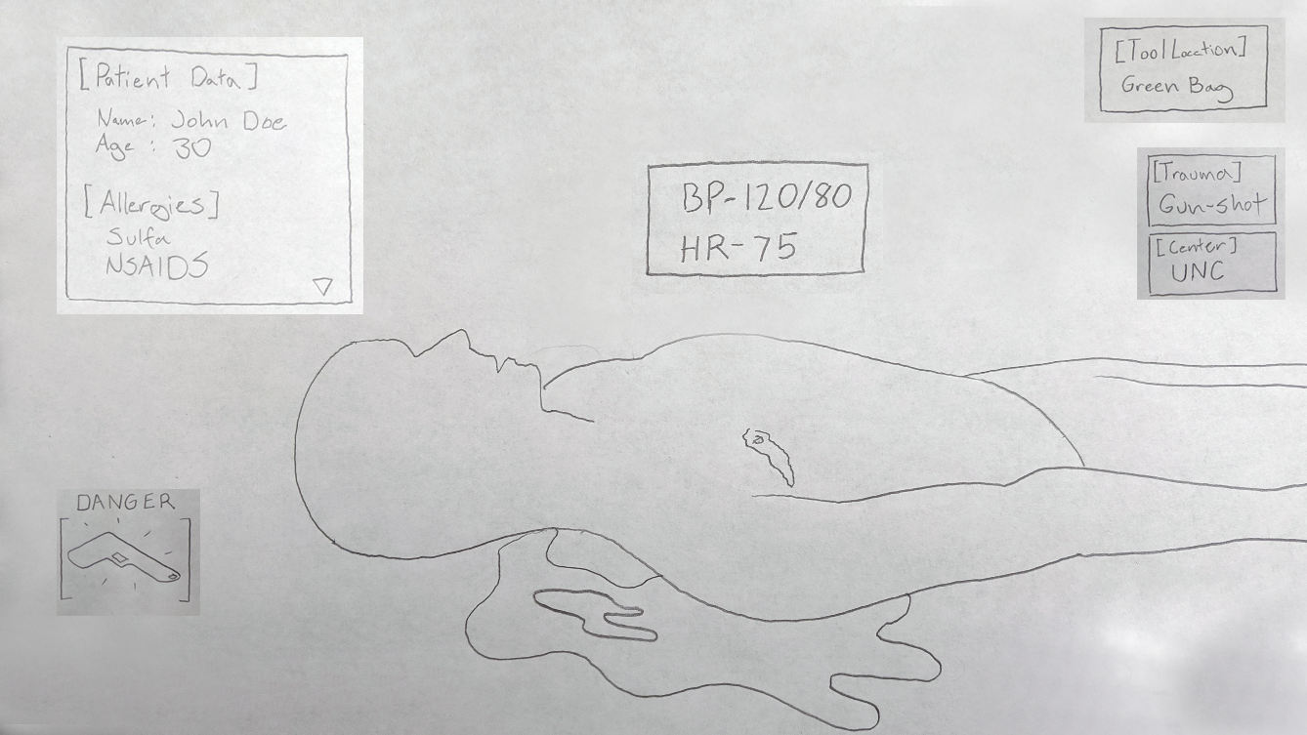
Possible User Interface Features
Display
  HUD
  Forearm mounted display
  Tablet, smartphone
Interactions
  HUD on/off
  Face scanner
  Threat scanner
  Ask backup
  Voice commands
  Haptics: touch in body parts to send information (danger, ask for help)
  Audio: push-to-talk, radio
Information:
  Patient’s info
  Real-time patient’s vitals
  Hospital recommendation based on location and trauma
  Procedures checklist – dynamic
  Procedures guidance
  Alerts
  Equipment location
  Threat identification: guns, knifes, body language
  Communication: voice, text, radio

Slide 46
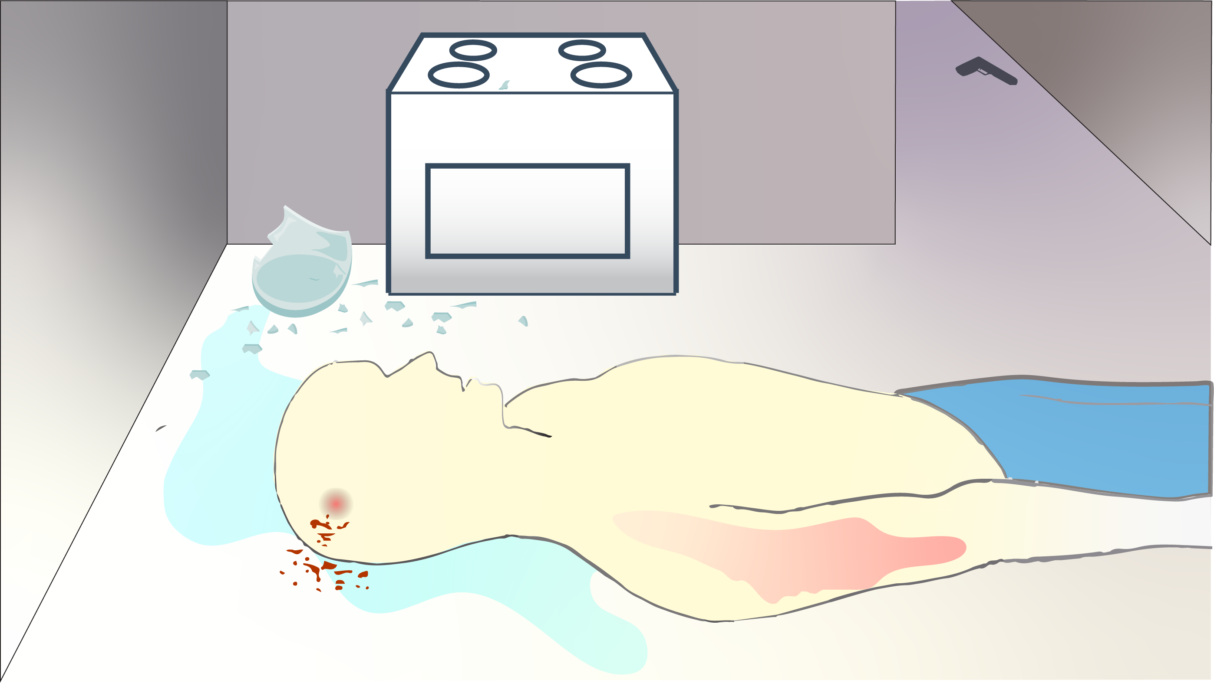
Notes:
You arrive at the residence. You touch the side of your safety glasses to activate the built-in HUD. It automatically enhances your vision. The system scans the environment while you are going to the kitchen.

Slide 47

Notes:
The system alerts you about a gun on the hallway. Turns out, the victim’s grandson is a known gang member. You discretely press a button to alert the police. In the kitchen, you see the man lying on the floor, conscious and breathing.

Slide 48

Notes:
While you get close to the victim, the system scans his face.

Slide 49
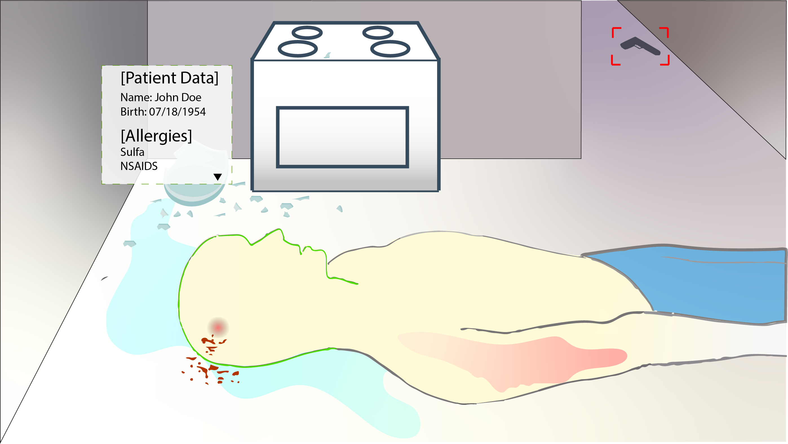
Notes:
After a few seconds, the HUD shows the patient information near to his body (Name, day of birth, allergies). The system highlights that the patient medicine allergies and automatically estimates the patient's body mass index.

Slide 50
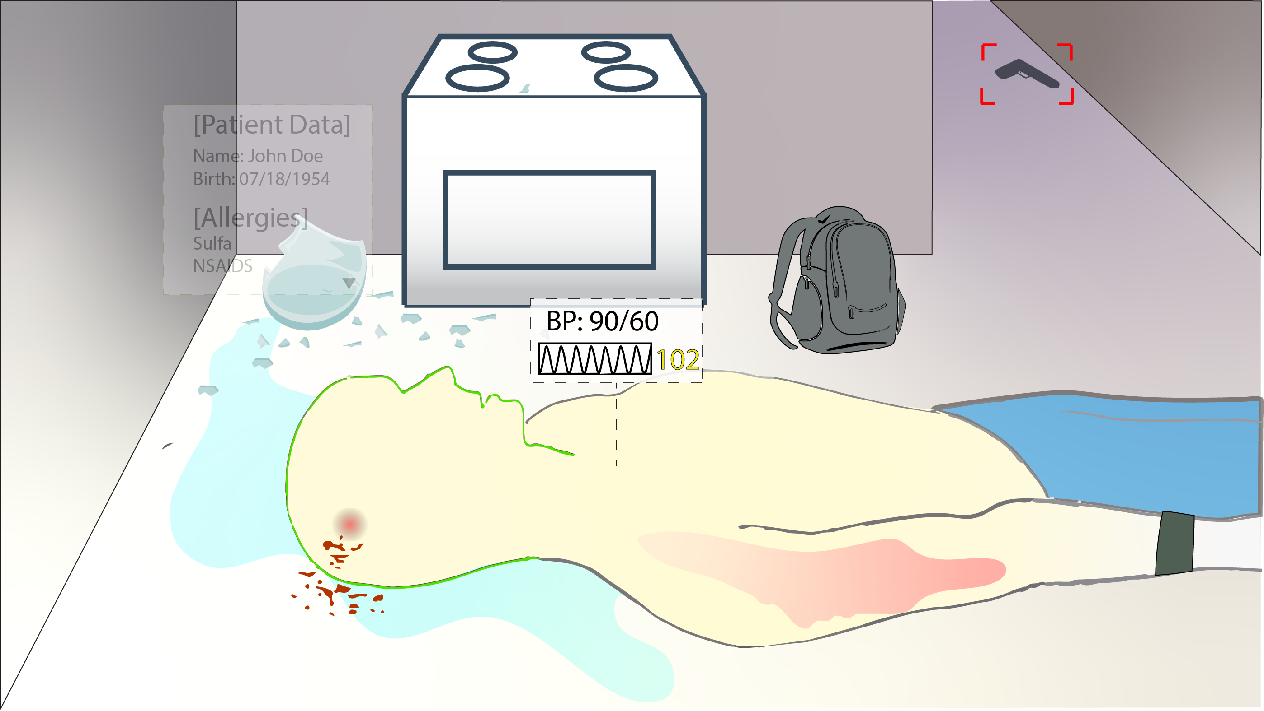
Notes:
You hook the monitoring equipment to the man. His vitals are shown in real time anchored to his body through your heads up display. A visual inspection reveals that he has red, blistered skin from the right arm to the chest. Additionally, his head is bleeding due to the fall and the cuts caused by the pieces of glass

Slide 51
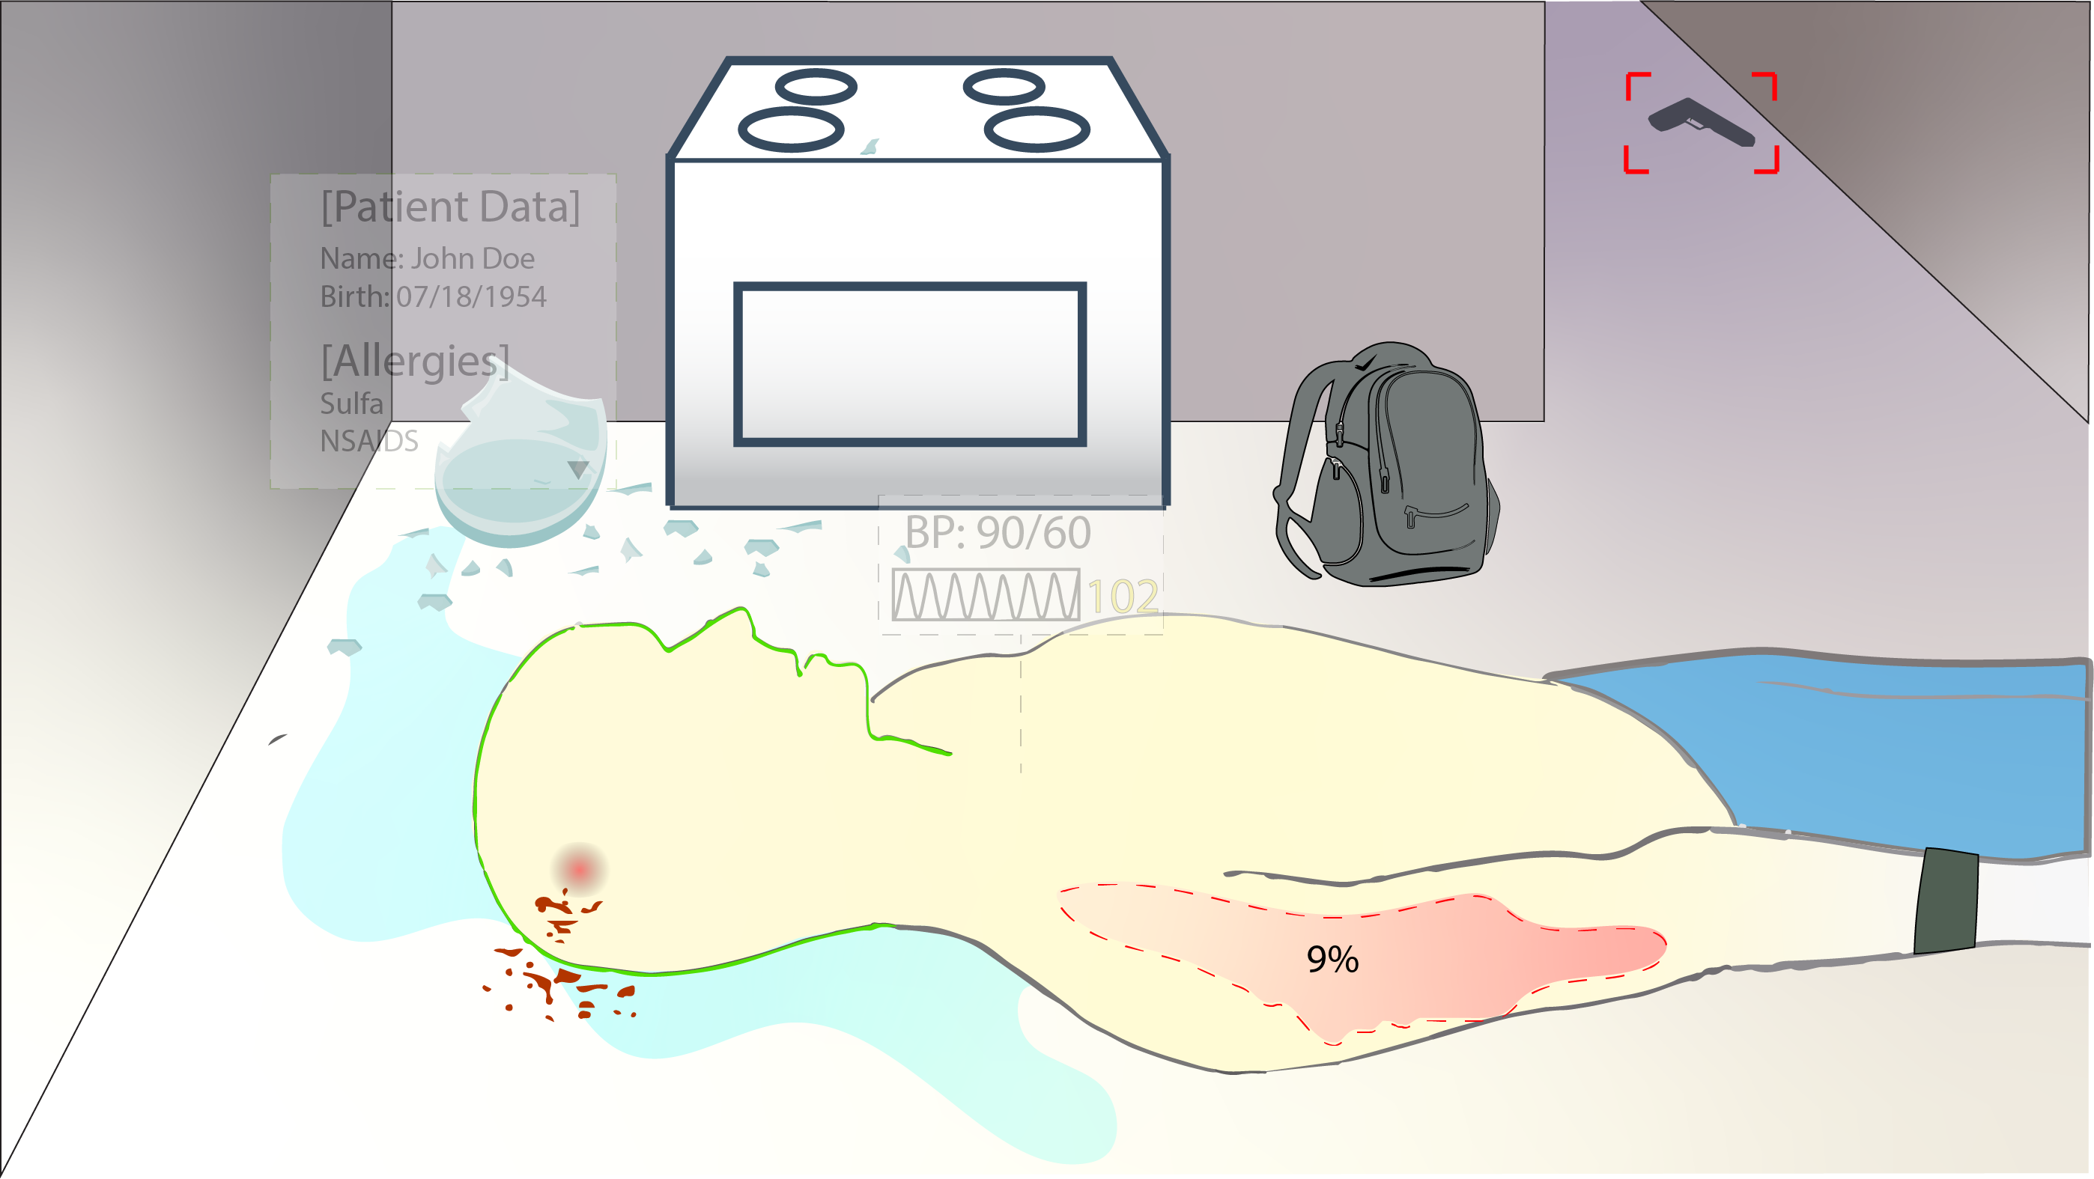
Notes:
The system detects body burn percentage and recommends which hospital the patient should be taken to.

Slide 52
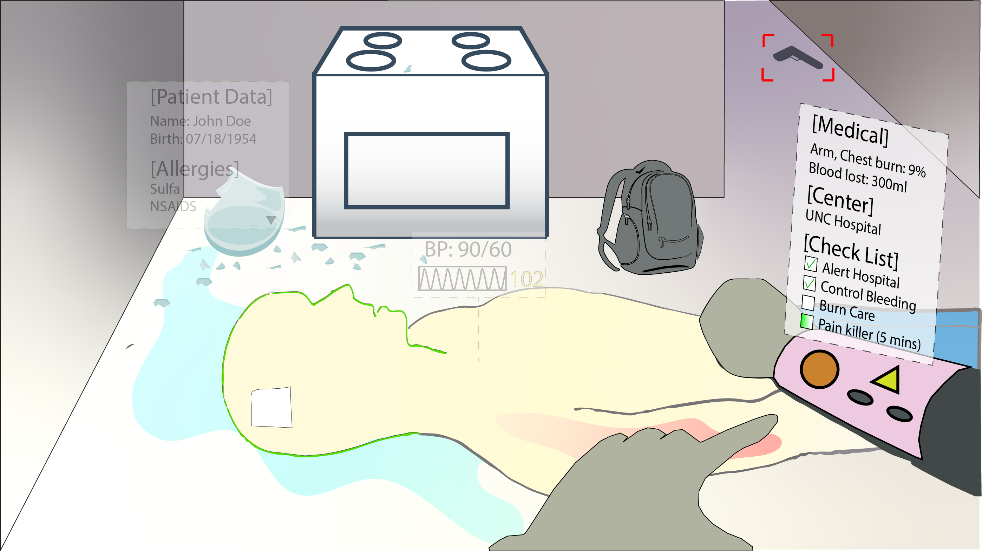
Notes:
You report out loud the situation. The system understands and shows a virtual display on your left arm a checklist of the procedures and medication dosage (based on the estimated BMI) that should be carried out. The system keeps tracking the time, to alert you when the medication should be administered again.

Slide 53
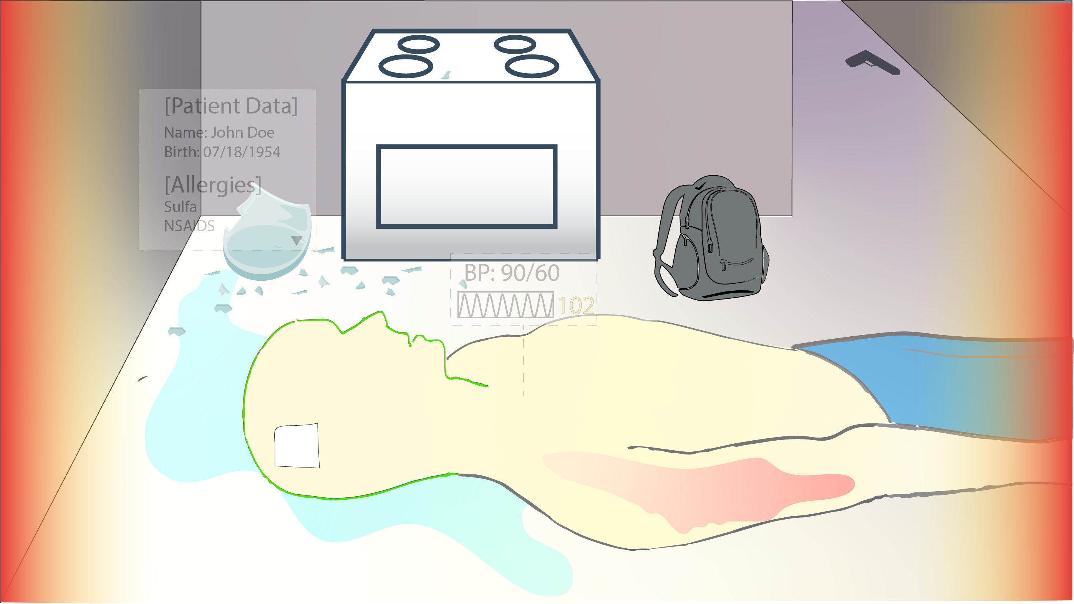
Notes:
You update the status via voice command when you finish the burn care. Heart rate rises suddenly. Armband vibrates to alert you. An alert also appears on your heads-up display as a red glowing in the edge of your view.

Slide 54
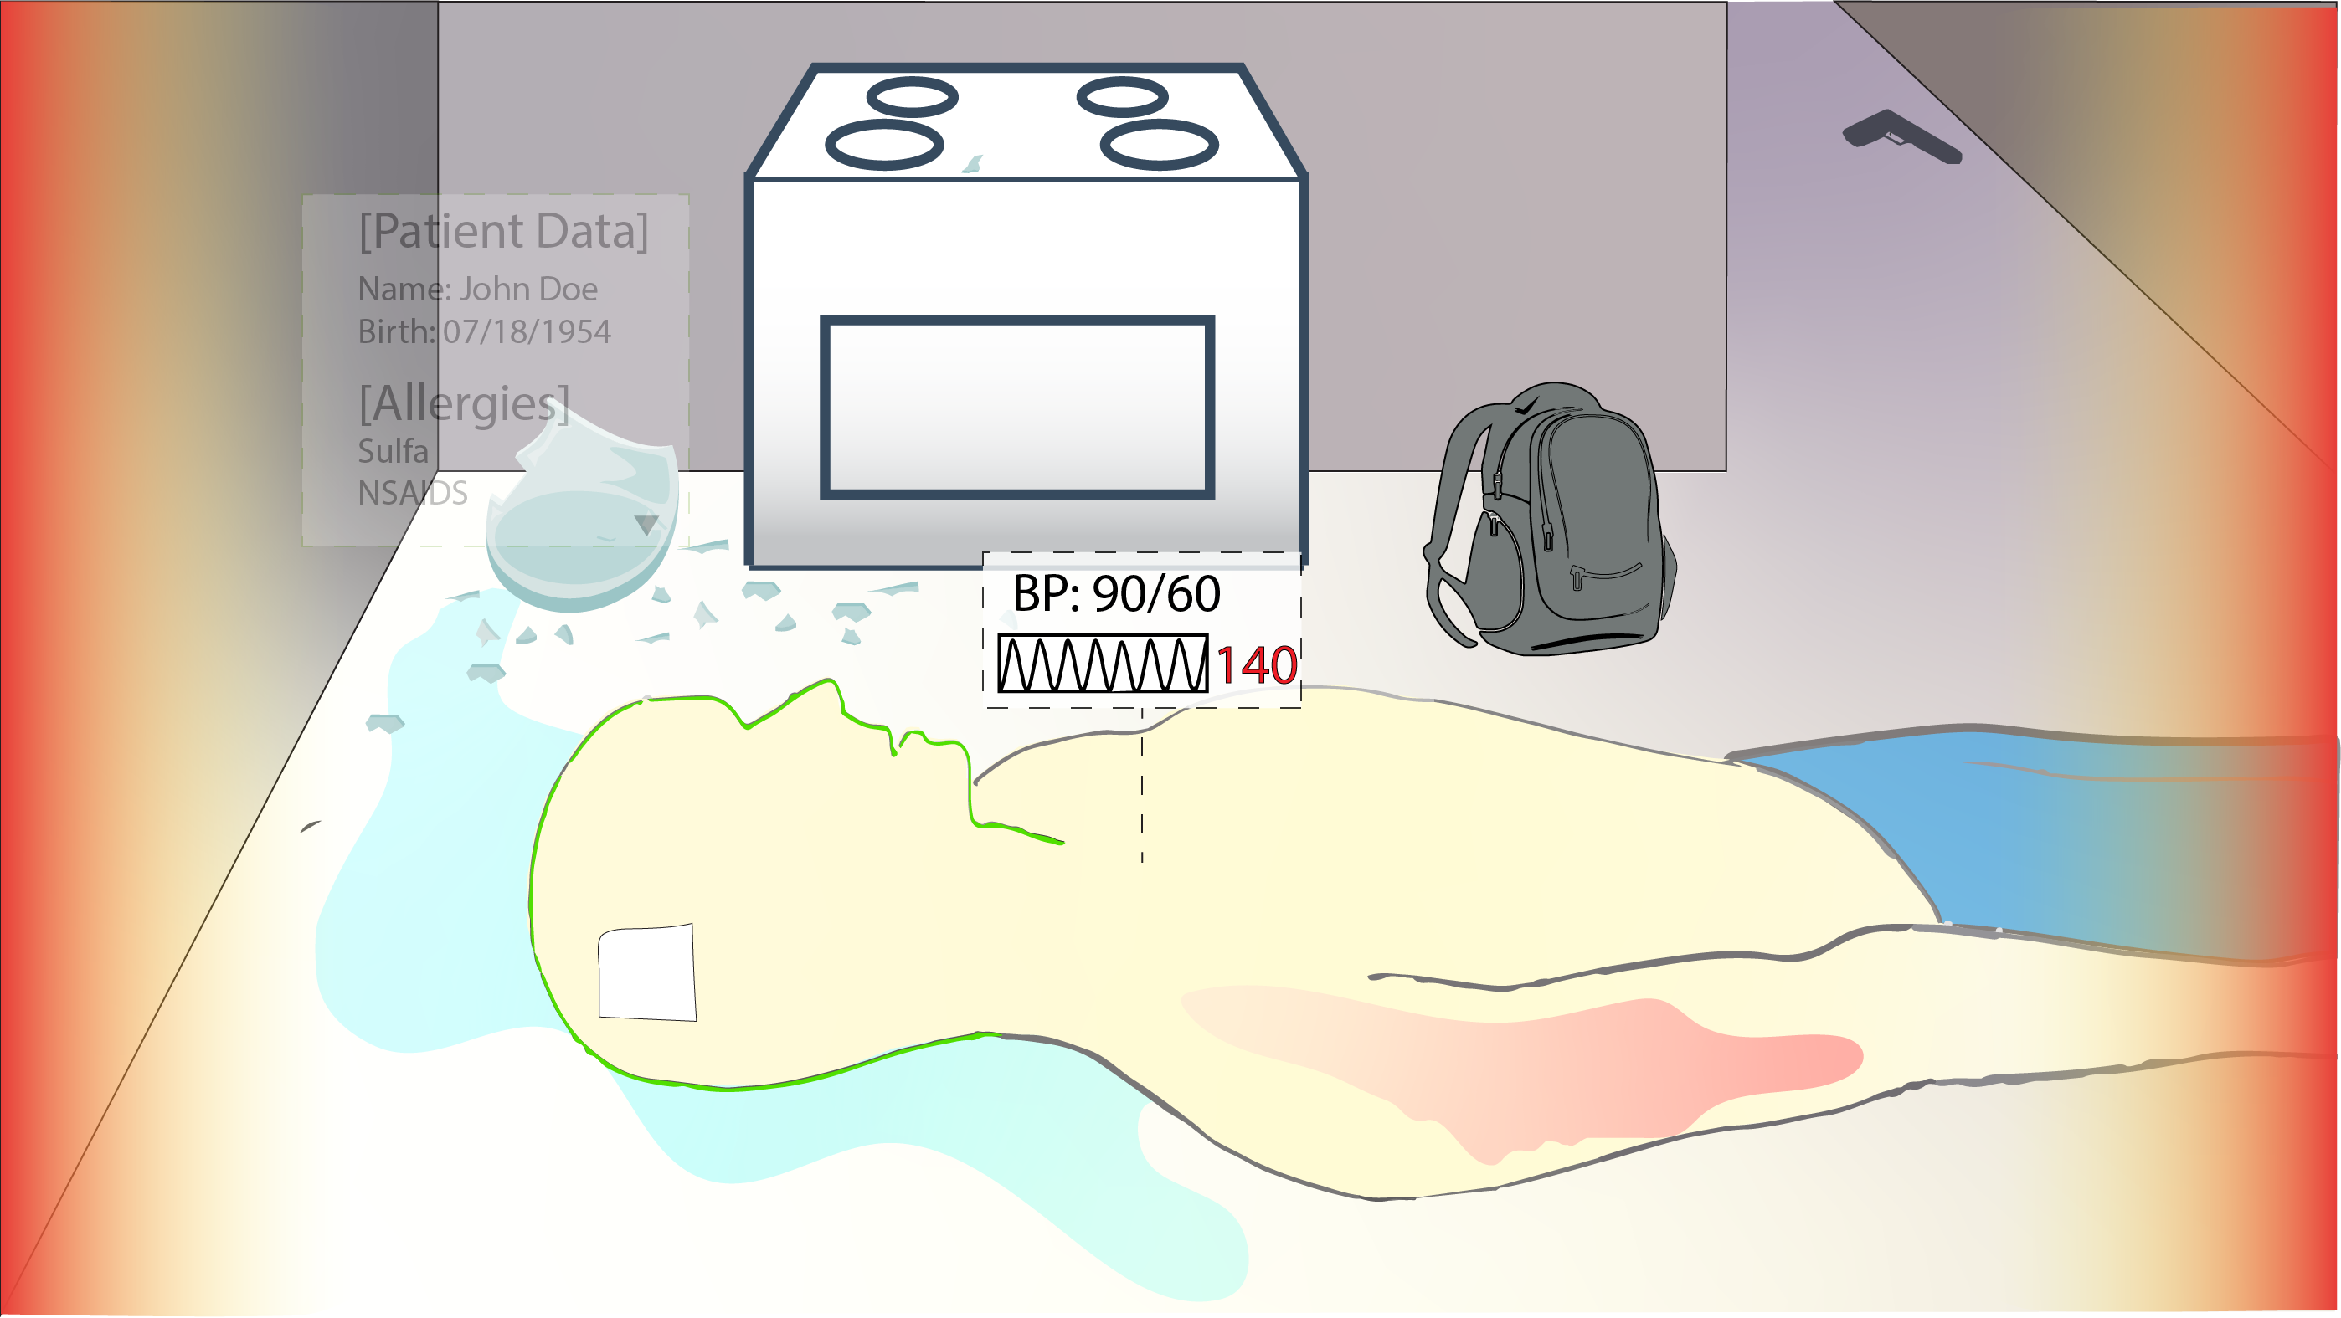
Notes:
There is a heart rate sudden change that gets highlighted on the heads-up display.

Slide 55
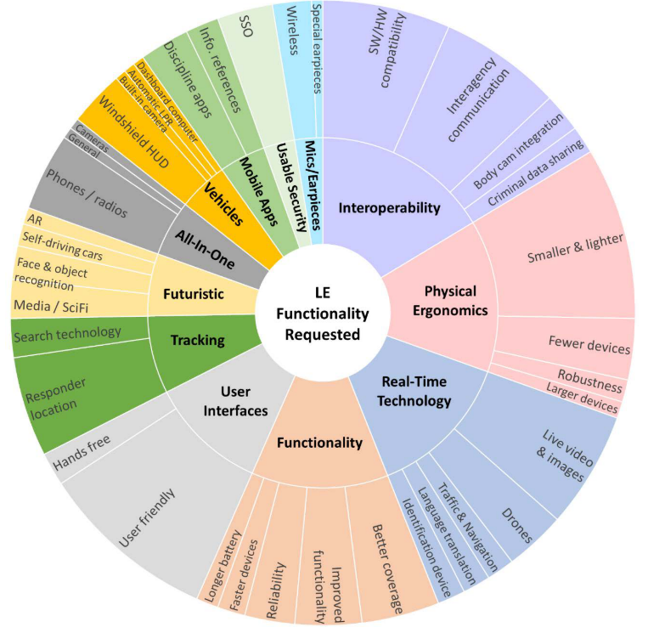
Requirement Analysis - LE
Functionality Requested
(“Voices of First Responders” Dawkins et al. 2018)
Body scanner: face recognition, detect gun, danger
Better communications: instant communication, clear voices, 1-1 and group
Information about indoor spaces: pinpoint info in maps
Information without the need to go back to the vehicle to use the computer
Alarm is tapping
Arm display
Easy access to information: Interface that integrates multiple databases

Slide 56
Requirement Analysis - LE
Chosen Scenario: Traffic stop
Scenario
Traffic stop
Key Role
Police officer who’s on duty patrolling the streets
Task to simulate
Execute the traffic stop, assess the vehicle and the occupants,
Proceed with warning, ticket or severe actions
Notes:
You are on patrol Saturday night at about 10:00 PM, driving along a lower‐middle‐class commercial road when you see a car with an occupant turn without signaling, causing the following car to brake suddenly. Although the action does not result an accident, you decide to pull the car over for unsafe movement. The car pulls over promptly.

Slide 57
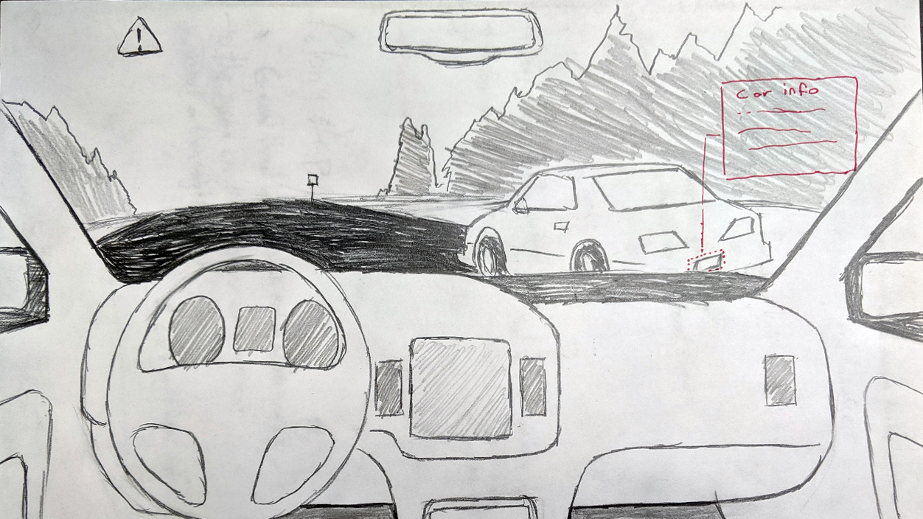

Slide 58
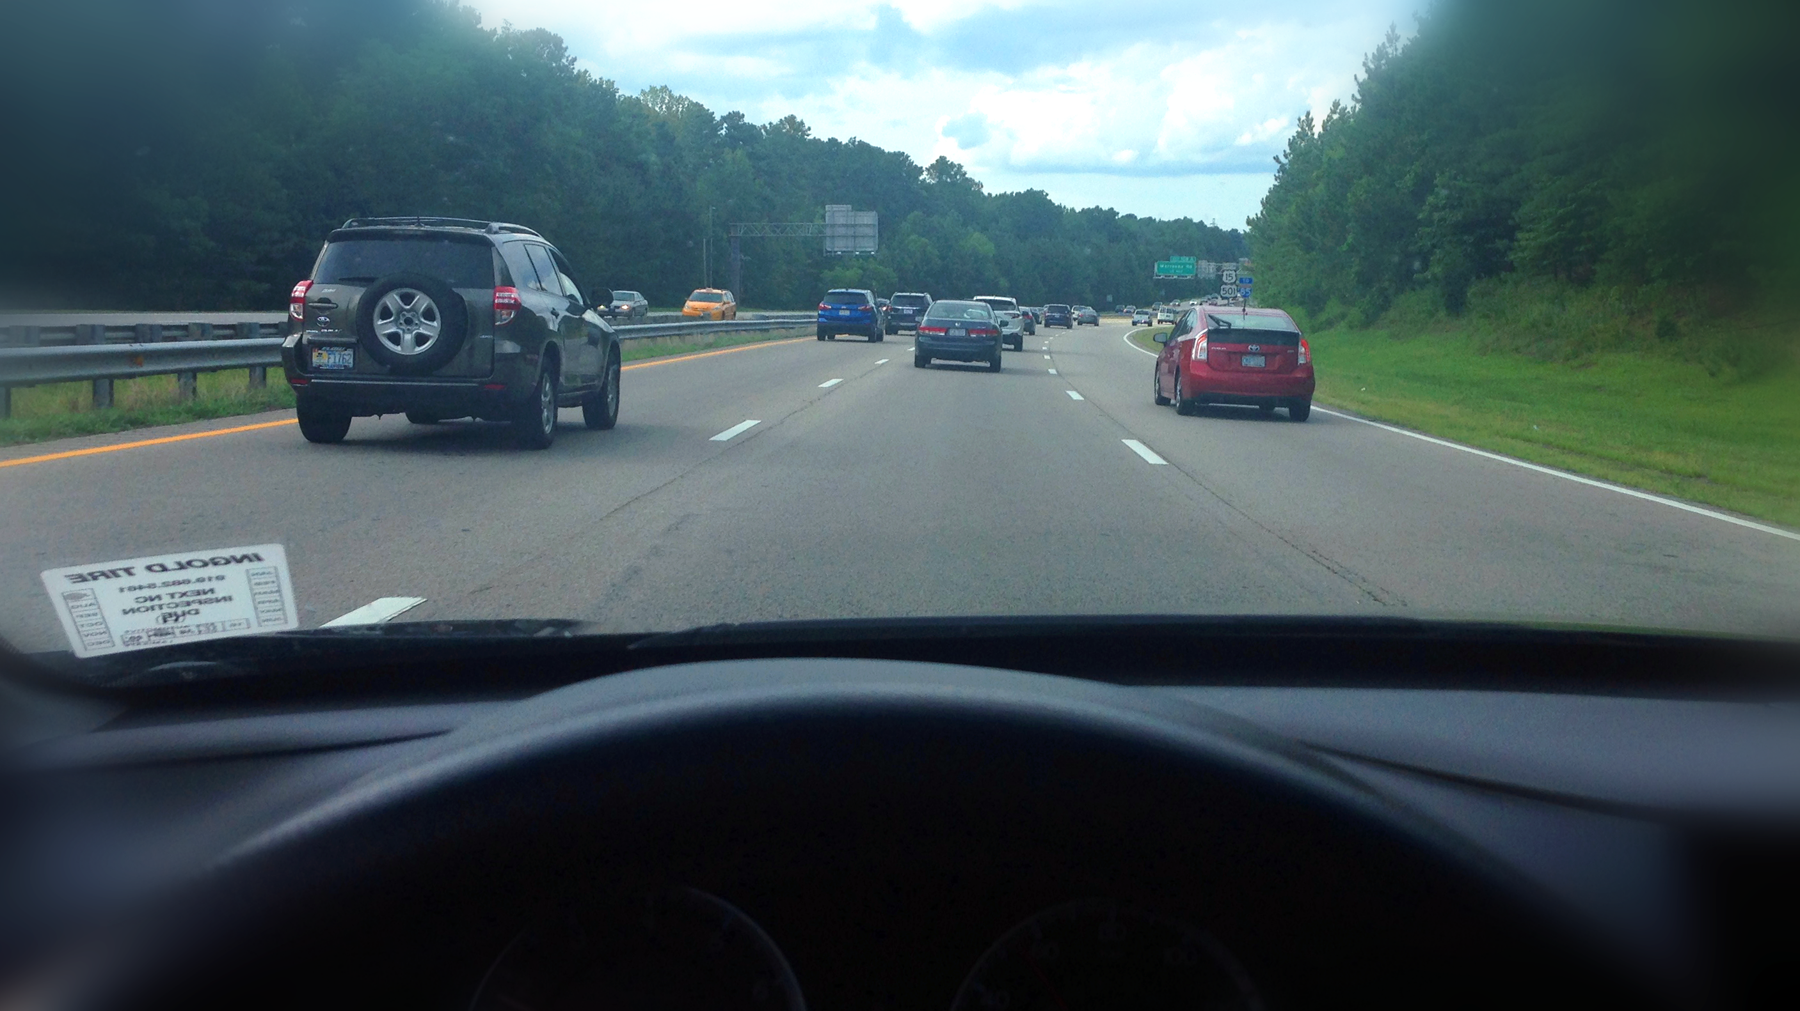
Passive system
Notes:
While you are driving the car, the system automatically scans and runs a checking on the cars plate. After a few seconds, the HUD displays the information about a car that has a expired tag.
The system also checked the owner of the vehicle. It is a male, 45yo. He is clear. (it doesn't mean that the current driver is the owner of the car). Based on this information the system suggest to proceed the traffic stop.
Furthermore, the system automatically sends an alert to the central informing that you are proceeding a traffic stop on the car. All information (car's plate and owners is shared with the central command).

Slide 59
Active system
“Run plate: TK7B9”
Vehicle
Owner
Driver
Toyota Prius
Color: Red
Plate: TK7B9
Tag expired
Notes:
Alternatively, you can as the system to run plates using voice commands.

Slide 60
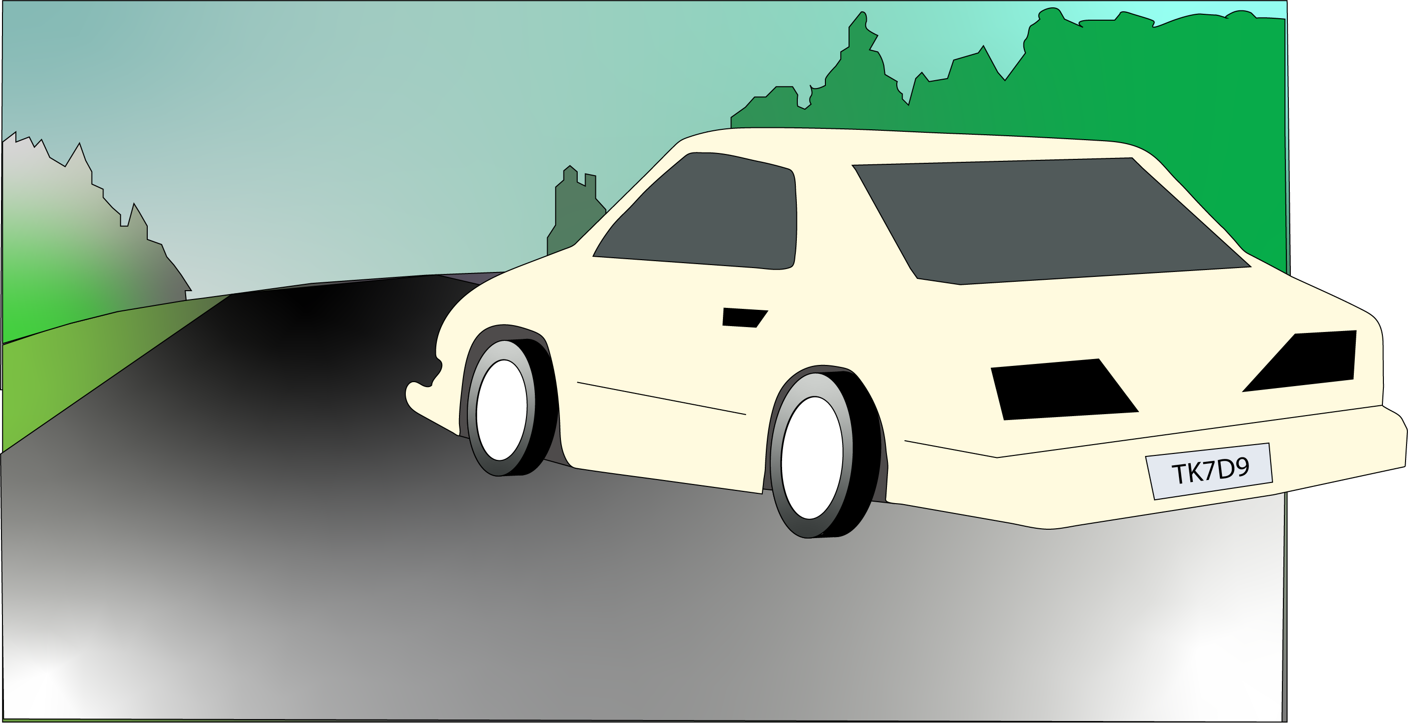
Notes:
You step out of the vehicle and walk towards the car that was pulled over. Since the traffic stop is at night time, the HUD automatically enhances your vision.

Slide 61
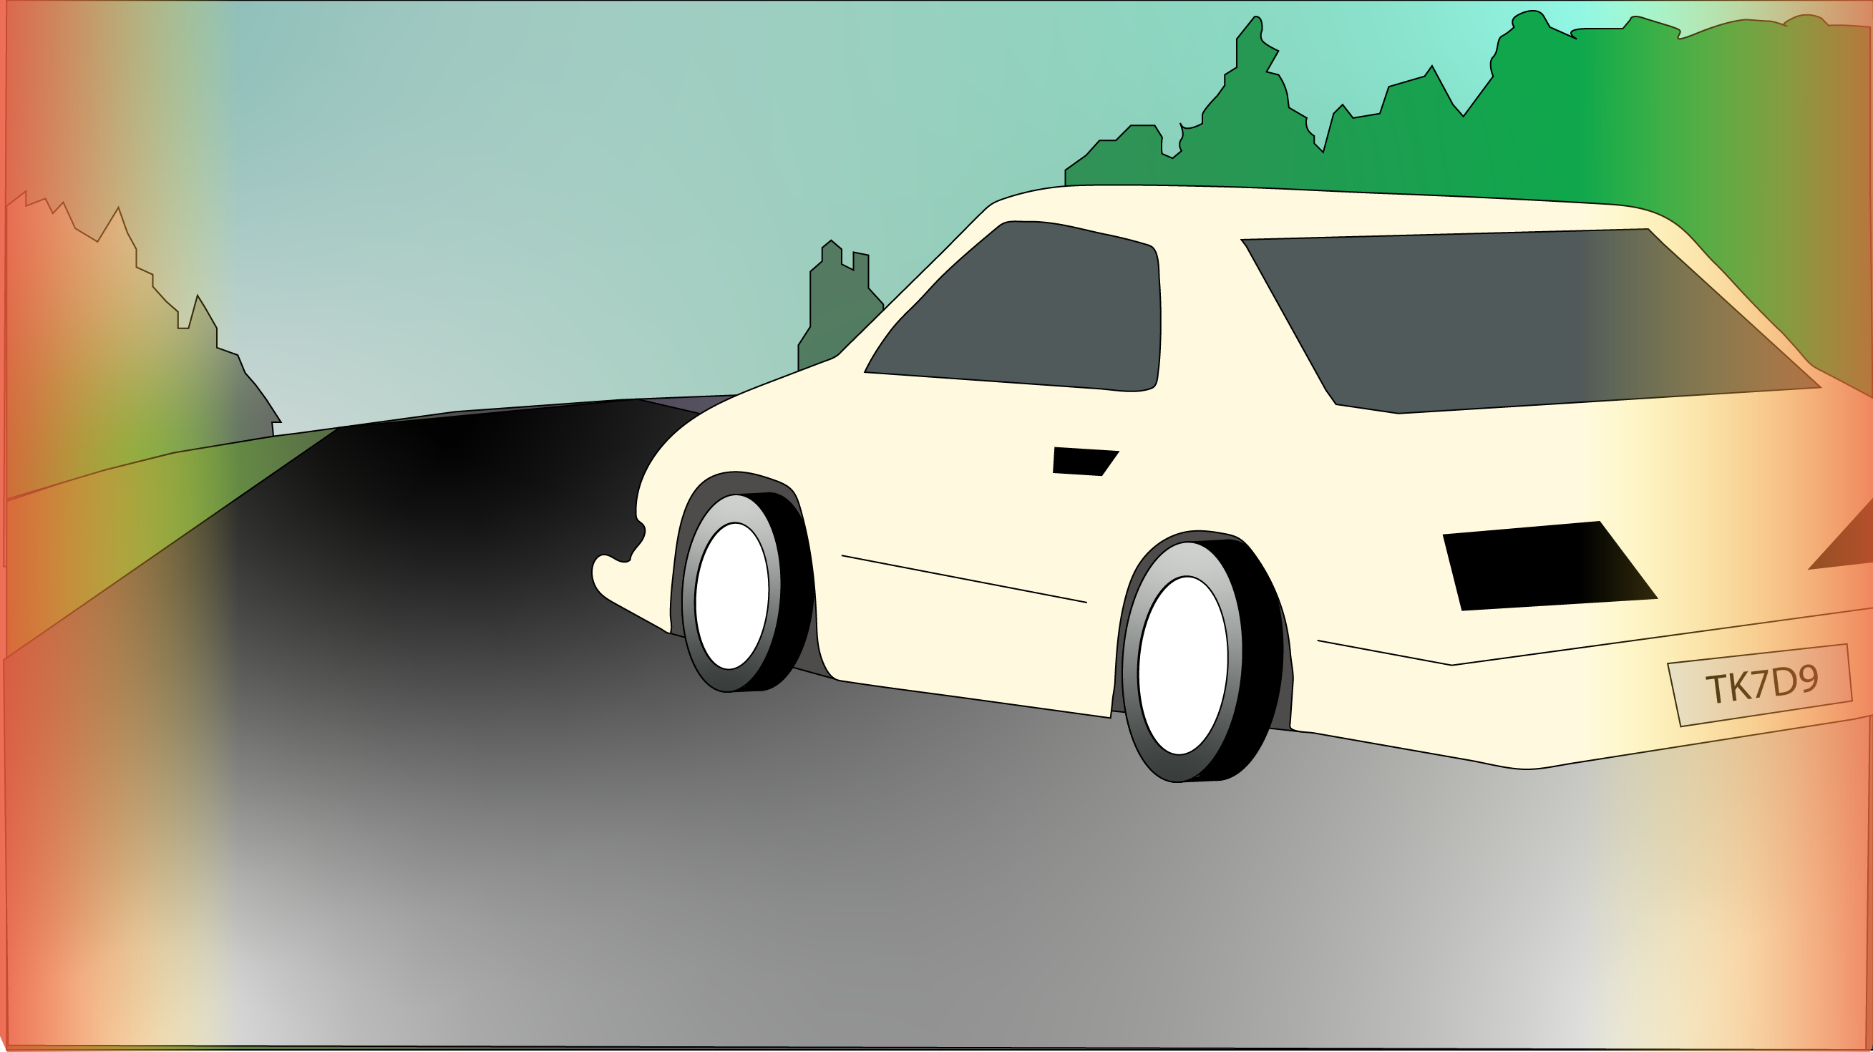
Notes:
You are in high alert, even if nothing seems suspicious. The HUD detected sudden movements inside the vehicle and gave you an alert.

Slide 62
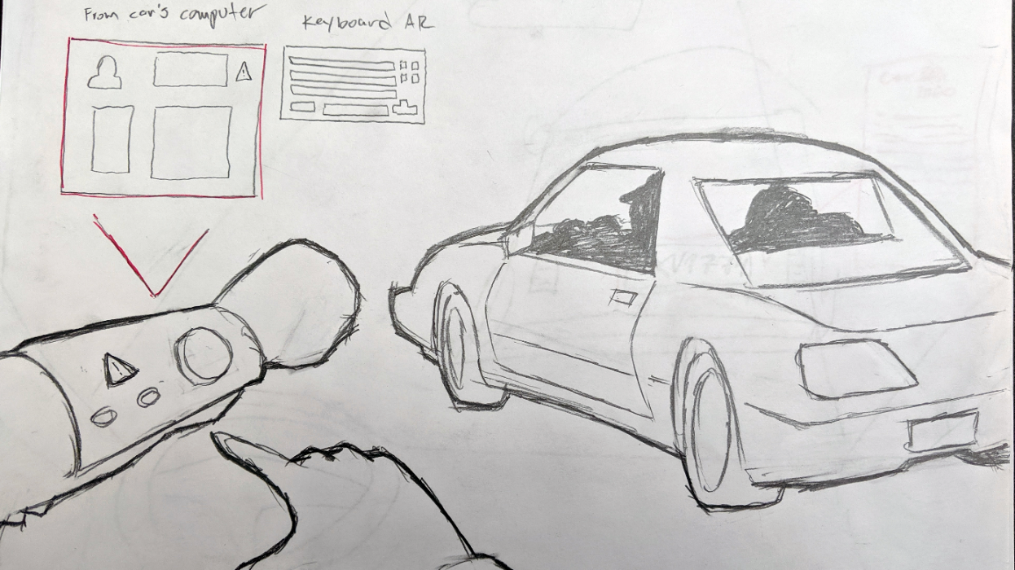

Slide 63
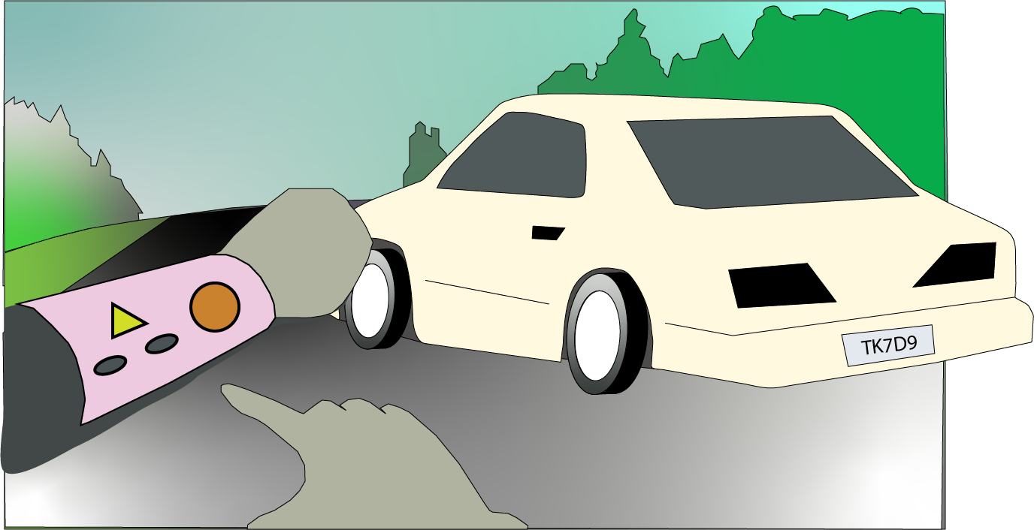
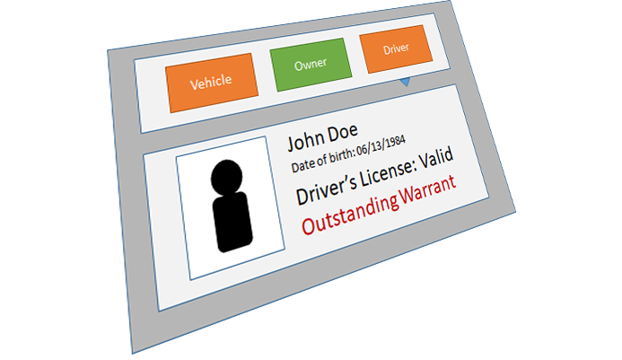
When interacting with the driver
Notes:
You approach the driver. You ask the driver to place his hands on the steering wheel. The system scans the drivers license. After a few seconds you receive an alert. You check the forearm display and see that the driver has an outstanding warrant.

Slide 64
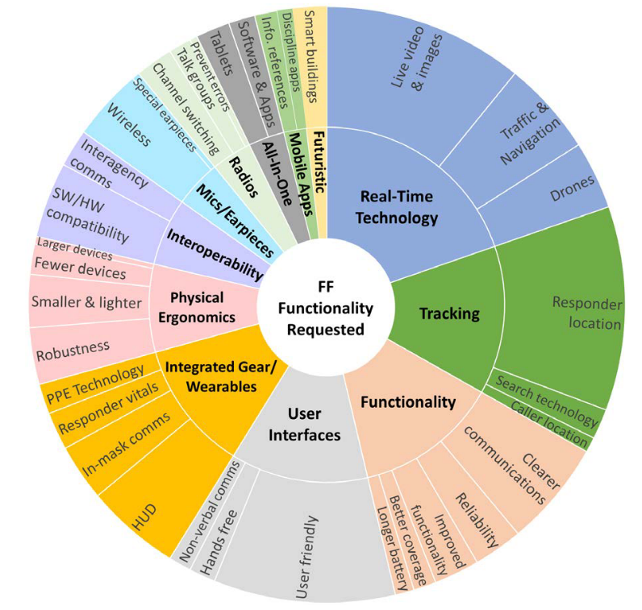
Requirement Analysis - FF
Functionality Requested
Information about the buildings, floor plans, people inside
Interactive maps: tactical information, shared location, 3D maps,
HUD: info about the environment, about the location of other folks
Reliable systems
Drone footage, 360 video of the scene before get there
Lighter equipment, smaller
Easy way to report (paper work)
(“Voices of First Responders” Dawkins et al. 2018)

Slide 65
Requirement Analysis - FF
Chosen Scenario: Search and Rescue
Scenario
Burning commercial building
Key Role
Firefighter who’s tasked with finding the victim
Task to simulate
Search + rescue: Path finding (in and out), hazard detection
and avoidance, victim detection
Notes:
You’ve been dispatched to a commercial structure fire on a Wednesday evening at about 7:00 PM. The information is that a 45 yo female employee is trapped inside the building. The smoke is dense and the visibility is low. You were informed that the person has a locomotion disability and may be in her office that is located on the second floor.

Slide 66
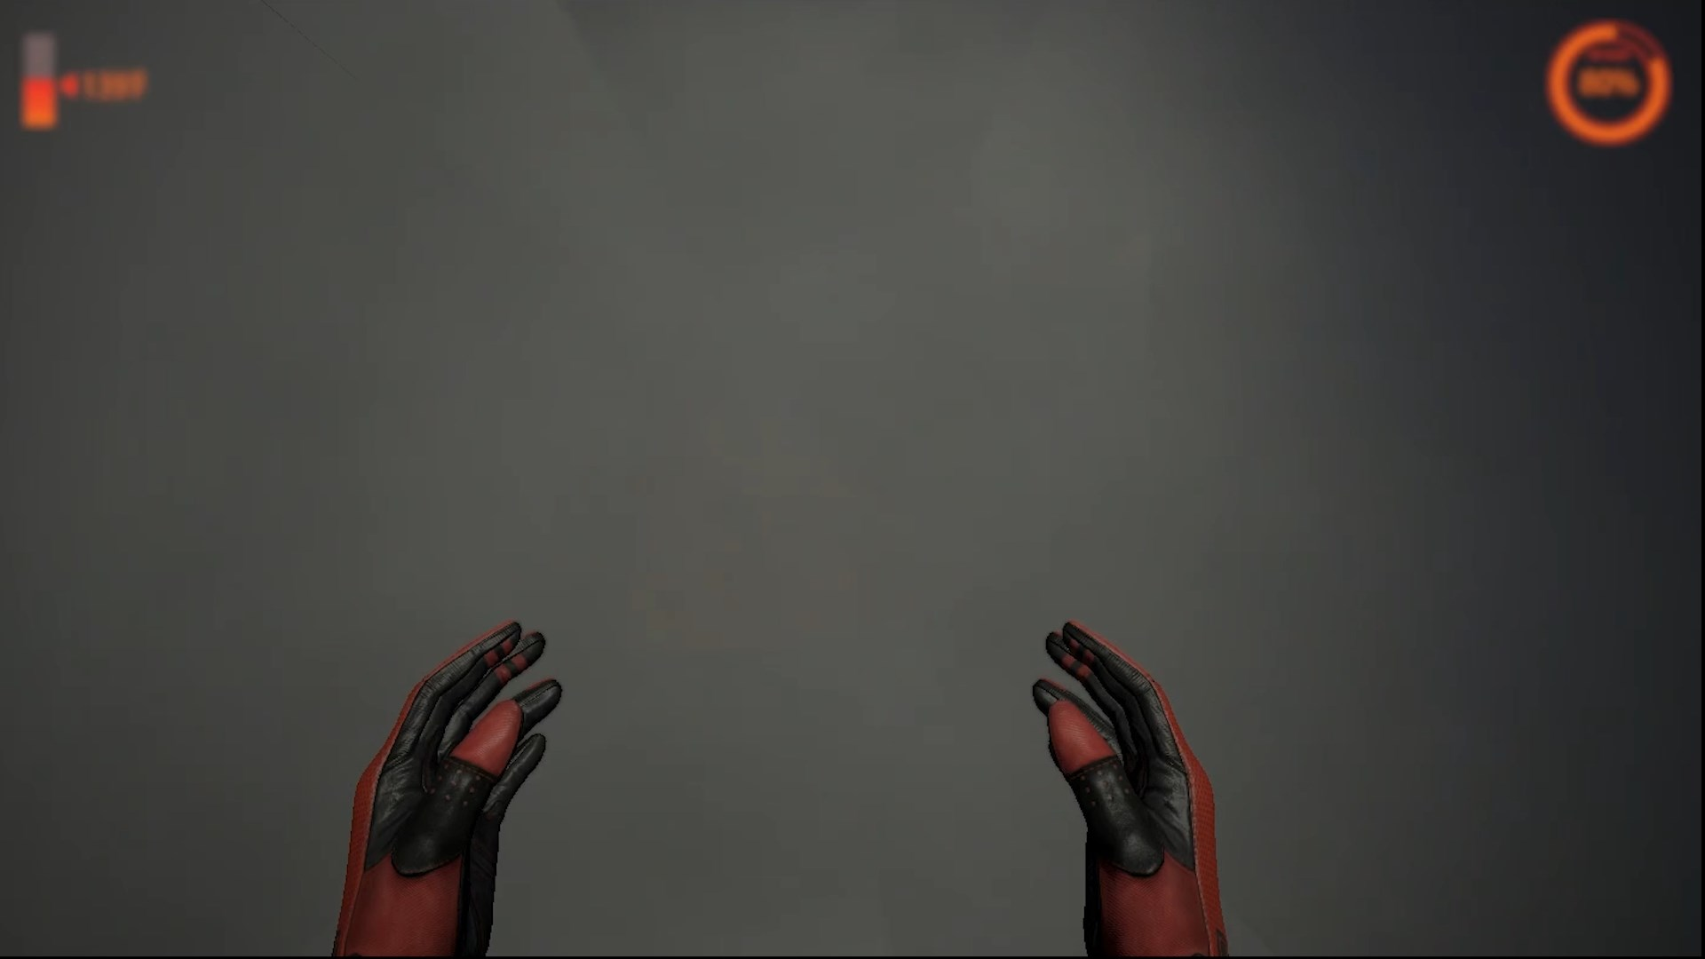
Notes:
The visibility is very low when you get to the second floor.

Slide 67
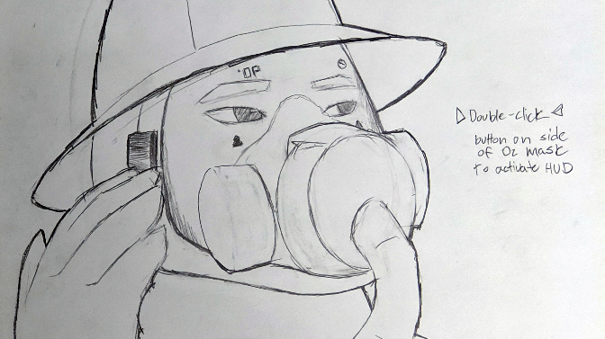
Notes:
You double tap the right side of your mask and activate the thermal imaging overlay on your mask.

Slide 68
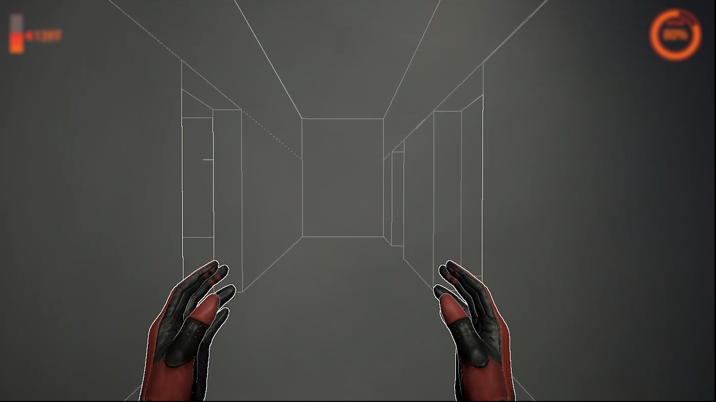
Notes:
Now, you can see through the smoke. The thermal overlay also highlights the edges of the walls, doors and furniture.

Slide 69
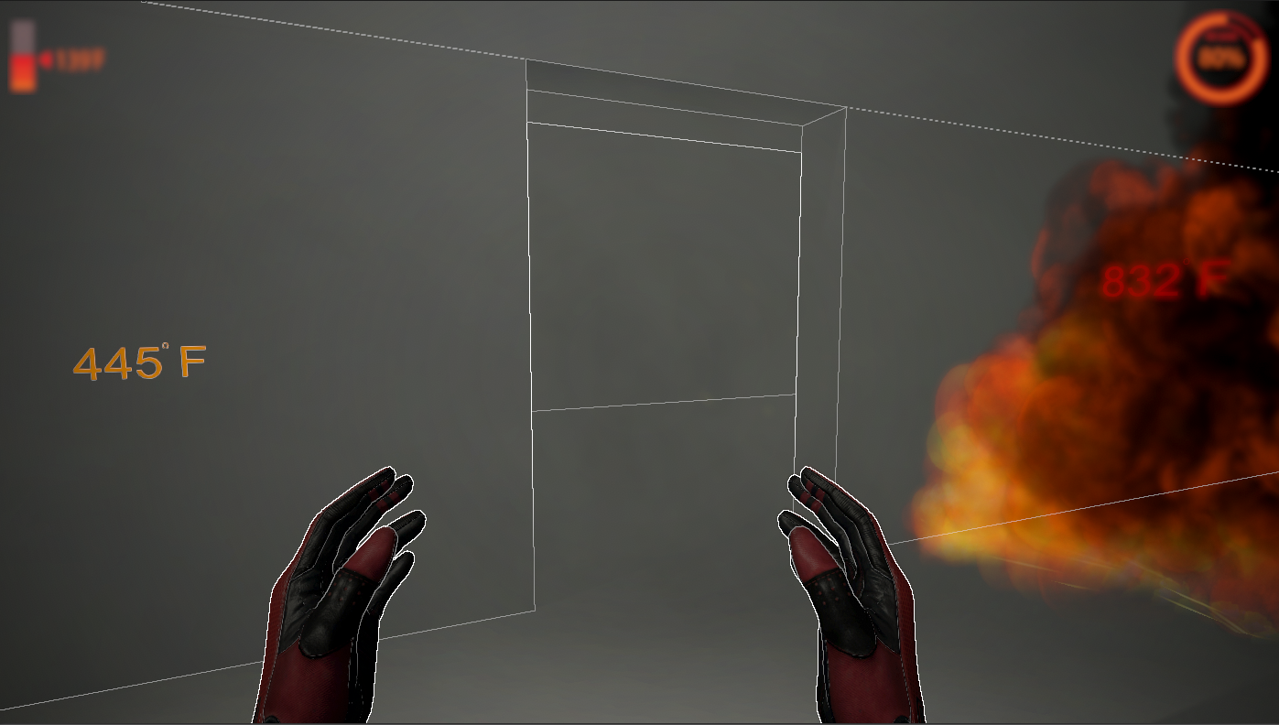
Notes:
You go through the hallway, searching the rooms. The ambient temperature is much higher now. Your mask indicates 445 degrees. Temps higher than 250F are plotted directly on the environment. You look back and see the path you have taken rendered on the ground.

Slide 70
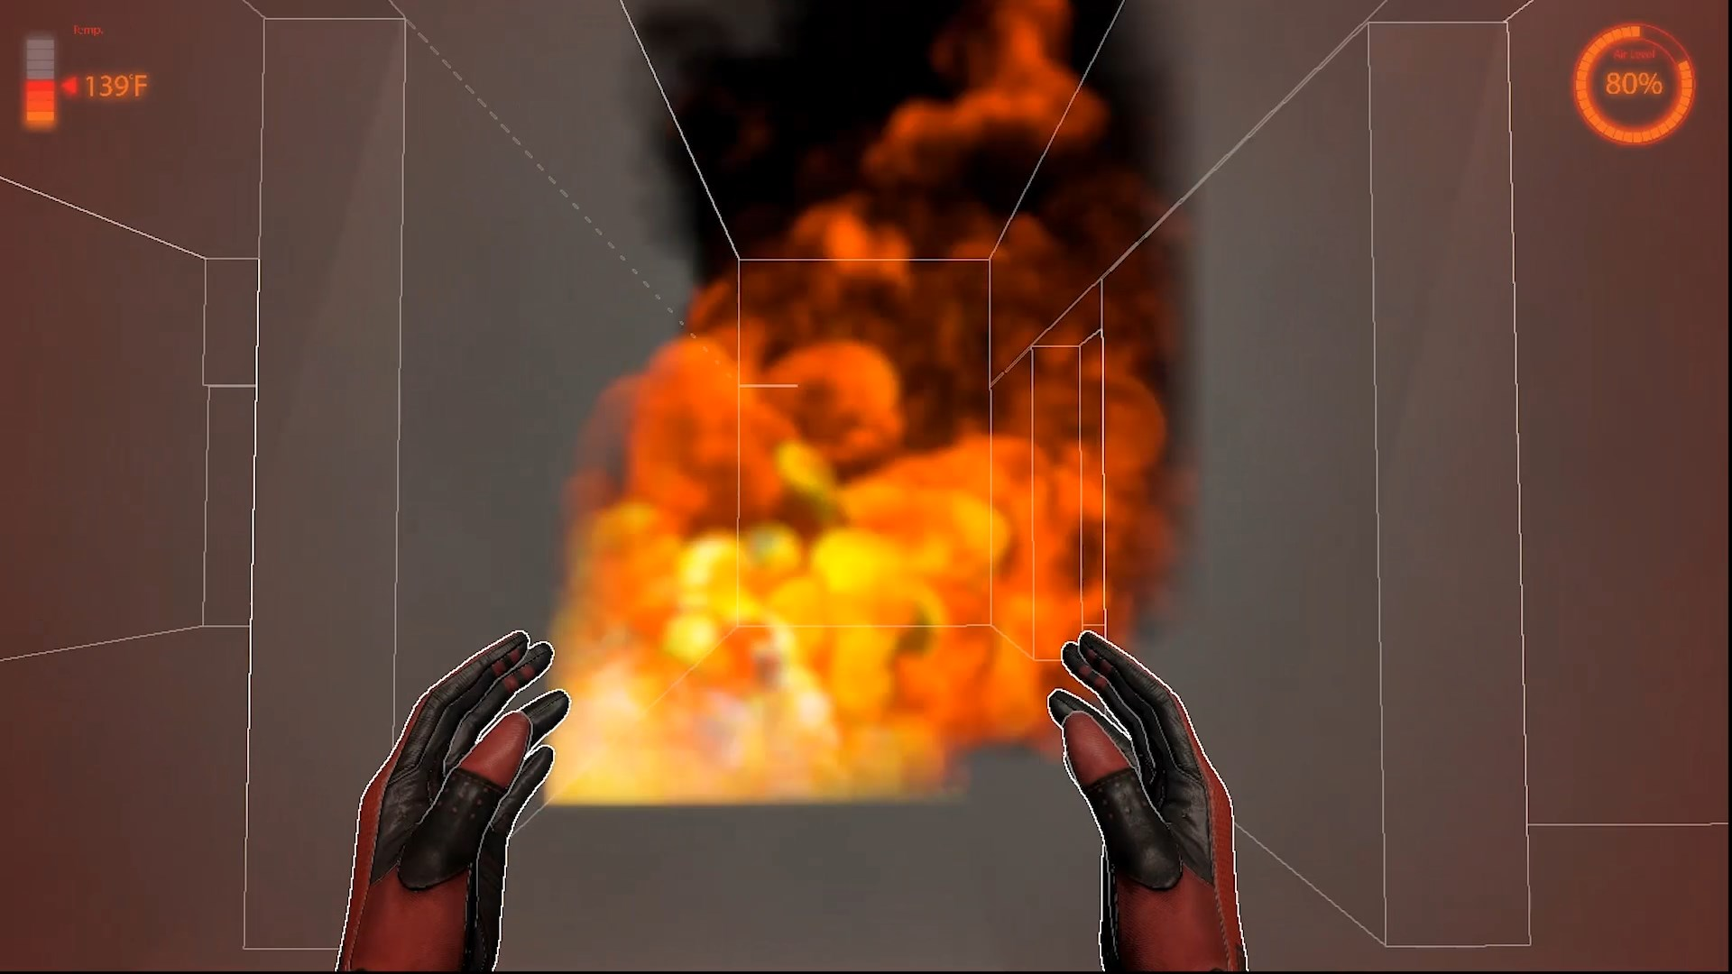
Notes:
You mark the area with a caution mark. The mark is automatically shared with the central commander.

Slide 71

Notes:
Further, in the hallway to your left, you find the fire source. You mark the area with a caution mark. The mark is automatically shared with the central commander.

Slide 72
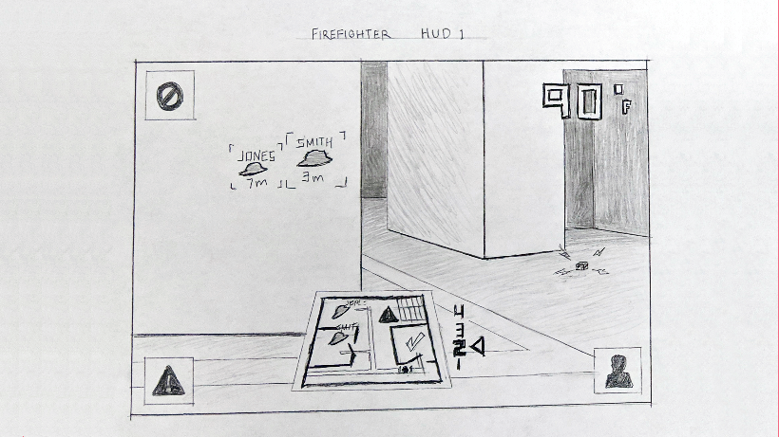

Slide 73
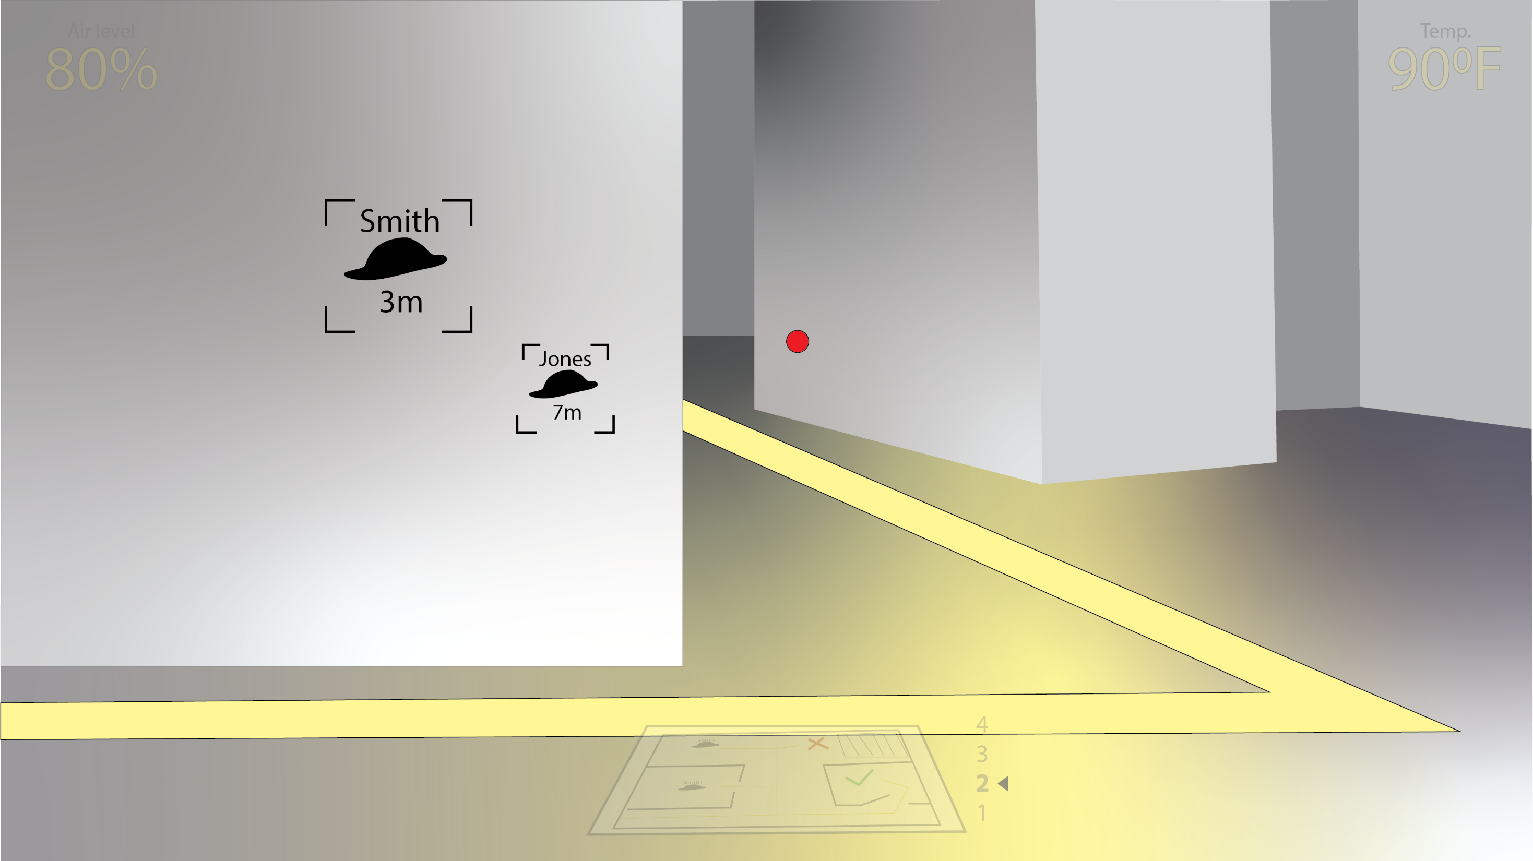

Slide 74
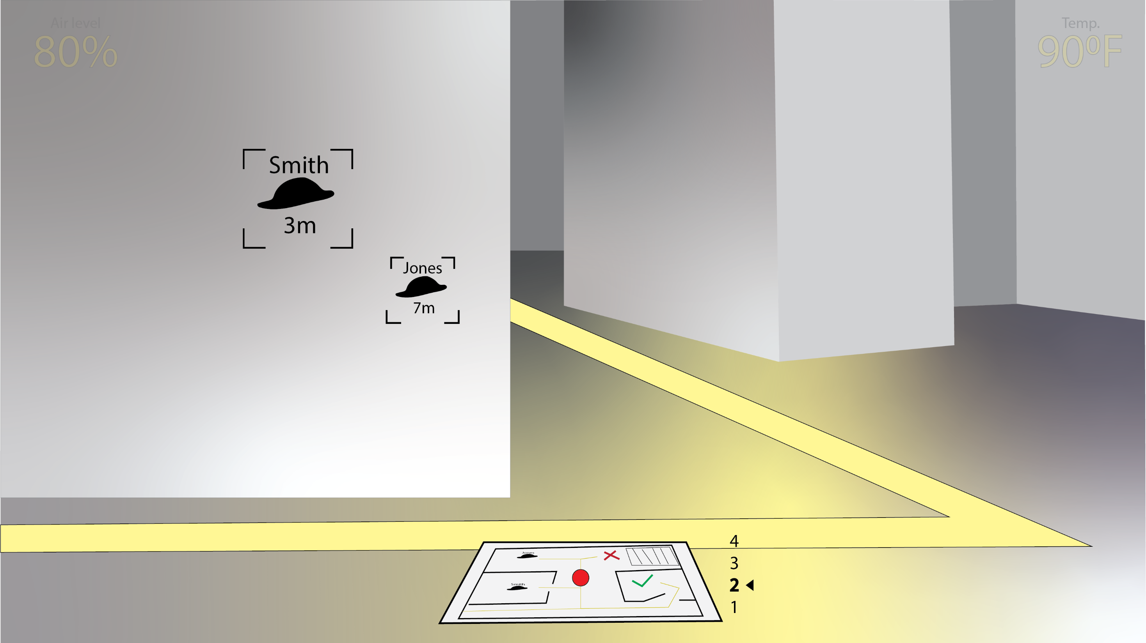

Slide 75
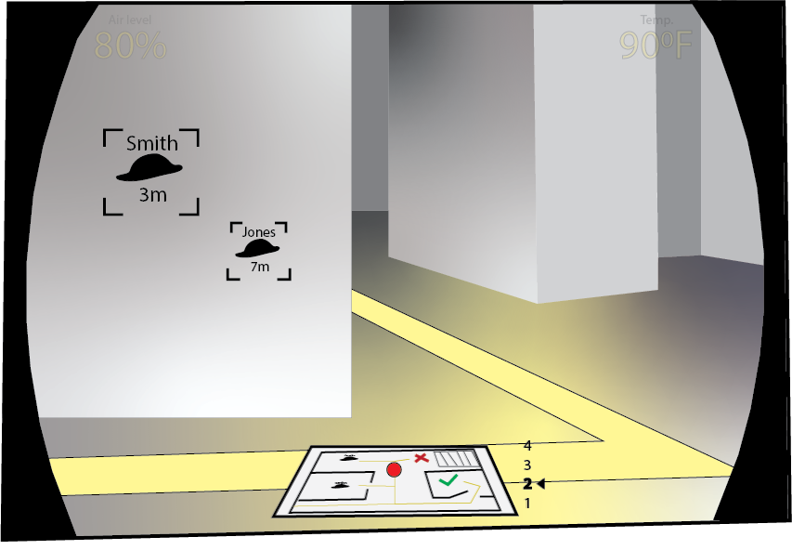
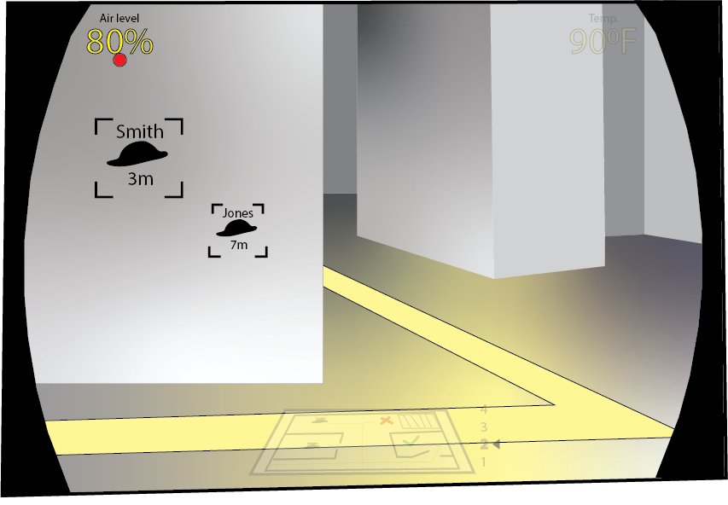

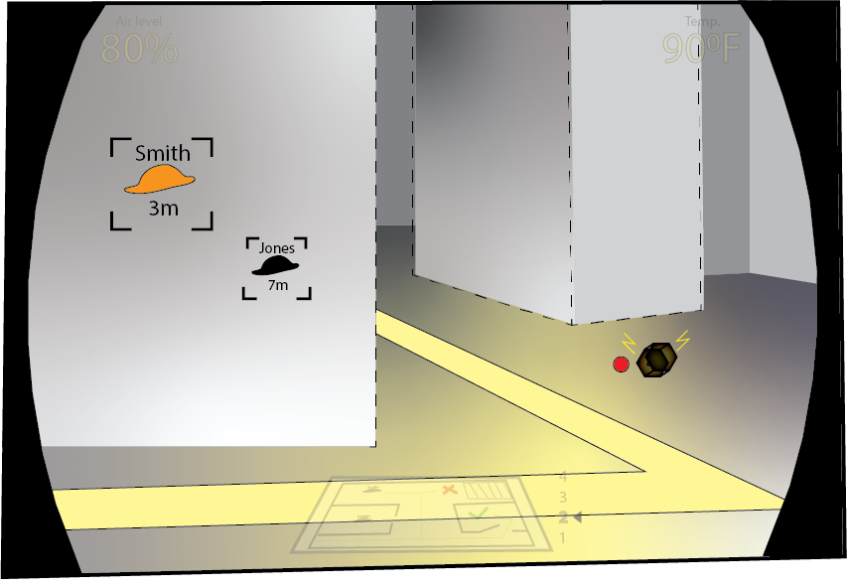


Slide 76



Slide 77

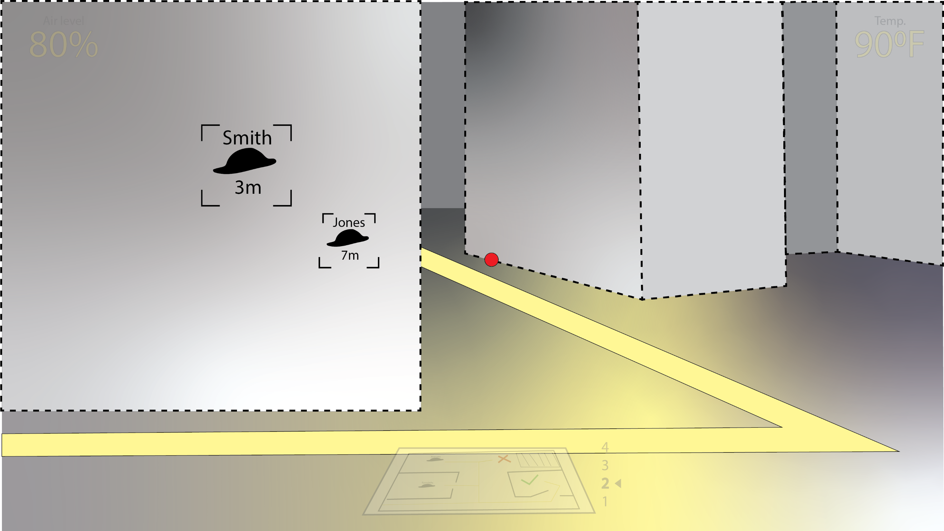

Slide 78
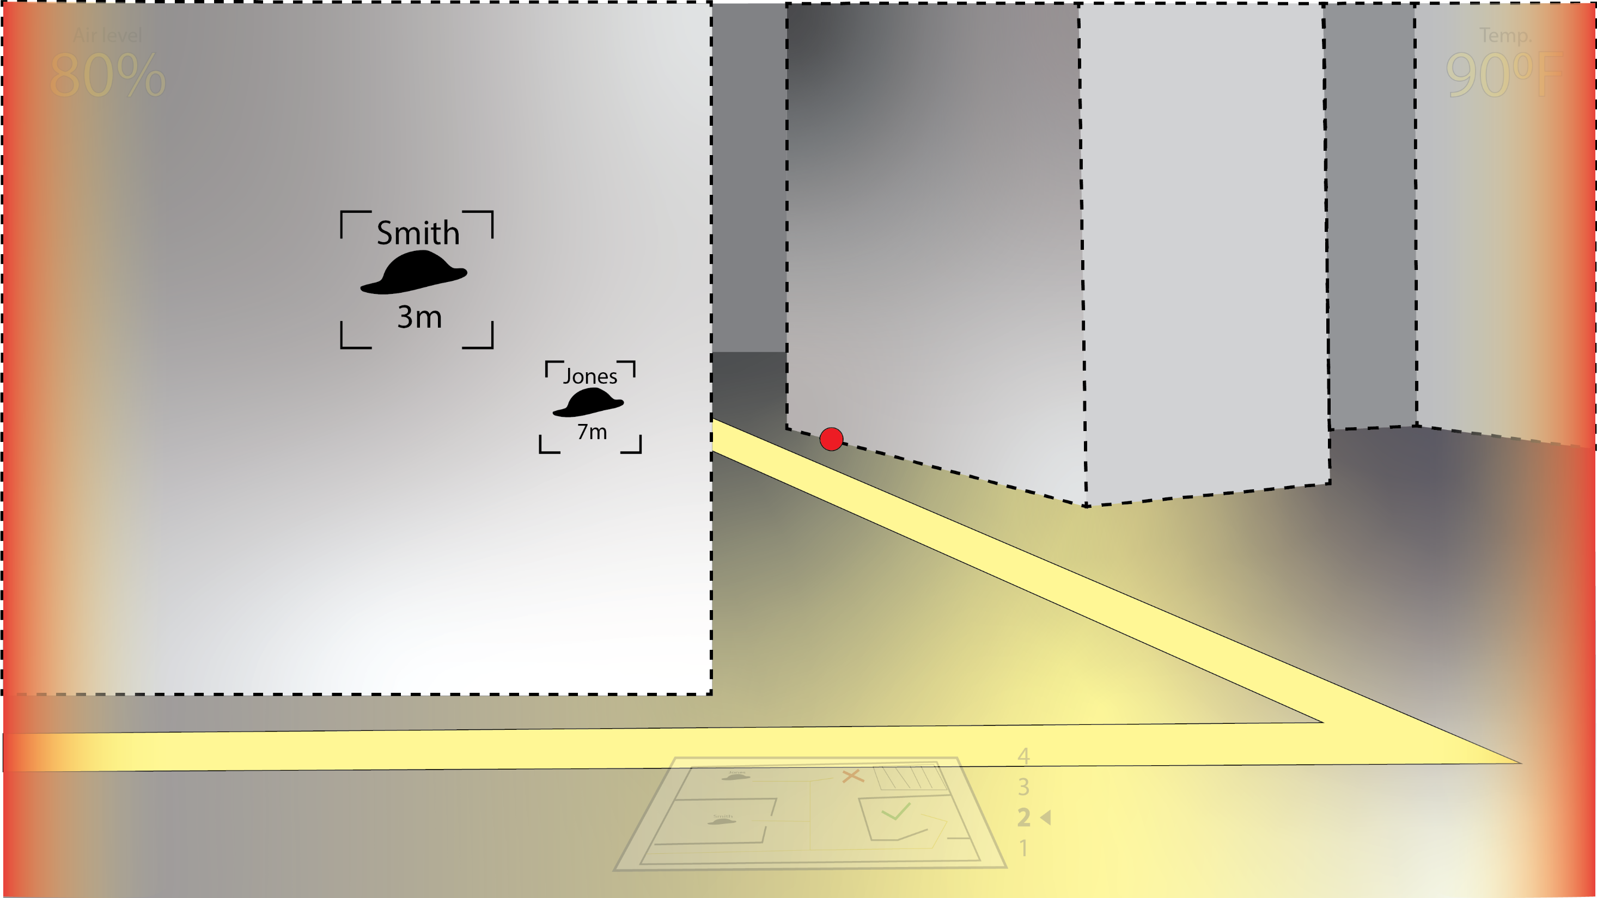

Slide 79
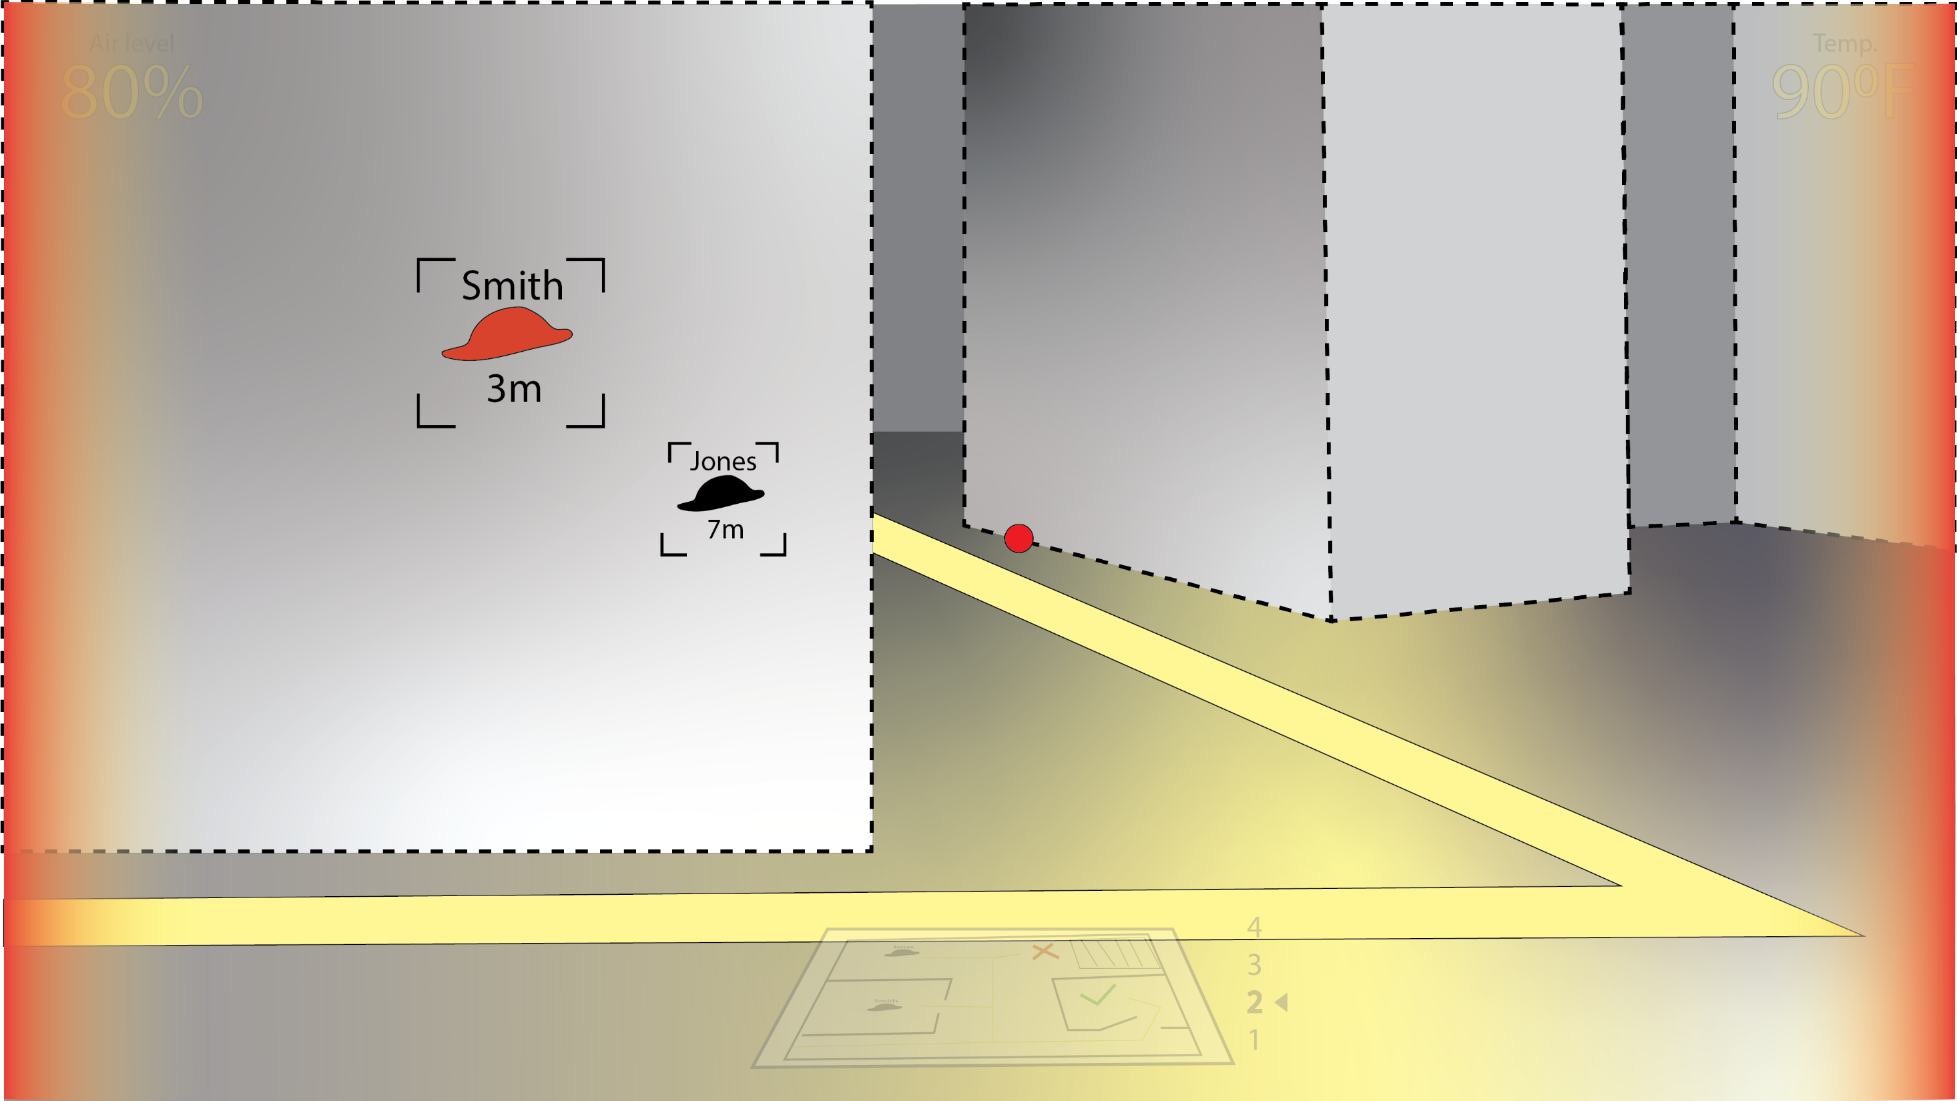

Slide 80
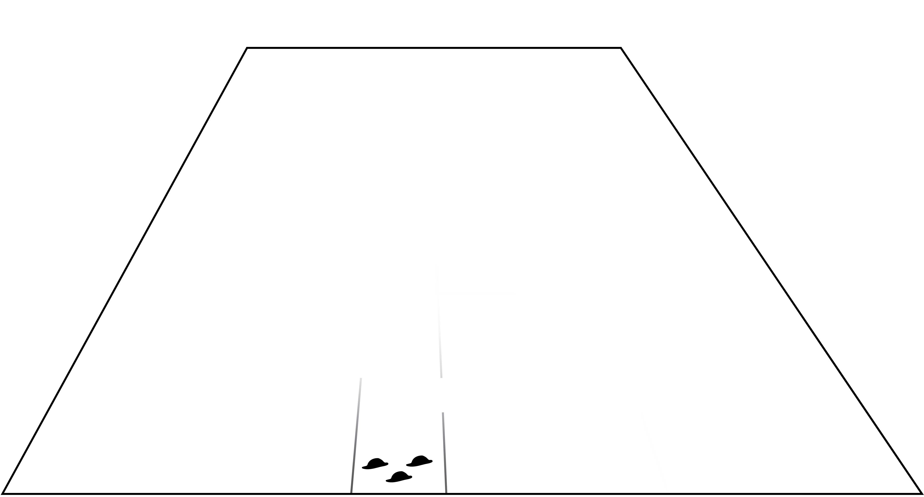
Dynamically generated floorplan
The floorplan is generated in real-time

Slide 81
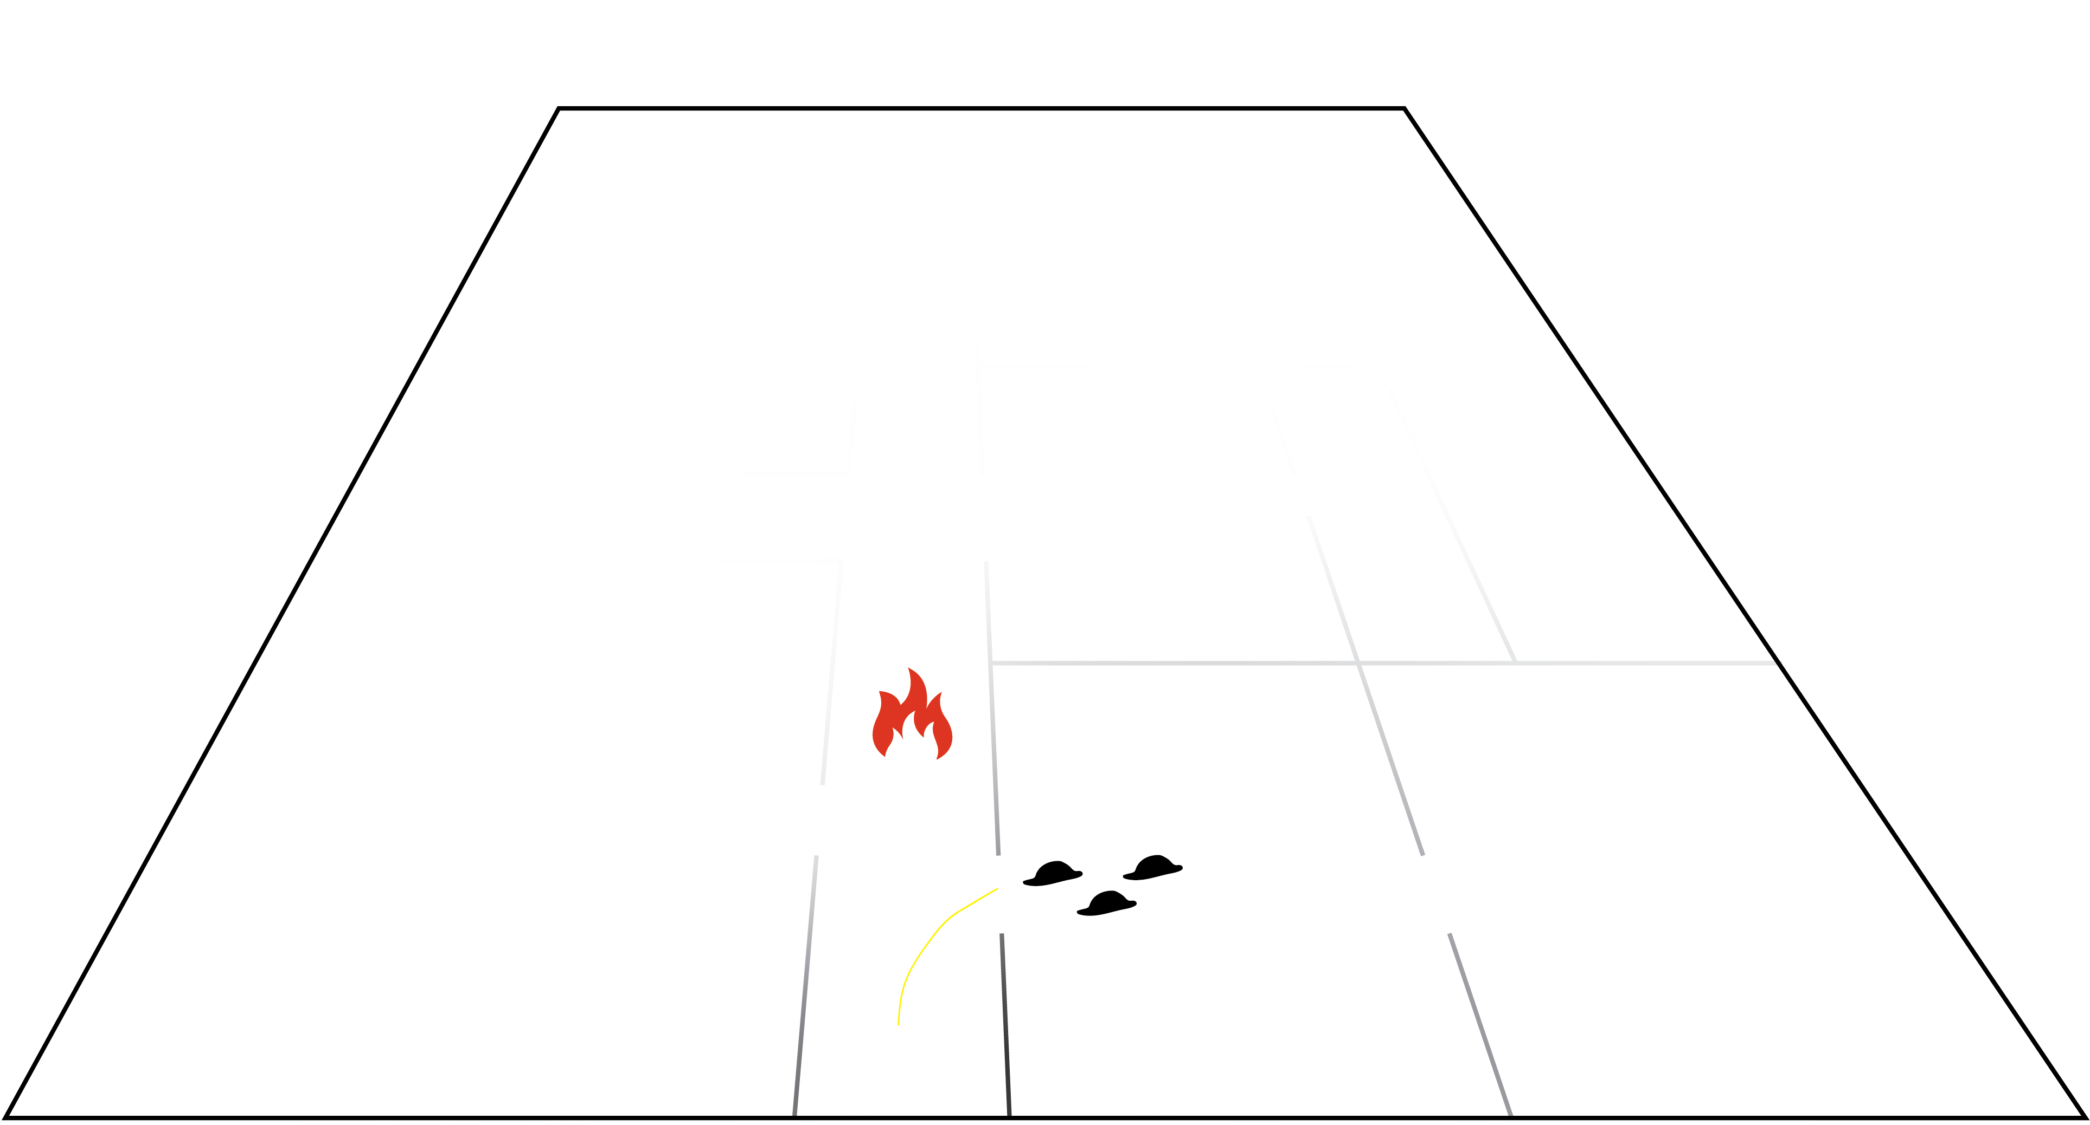
Dynamically generated floorplan
Fire marker added

Slide 82
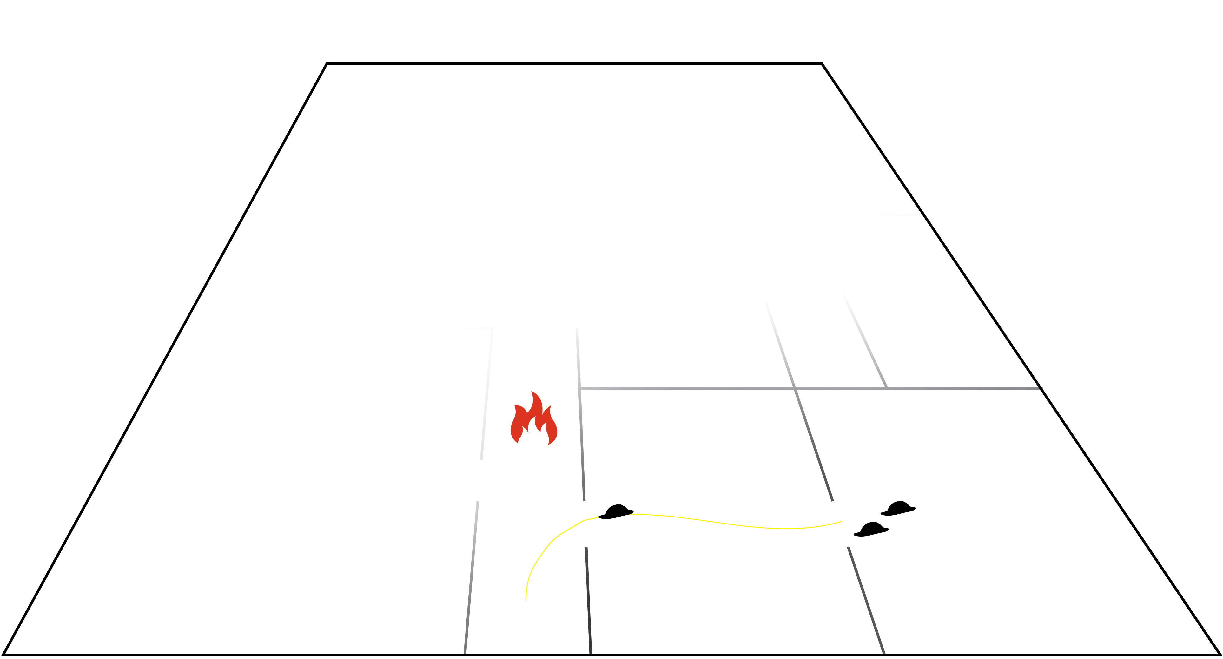
Dynamically generated floorplan

Slide 83
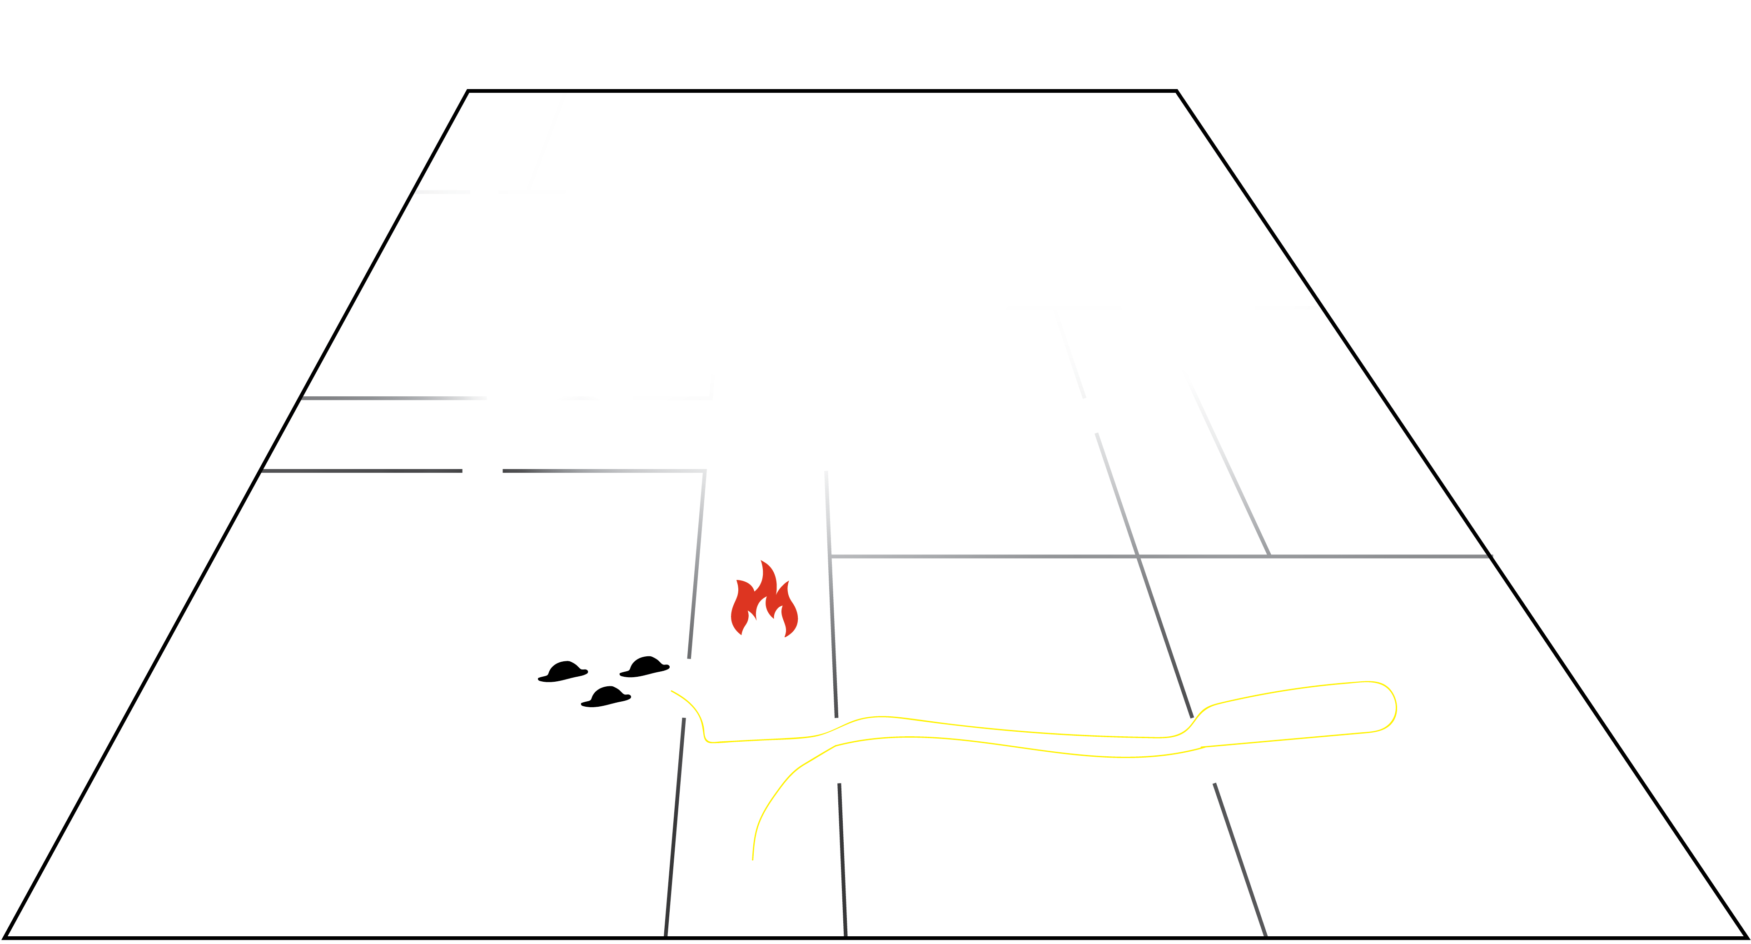
Dynamically generated floorplan

Slide 84
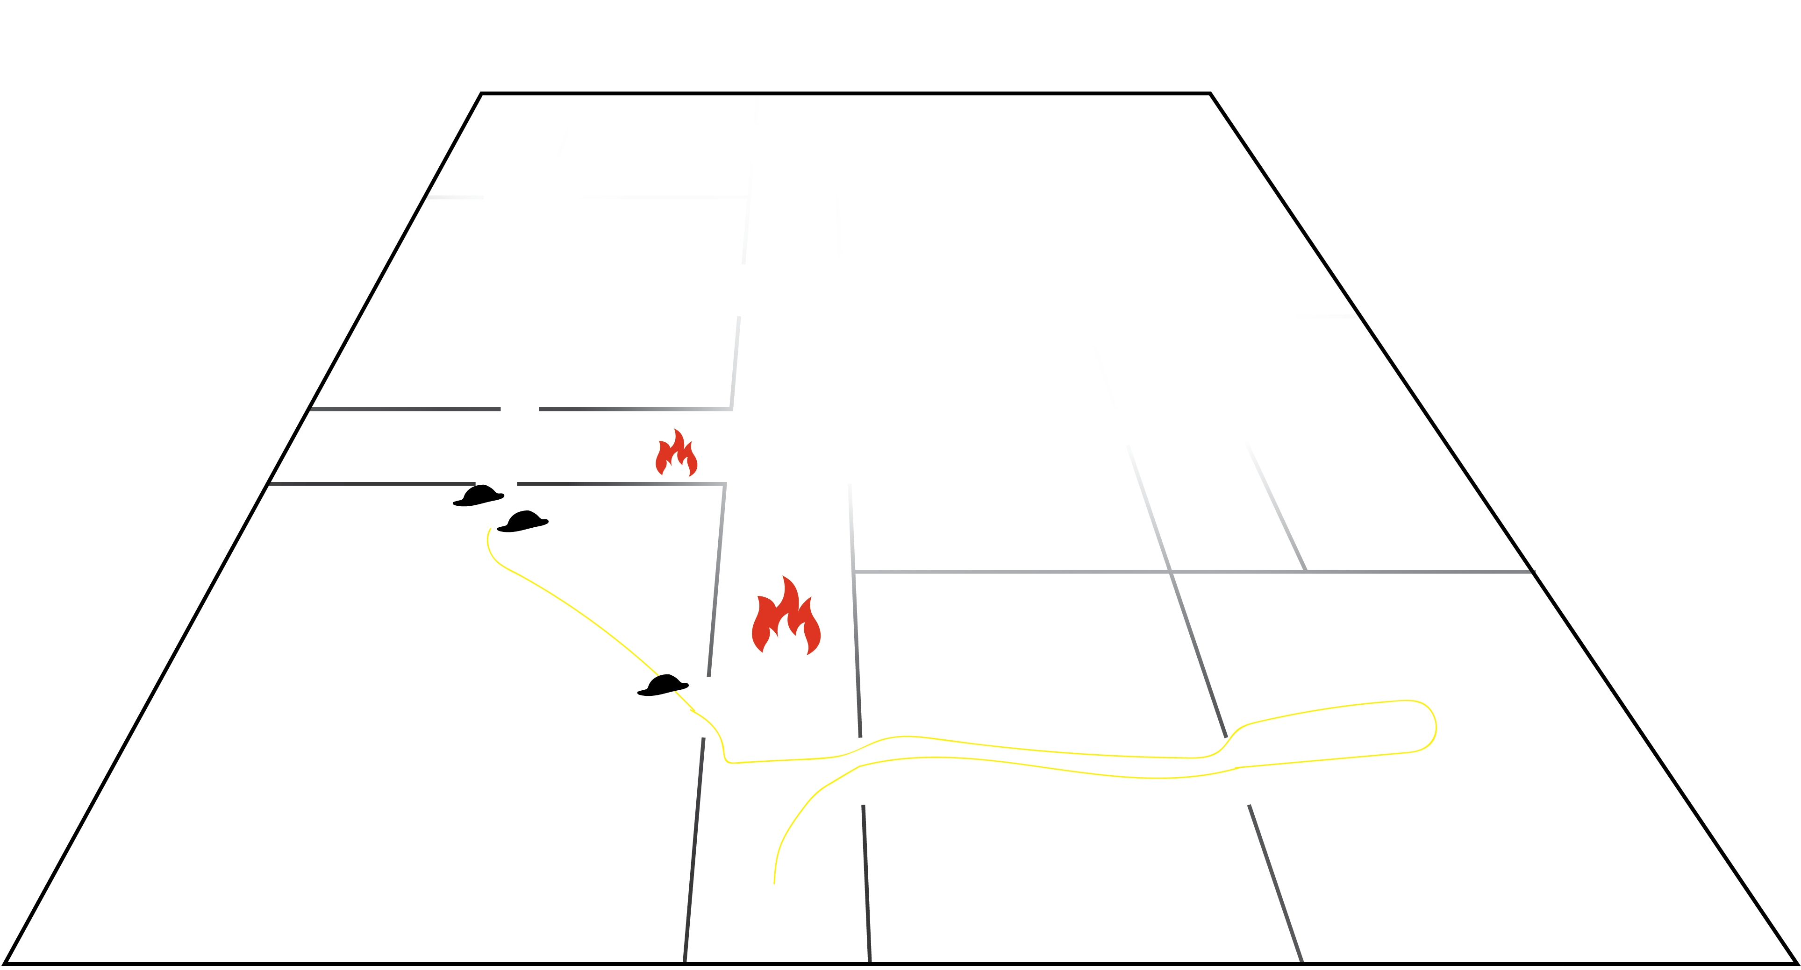
Dynamically generated floorplan
New fire marker added

Slide 85
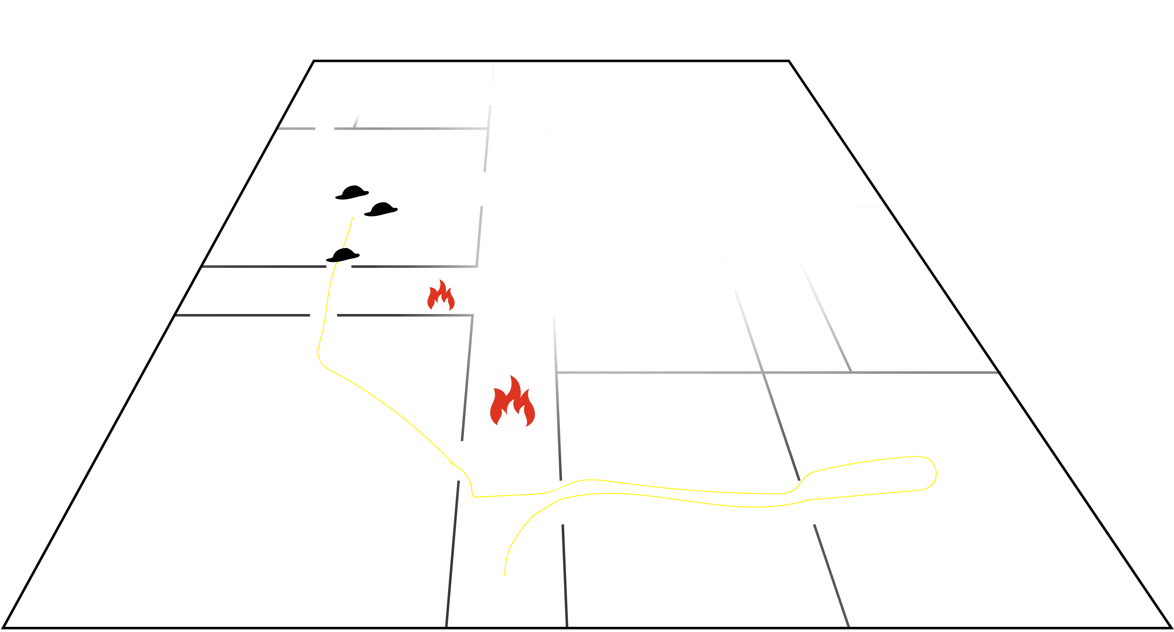
Dynamically generated floorplan

Slide 86
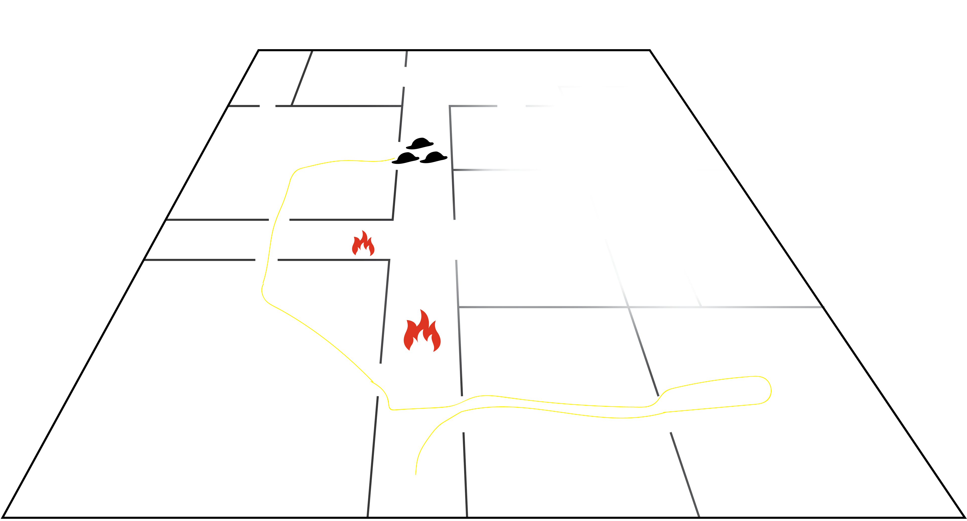
Dynamically generated floorplan

Slide 87
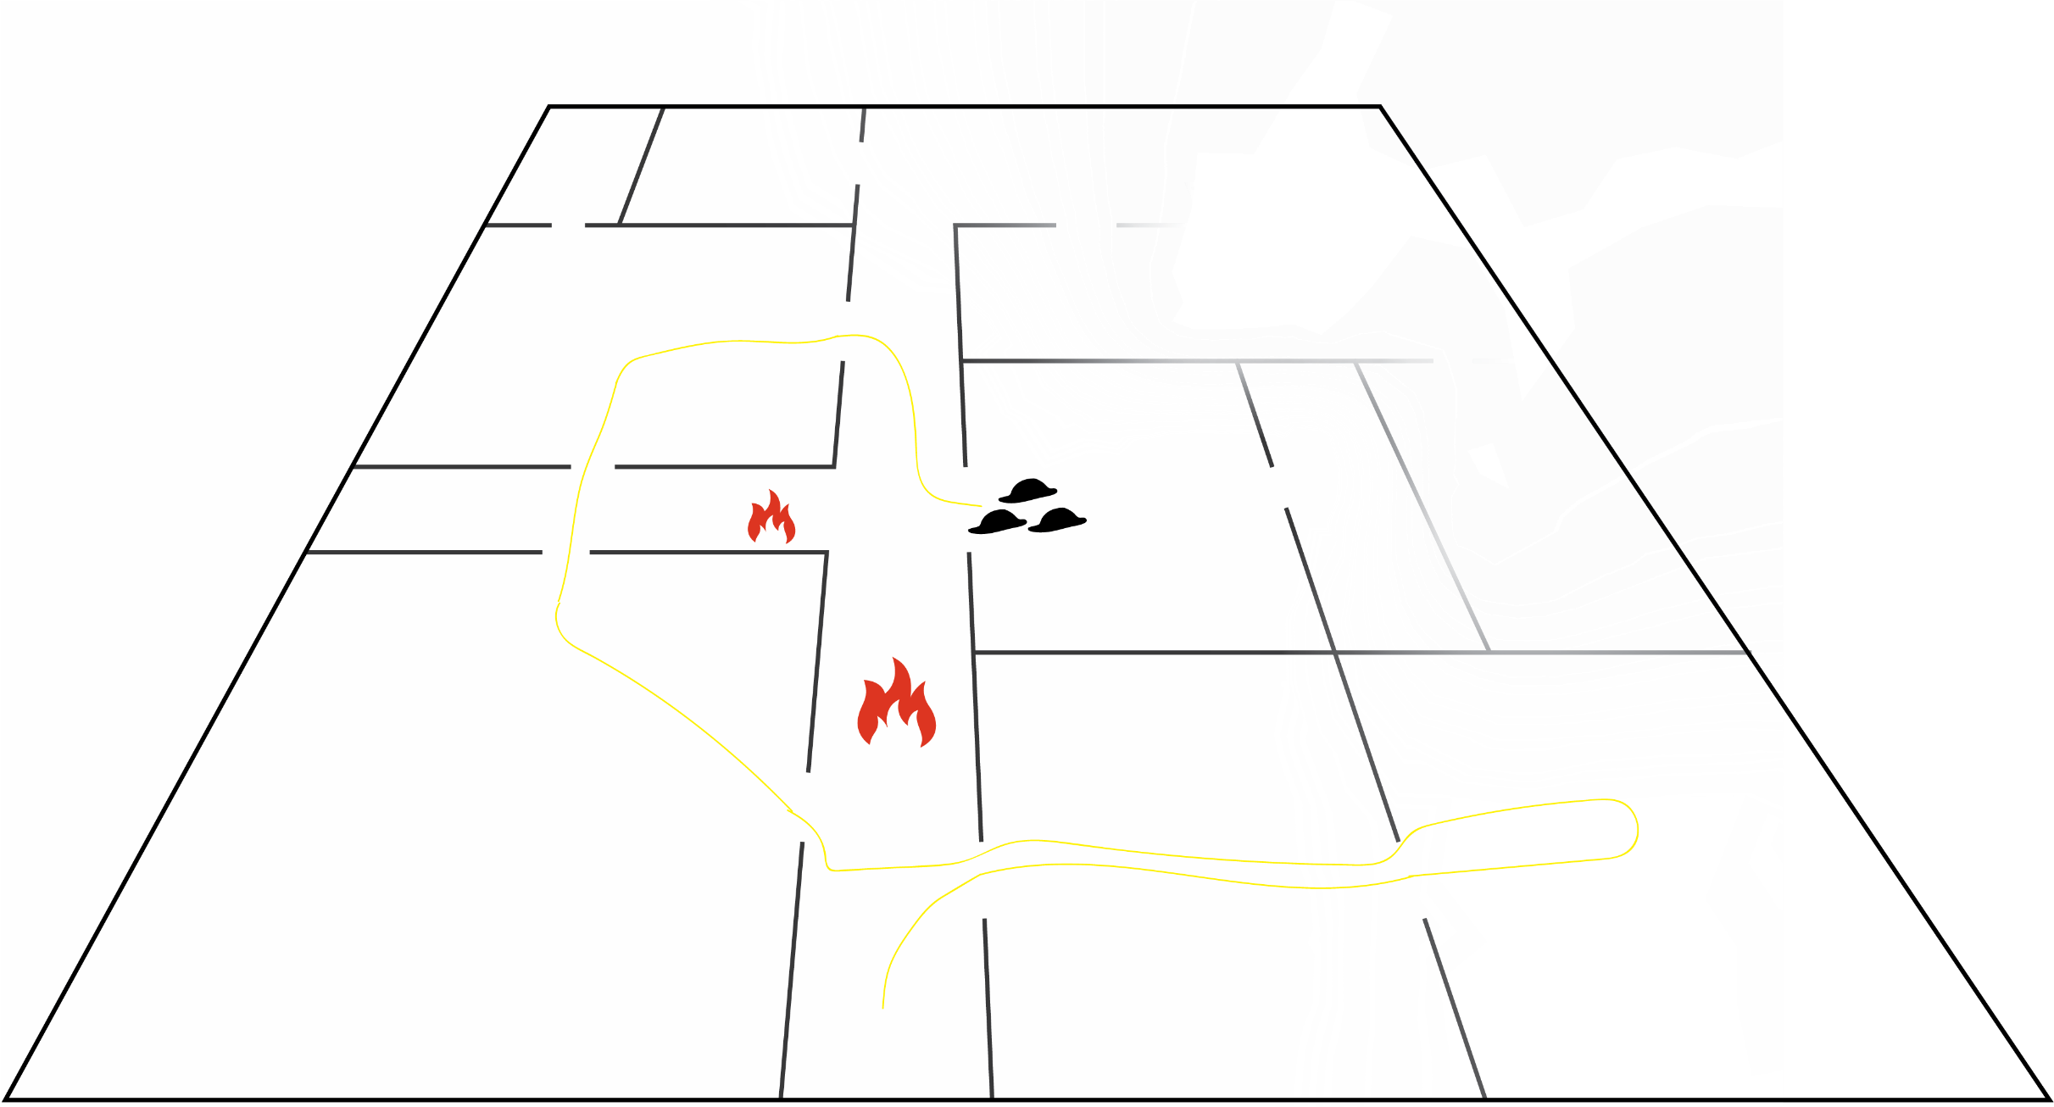
Dynamically generated floorplan

Slide 88

Dynamically generated floorplan

Slide 89

Dynamically generated floorplan

Slide 90

Dynamically generated floorplan
Victim found

Slide 91

Dynamically generated floorplan

Slide 92

Dynamically generated floorplan
The fire spreads
Blocking the way out

Slide 93

Dynamically generated floorplan
Central commander sends a new path

