Slide 1
Design, Prototyping and Evaluation of Next Generation Public Safety User Interfaces
Duke University
DiVE Virtual Reality Research Lab
Jerônimo G. Grandi, Ph.D.
Regis Kopper, Ph.D.
Mark Ogren

Slide 2
About us
Regis Kopper
Jeronimo G. Grandi
Mark Ogren
Project Principal Investigator
Director of the Duke immersive Virtual Environment (DiVE) Lab
Assistant Research Professor of Mechanical Engineering and Materials Science, and Computer Science
Postdoctoral Associate – DiVE Lab
Ph.D. in Computer Science
IT Analyst at Duke
User Services Specialist
Volunteer

Slide 3
Agenda
Goals
Project Phases
Methodology
Expected Results
Discussion and Q&A
Next steps

Slide 4
Goals
Design, prototype and evaluate user interfaces for the next generation public safety ecosystem and its first responders.
Notes:
User interfaces: How do we interact with other people, the environment, or a system through technology. Radio for communication with other folks. Computer to fill reports
Next generation: What kind of technology you guys is going to have and use in the future?
The idea of this project is to design, prototype and test this new interfaces. But how?

Slide 5
Goals
Design, prototype and evaluate user interfaces for the next generation public safety ecosystem and its first responders.
How?
Partner with PSOs in order to fully understand the needs and expectations of first responders
First responders contribute through their feedback and experience
Wake County EMS, Durham Fire Department and Hillsborough Police Department
Immersive virtual reality (VR) as a simulation platform to evaluate UI designs.
Through VR, we can achieve high levels of realism with computer simulation.
There are no risks to the user
Simulations can be repeated and tweaked as many times as necessary in a safe and effortless manner
Notes:
We are not developing a training simulaton. Our goal is to design and test new user interfaces, Of curse we will have a simulation environment, but it will be just for testing proposes, not for training.

Slide 6
The Project
The project addresses Goal 2 of the NIST Public Safety Innovation Accelerator Program – User Interface (PSIAP-UI): Research on the Effectiveness and Transferability of AR/VR Simulations.
The interfaces are envisioned with the capability of the FirstNet
Interoperable high-speed broadband LTE network
Handle critical situations that goes beyond a common voice communication channel
First responders will have the opportunity to:
Learn the precise location of indoor and outdoor points of interest
Receive real-time data analytics that are relevant to the mission
Have assurances for clear and reliable mission critical voice communications
Notes:
Our project is not dependent of FirstNet. We are envisioning design possibilities that will be possible with the advance of technology

Slide 7
Notes:
This is a video footage that won the NIST prize competition, the idea was to conceptualize "The Future of Public Safety Technology” National Institute of Standards and Technology
In this video they simulate a situation where all public safety organizations are involved and how the technology will help to mitigate the problems

Slide 8
Project Overview
Notes:
The project contains 4 phases. Each phase is incremental on each other. So we can advance toward the final goal
Here we present an overview of the phases.
The

Slide 9
Project Overview

Slide 10
Project Overview
Notes:
The project contains 4 phases. Each phase is incremental on each other. So we can advance toward the final goal
Here we present an overview of the phases.
The

Slide 11
Project Overview
Notes:
The project contains 4 phases. Each phase is incremental on each other. So we can advance toward the final goal
Here we present an overview of the phases.
The

Slide 12
Project Overview
Notes:
The project contains 4 phases. Each phase is incremental on each other. So we can advance toward the final goal
Here we present an overview of the phases.
The

Slide 13
Requirement Analysis (11/2018 – 05/2019)
Meetings, Interviews, and Training and Operation Observations
Collect feedback
Refine the design
Re-engaging with the PSOs
Design, prototype low-fidelity interfaces
1-1 Interviews
Design and prototype
Group Discussions
Training Observations
Shadow Operations
Notes:
The project contains 4 phases. Each phase is incremental on each other. So we can advance toward the final goal
Here we present an overview of the phases.
The

Slide 14
Expected Results
Early concepts of possible designs and low-fidelity interfaces
Documentation detailing the discoveries from the research
Public Safety User Interface Resource Library
Open-source repository with all technical material
Inform the community about the findings
IEEE VR 2019 – Osaka, Japan
Notes:
Sharing the knowledge with the scientific community
Curated website that will contain all findings from the project, with care to make it accessible to the general population and specifically to public safety stakeholders.

Slide 15
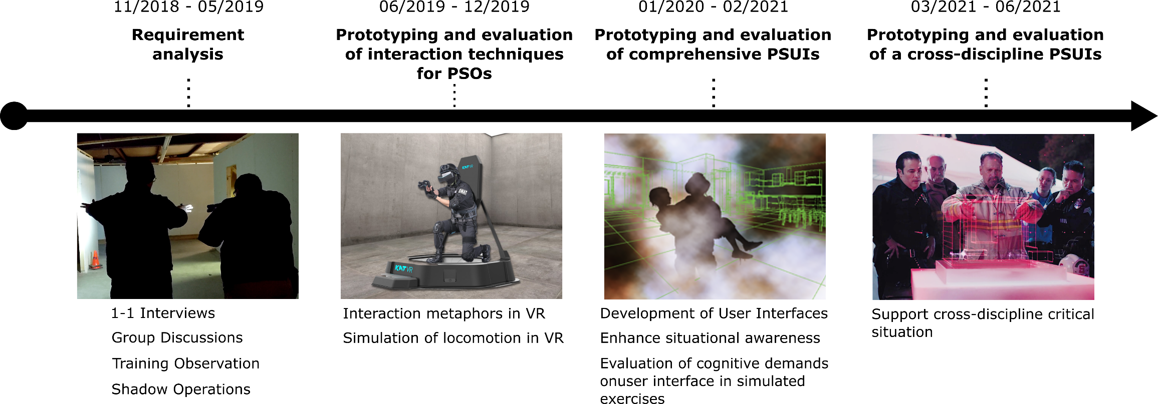
Discussion and Q&A

Slide 16
Next Steps
Schedule 1-1 interviews
Schedule Group meeting
Possibility to observe training sessions
Possibility to shadow operations

Slide 17
The Project
These technologies need to help the first responders’ to solve their real problem and not add another layer of complexity in their workflow.
The reality of public safety involves complex scenarios with many factors at play
User-centered approach that can make the deployment and adoption of next-generation user interfaces reflect the first responders’ needs, requirements, and contexts of use.
Notes:
These technologies we saw in the video
For these reasons, our intention with this project is to use a user-centered…

Slide 18
Methodology
Meetings, Interviews, and Training and Operation Observations
Collect feedback
Refine the design
Re-engaging with the PSOs
Design, prototype low-fidelity interfaces

Slide 19
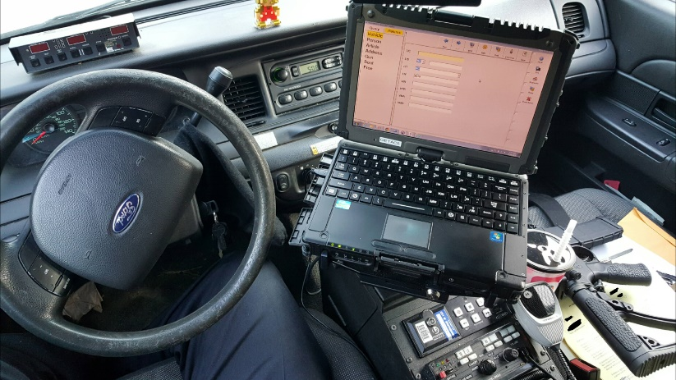
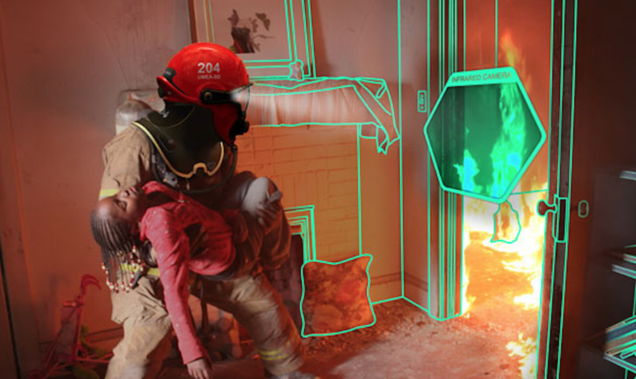
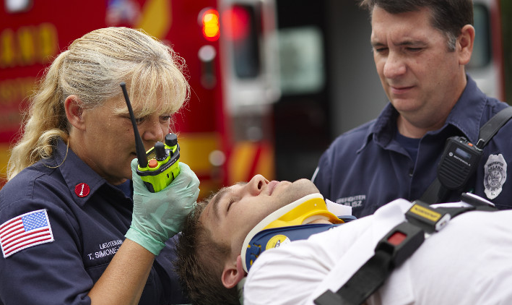
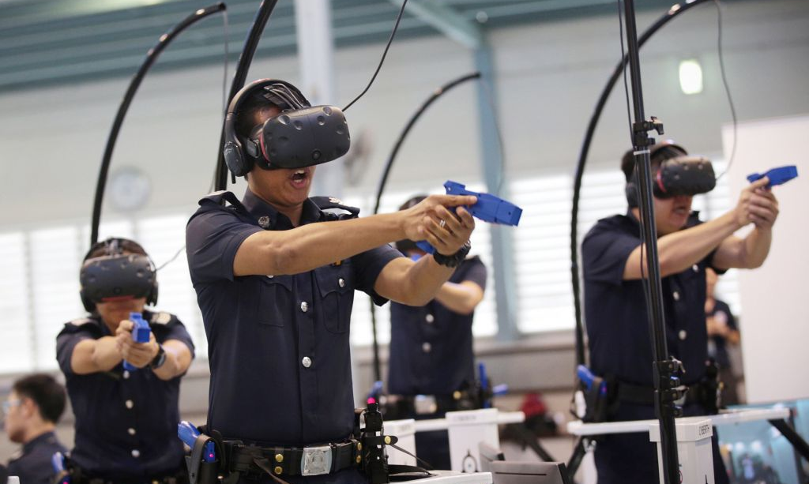
The Project
Conventional Interfaces
Next Generation Interfaces
Notes:
, through highly secure and resilient systems

Slide 20
Project Overview
Close observation and documentation of the culture at each of the PSOs
Meetings and Interviews, training observation, shadow operations
Notes:
The project is in its beginning.. Right now we are in the first phase that is the requirement analysis.
In this phase, we

Slide 21
Project Overview
Travel and selection tasks in VEs in the context of identified critical elements for each public safety disciplines
The main goal of this phase is to establish what techniques are preferable to use
Notes:
After understanding the critical tasks for each public safety discipline, we will implement UIs that aim specifically at addressing the identified demands.

Slide 22
Project Overview
Combine most effective interaction techniques with cognitive aids for enhanced situational awareness and wayfinding
Notes:
we will use the findings from phase 2 as input in the design of comprehensive UIs for fire safety, EMS and law enforcement.

Slide 23
Project Overview
The goal of this phase is to design a VE for a critical situation that needs a response from fire, EMS and law enforcement

