Slide 1
Design, Prototyping and Evaluation of Next Generation Public Safety User Interfaces
Duke University
DiVE Virtual Reality Research Lab
Jerônimo G. Grandi, Ph.D.
Regis Kopper, Ph.D.
Notes:
Hi

Slide 2
About us
Regis Kopper
Jerônimo G. Grandi
Project PI
Assistant Research Professor of Mechanical Engineering and Materials Science, and Computer Science
Director of the Duke immersive Virtual Environment (DiVE),
Postdoctoral Associate – DiVE Lab
Ph.D. in Computer Science

Slide 3
Agenda
Project Motivation
Background on User Interfaces
Goals
Approach
Project Overview
Focus on the Requirement Analysis
Notes:
This what we are going to talk about in this presentation.
First, we give the motivation to execute this project
Followed by the project goals
Next, we present some background on user interfaces
And the goals
With an overview of the role project
And finally, we focus on the requirement analysis that is the first phase of the project

Slide 4
Project Motivation
FirstNet: new era of crisis management
Enable interoperable single high-speed broadband LTE network
Handle critical situations that goes beyond a common voice communication channel
Notes:
With the introduction of the firtnet. An interoperable single high-speed broadband LTE network
It will be possible to handle situations that goes beyond the common voice communication channel

Slide 5
Project Motivation
FirstNet: new era of crisis management
Enable interoperable single high-speed broadband LTE network
Handle critical situations that goes beyond a common voice communication channel
First responders will have the opportunity to:
Learn the precise location of indoor and outdoor points of interest
Receive real-time data analytics that are relevant to the mission
Have assurances for clear and reliable mission critical voice communications
Notes:
, through highly secure and resilient systems

Slide 6
Project Motivation
FirstNet: new era of crisis management
Enable interoperable single high-speed broadband LTE network
Handle critical situations that goes beyond a common voice communication channel
First responders will have the opportunity to:
Learn the precise location of indoor and outdoor points of interest
Receive real-time data analytics that are relevant to the mission
Have assurances for clear and reliable mission critical voice communications
Improve mission success
Notes:
, through highly secure and resilient systems

Slide 7
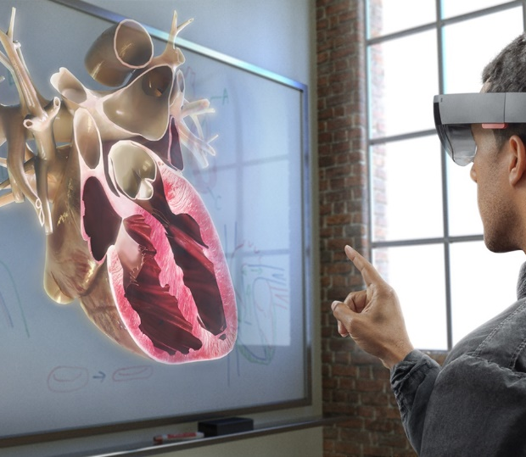
Background on User Interfaces – Visualization Interfaces
VR HMDs
CAVEs
Head-mounted See-through
Mobile AR
HTC Vive
DiVE Cave
Microsoft Hololens
Google ARCore
Notes:
Explicar o que são as interfaces e como elas podem ajudar os PSOs

Slide 8
Leap Motion Project North Star

Slide 9
Microsoft Hololens

Slide 10
Goals
Design, prototype and evaluate user interfaces for the next generation public safety ecosystem and its first responders.

Slide 11
Project Overview
Prototyping and evaluation of interaction techniques
Prototyping and evaluation of public safety user interfaces
Prototyping and initial evaluation of a cross-discipline public safety user interface
Requirement analysis
11/2018 – 05/2019
06/2019 – 12/2019
01/2020 – 02/2021
03/2021 – 06/2021
1
2
3
4
Notes:
Project overview

Slide 12
Project Overview
Prototyping and evaluation of interaction techniques
Prototyping and evaluation of public safety user interfaces
Prototyping and initial evaluation of a cross-discipline public safety user interface
Requirement analysis
11/2018 – 05/2019
06/2019 – 12/2019
01/2020 – 02/2021
03/2021 – 06/2021
1
2
3
4
Notes:
Project overview

Slide 13
Project Overview
Prototyping and evaluation of interaction techniques
Prototyping and evaluation of public safety user interfaces
Prototyping and initial evaluation of a cross-discipline public safety user interface
Requirement analysis
11/2018 – 05/2019
06/2019 – 12/2019
01/2020 – 02/2021
03/2021 – 06/2021
1
2
3
4
Notes:
Project overview

Slide 14
Project Overview
Prototyping and evaluation of interaction techniques
Prototyping and evaluation of public safety user interfaces
Prototyping and initial evaluation of a cross-discipline public safety user interface
Requirement analysis
11/2018 – 05/2019
06/2019 – 12/2019
01/2020 – 02/2021
03/2021 – 06/2021
1
2
3
4
Notes:
Project overview

Slide 15
Project Overview
Prototyping and evaluation of interaction techniques
Prototyping and evaluation of public safety user interfaces
Prototyping and initial evaluation of a cross-discipline public safety user interface
Requirement analysis
11/2018 – 05/2019
06/2019 – 12/2019
01/2020 – 02/2021
03/2021 – 06/2021
1
2
3
4
Transformative impact on the adoption of next generation technology for all public safety disciplines
Notes:
The project will have a transformative impact on the adoption of next generation technology for all public safety disciplines by offering a collection of user interfaces

Slide 16
Requirement Analysis
1
Fully understand the Public Safety Organizations (PSOs) processes
Needs, expectations and culture
Identification of problems that are deemed as important both by the researchers and the members of the target environment.
Establish the gaps and opportunities for novel user interfaces designs
Notes:
Focus on the first part… more details here.

Slide 17
Approach
Collaborate with Wake County Emergency Medical Services
And also with:
Hillsborough Police Department
Durham Fire Department
To fully understand the needs and expectations of first responders in all disciplines
Notes:
In order to fully understand the needs and expectations of first responders in all disciplines
Requirement analysis: officers, supervisors and non-sworn personnel will be available to researchers for interviews so that the current processes are fully understood, particularly on opportunities for benefit from new technology. In situations where there is minimal risk, such as routine calls for service, traffic stops and community interactions, the 127 N Churton ▪ Hillsborough, NC 27278 ▪ Tel (919) 296-9500 ▪ Fax (919) 732-2187 researchers will be able to observe officer responses in the field. We will also allow researchers to observe training exercises. - Prototyping: Hillsborough Police members will give formative feedback on the design of early prototypes. - Evaluation: officers and supervisors will volunteer as experiment participants in the evaluation phases of the prototyped user interfaces developed during the course of this project. Personnel will be available to travel to Duke University to participate in such experiments, and we will also offer a space for the installation of a virtual reality system at Hillsborough PD headquarters.

Slide 18
Requirement Analysis - Procedure
Close observation and documentation of EMS Culture
Meetings and Interviews
Observe training exercises
Shadow operations
Accompany response calls, rescue, when possible
Notes:
Requirement analysis: officers, supervisors and non-sworn personnel will be available to researchers for interviews so that the current processes are fully understood, particularly on opportunities for benefit from new technology. In situations where there is minimal risk, such as routine calls for service, traffic stops and community interactions, the researchers will be able to observe officer responses in the field. We will also allow researchers to observe training exercises. - Prototyping: Hillsborough Police members will give formative feedback on the design of early prototypes. - Evaluation: officers and supervisors will volunteer as experiment participants in the evaluation phases of the prototyped user interfaces developed during the course of this project. Personnel will be available to travel to Duke University to participate in such experiments, and we will also offer a space for the installation of a virtual reality system at Hillsborough PD headquarters.
firefighters , administrative chiefs, and administrative personnel, will be available for interviews, and we will allow the researchers to observe training exercises as well as to accompany response calls whenever possible to fire, rescue, EMS, and hazardous materials

Slide 19
Requirement Analysis - Procedure
Iterative design of interfaces
Design of early, low-fidelity prototypes
Collect feedback
Refine the design
Re-engaging with the PSOs
Notes:
Requirement analysis: officers, supervisors and non-sworn personnel will be available to researchers for interviews so that the current processes are fully understood, particularly on opportunities for benefit from new technology. In situations where there is minimal risk, such as routine calls for service, traffic stops and community interactions, the researchers will be able to observe officer responses in the field. We will also allow researchers to observe training exercises. - Prototyping: Hillsborough Police members will give formative feedback on the design of early prototypes. - Evaluation: officers and supervisors will volunteer as experiment participants in the evaluation phases of the prototyped user interfaces developed during the course of this project. Personnel will be available to travel to Duke University to participate in such experiments, and we will also offer a space for the installation of a virtual reality system at Hillsborough PD headquarters.

Slide 20
Requirement Analysis - Outcome
Documentation detailing the discoveries from the research
Public Safety User Interface Resource Library
Inform the community about the potential of virtual reality to improve first responder communication and operations
Notes:
Focus on the first part… more details here.

